Slide 1
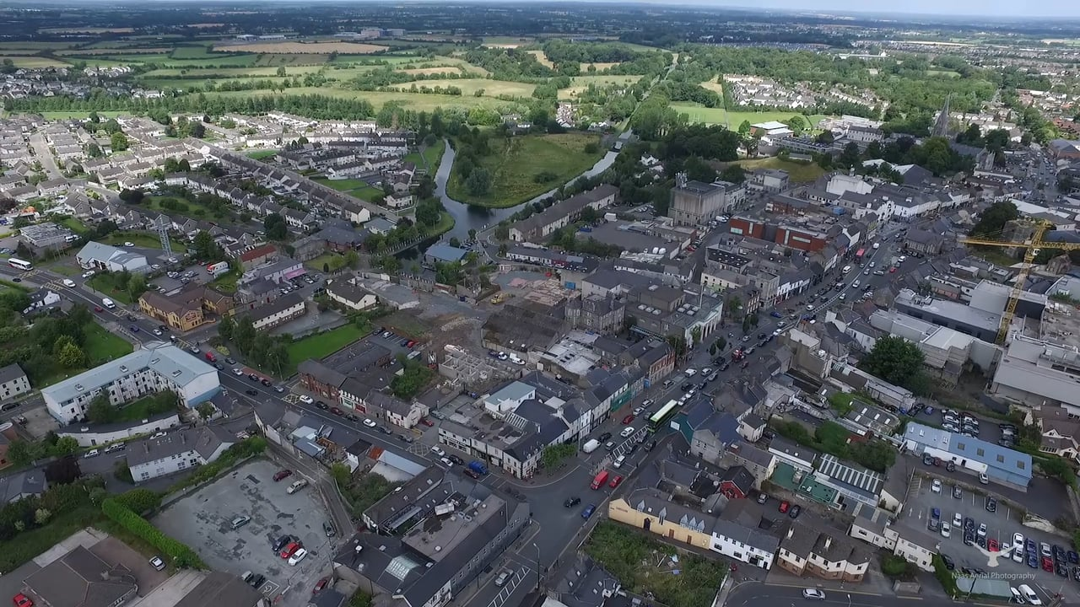
Naas Local Area Plan
2018-2024

Slide 2
Overall context

Slide 3
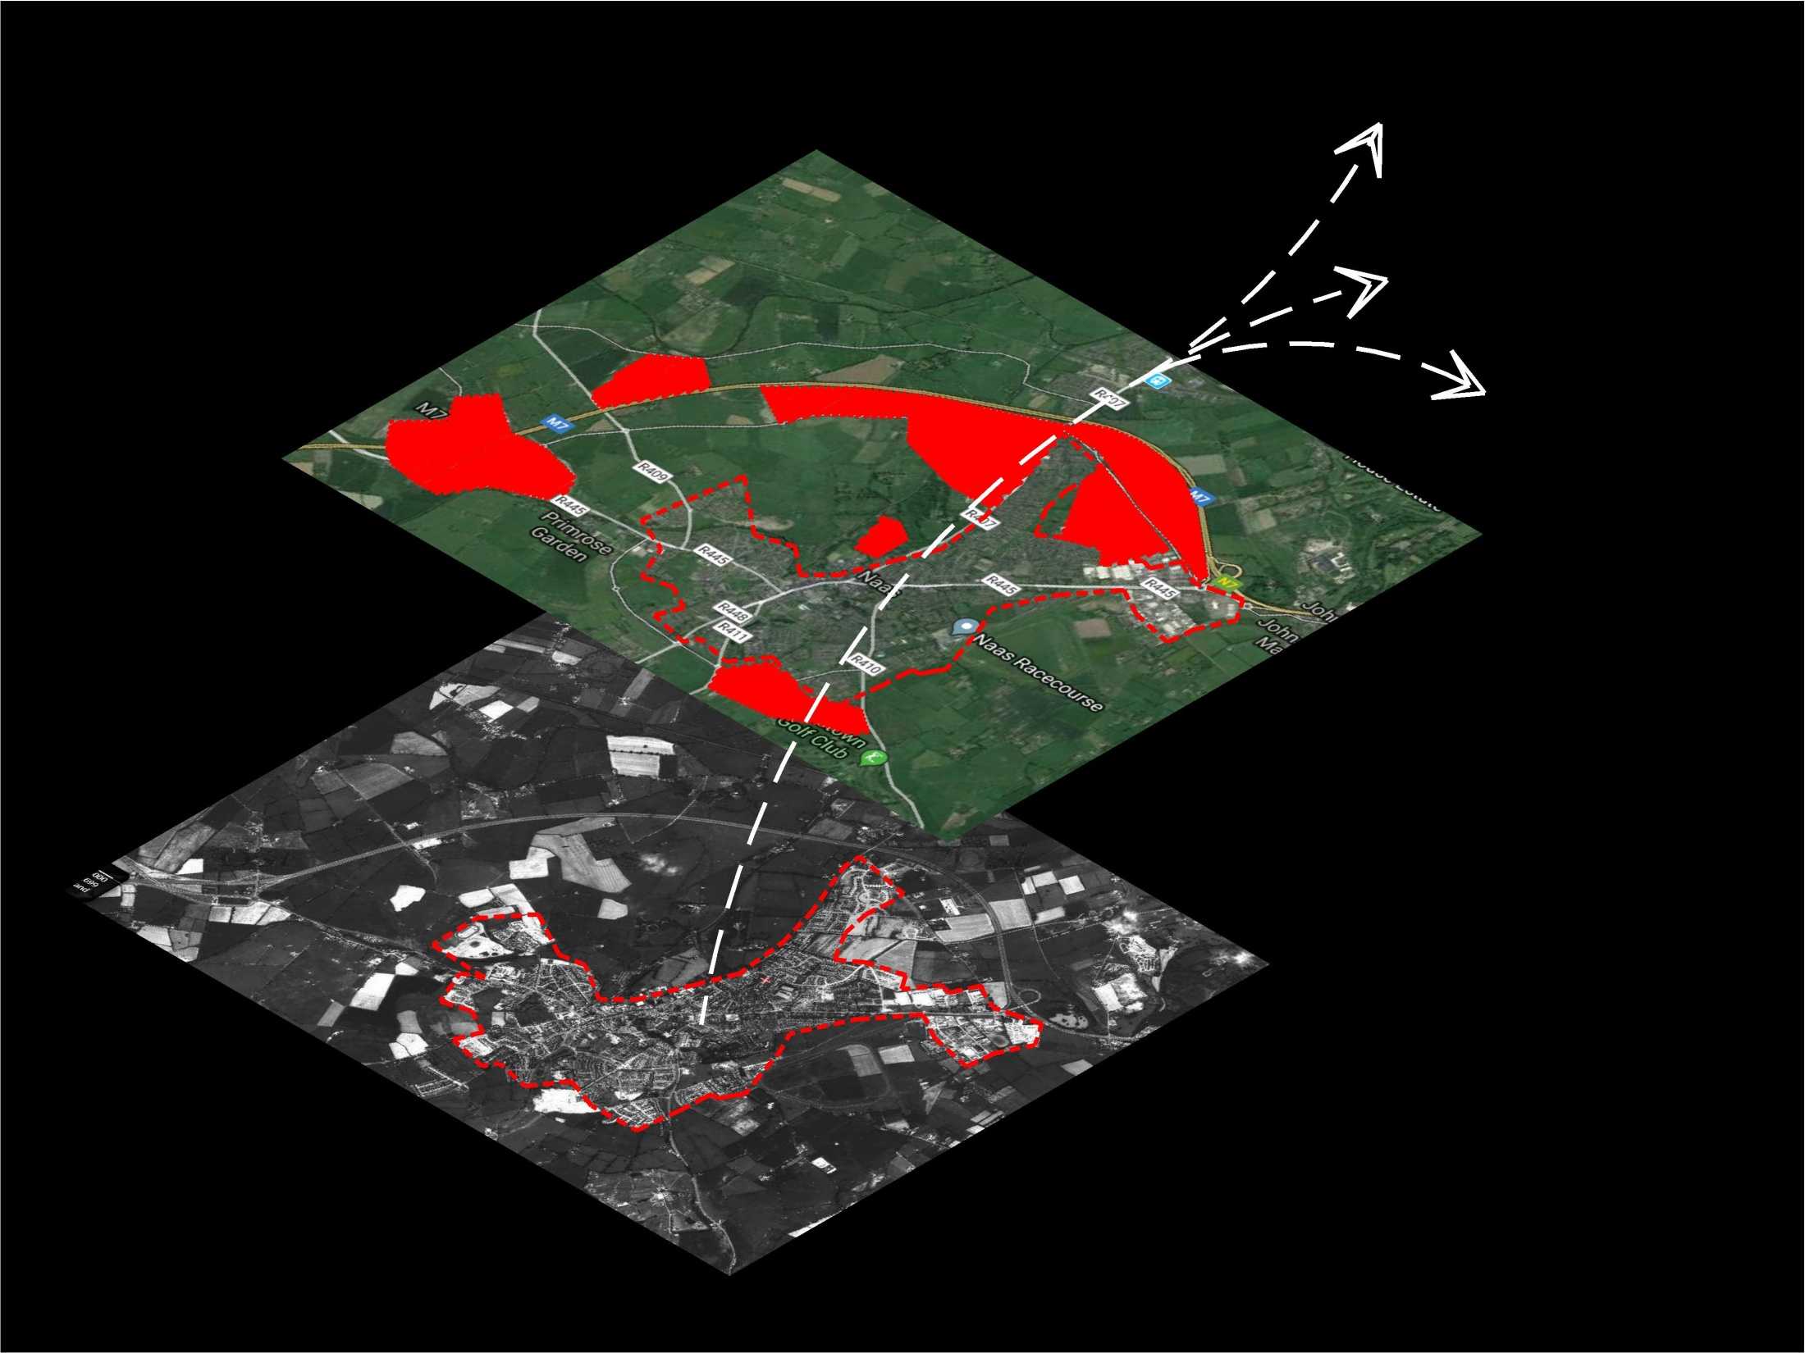
2040
population
?????
2018 pop.
approx. 21493
1990 pop.
approx. 10,000

Slide 4
Navan
Dundalk
Drogheda
Mullingar
Tullamore
Portlaoise
Kilkenny
Westport
Wexford
Naas 2040
What kind of town?
economically
socially
environmentally
physically
Notes:
Vision for Naas -What is our value system as a county town? / Most cities trying to balance Liveability and Livelihood / What is our identity and how can we develop?/ What might the shape of success look like if its driven by values (vision)

Slide 5
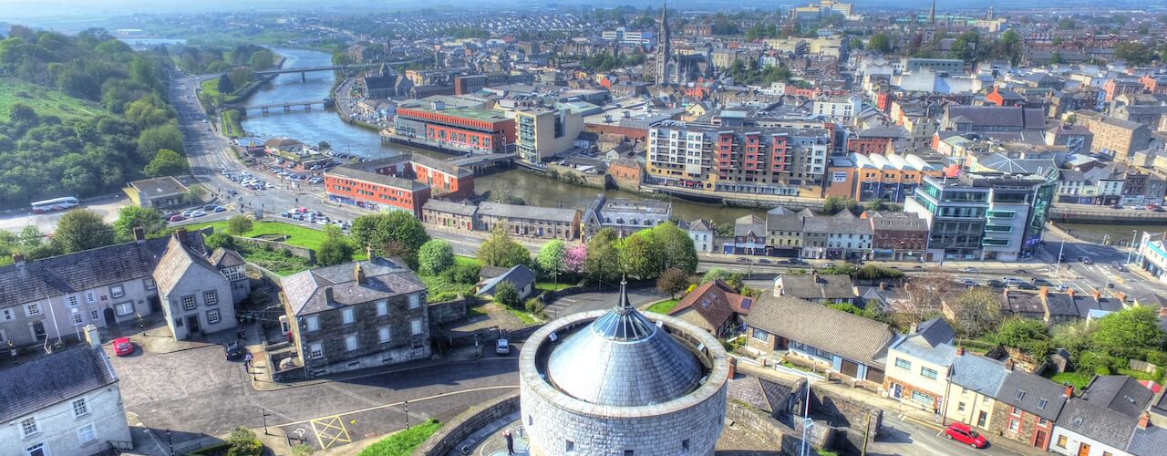
Identity / Role & Value System
Integrated Themes
Long term thinking
Legible town jigsaw
Good governance
Infrastructure
Notes:
Successful cities and towns tend to perform well across multiple sectors (and therefore balance Livelihood and Liveability): Economic; Housing; Environmental; Cultural

Slide 6
Overall context:
LAP – legal / statutory
Regional – powerful plans - towns
National Planning Framework
How can we make this LAP really work for Naas?

Slide 7
Climate change
Technology/data
Automation
Ageing population
Citizen capacity

Slide 8
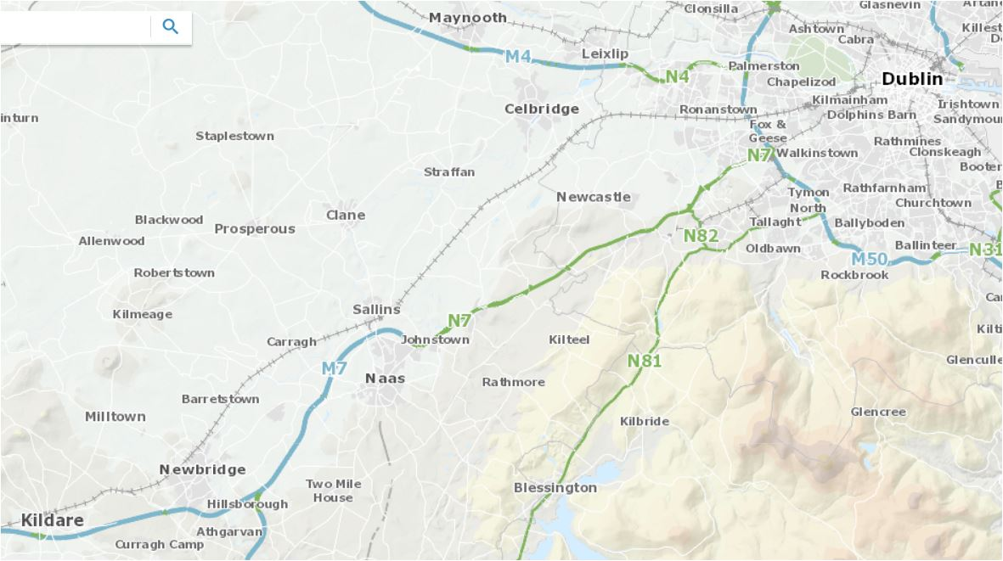
Strategic location
Exciting Hinterland
Motorway & rail
Canal
Spine of main street

Slide 9
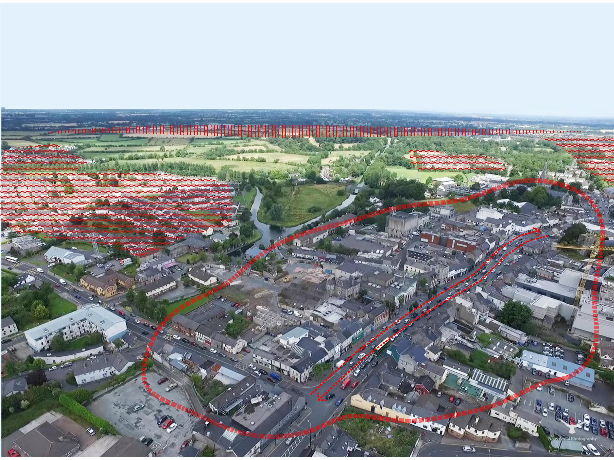
Role as county town?
Leadership
Assets/Platforms
Infrastructure
Projects
Attitude
Strong economic periphery
Housing estate town
Underperforming town centre
Fragmented urban structure
Vehicle dominated Movement

Slide 10
Key Sectors (High level themes)

Slide 11
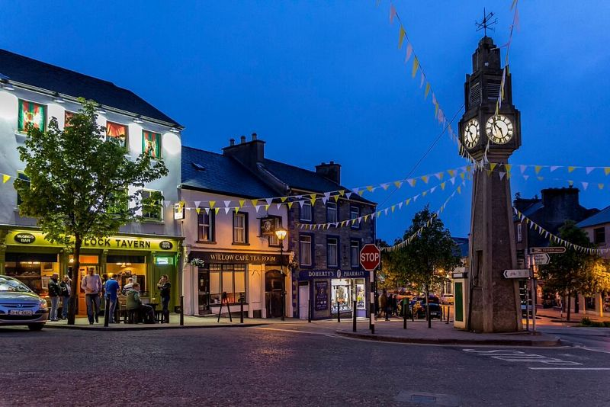
Balance Livelihood & Liveability

Slide 12
AchievementsIssues & challenges;
& the way forward
value system;
the shape
of success; blockages / disconnects

Slide 13
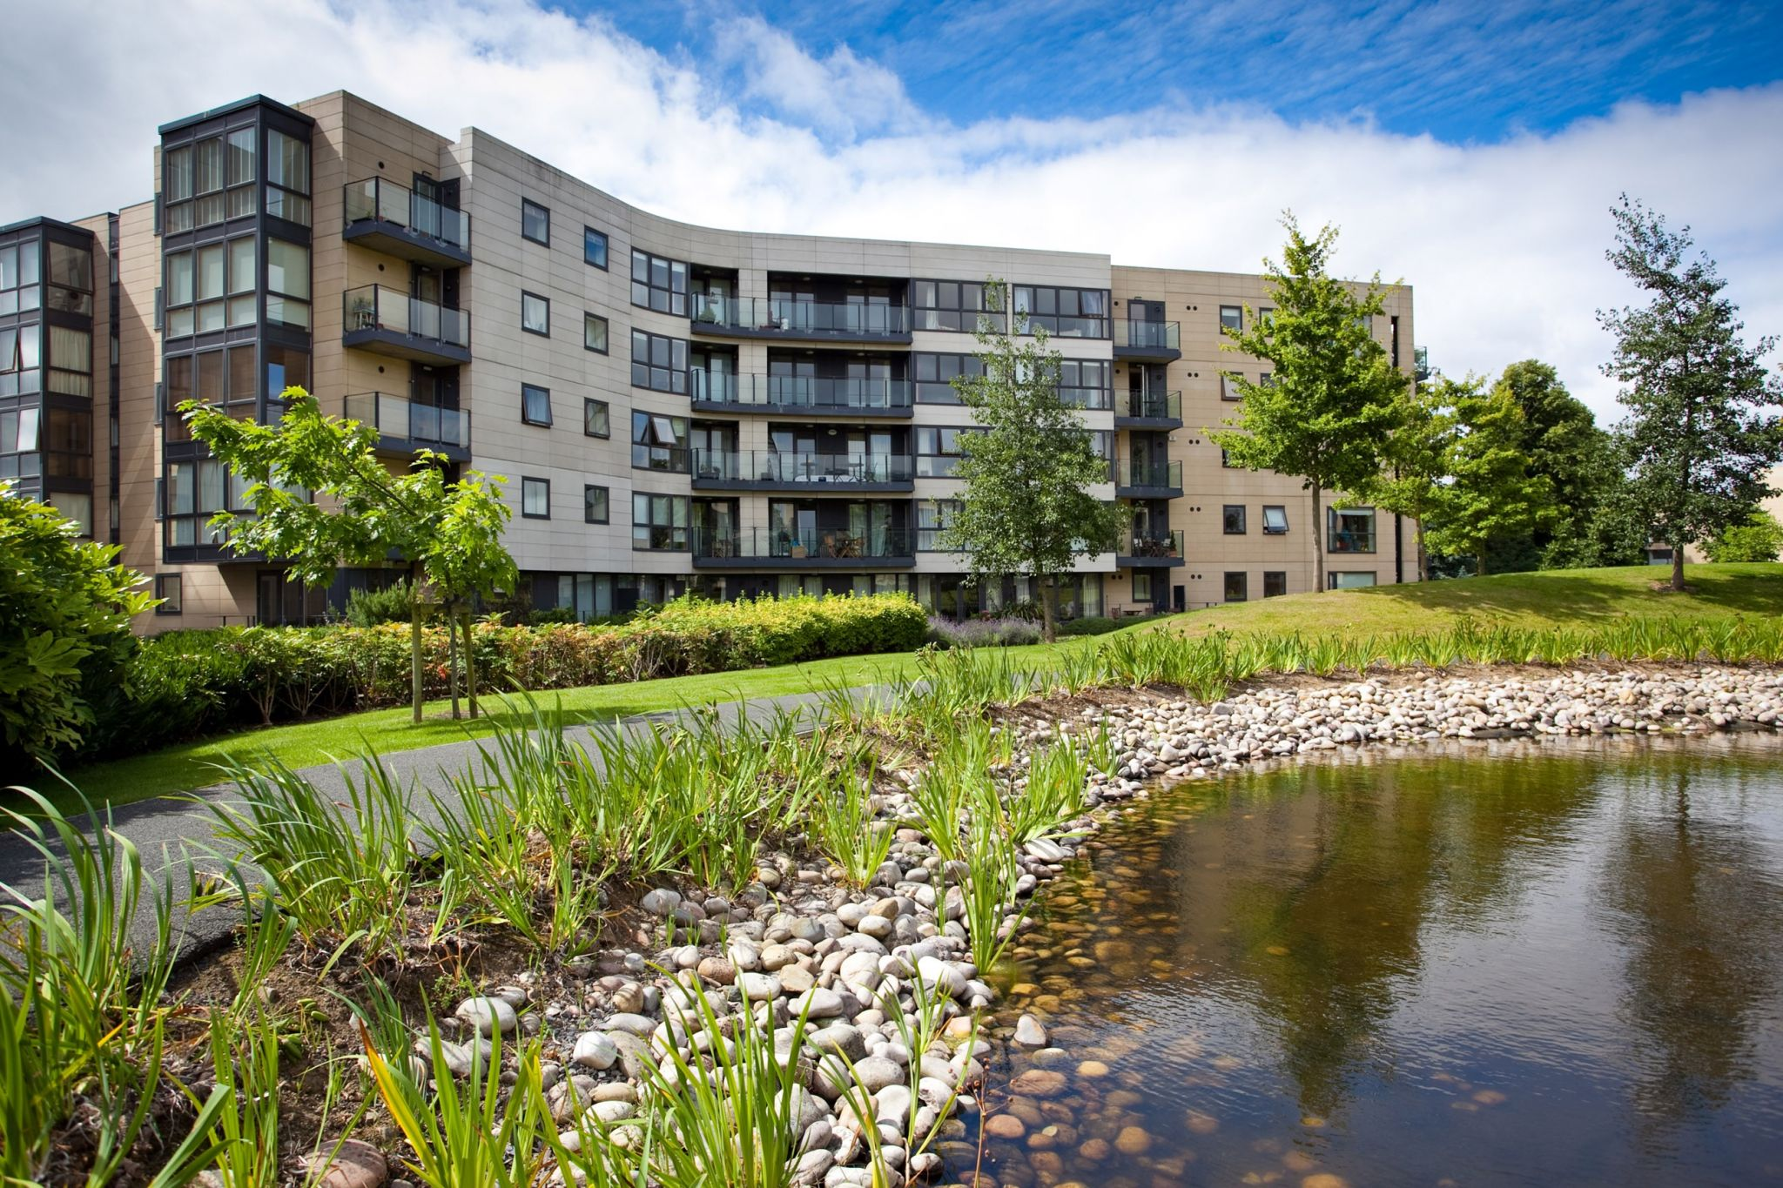
Housing /
residential
Sustainable density
Mixed-tenure
Diversity of typologies (incl. apartments)
Liveable neighbourhoods
Supported by social infrastructure
Notes:
Successful cities and towns tend to perform well across multiple sectors (and therefore balance Livelihood and Liveability): Economic; Housing; Environmental; Cultural

Slide 14
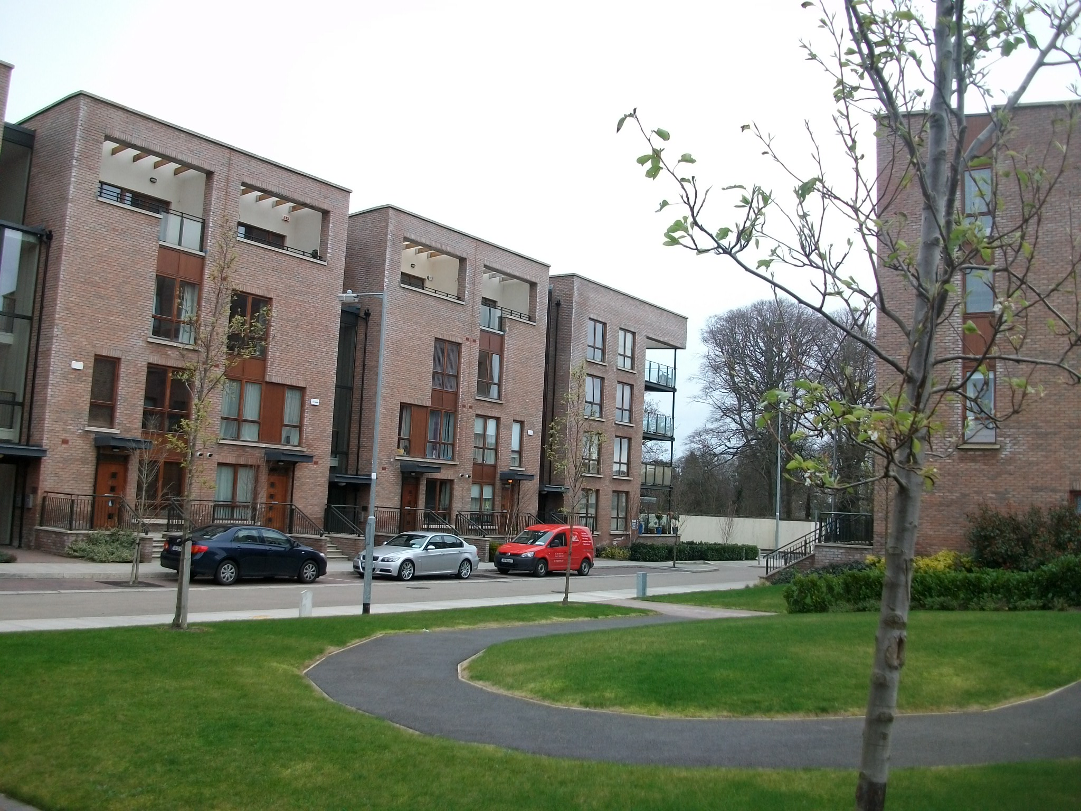
TrinityHaus
www.trinityhaus.tcd.ie

Slide 15
Environmental sustainability
Climate Change
Realignment in Naas:
Green infrastructure
Low carbon society &economy
Density & sustainable construction
Behaviour change
Notes:
Successful cities and towns tend to perform well across multiple sectors (and therefore balance Livelihood and Liveability): Economic; Housing; Environmental; Cultural

Slide 16
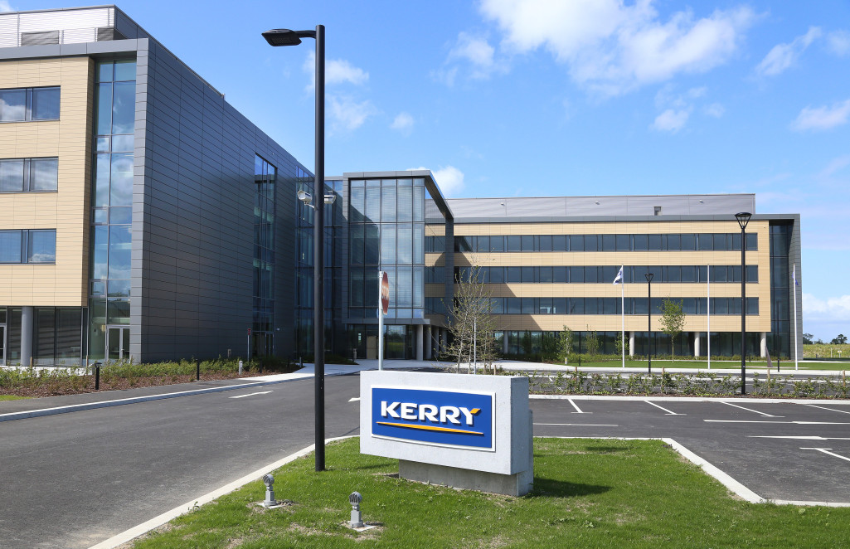
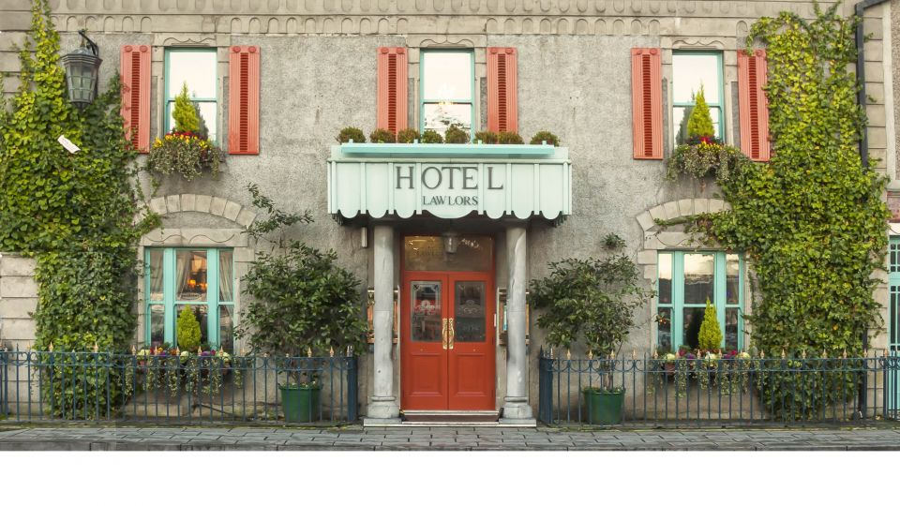
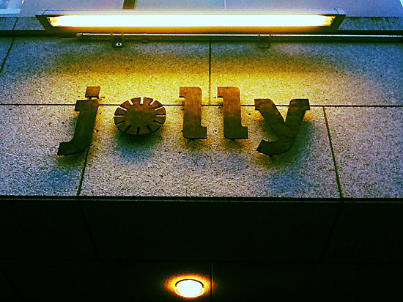
Naas economy
12,000 jobs
Spatial character: periphery and bleaching of town centre economically
Character of peripheral model
Notes:
Successful cities and towns tend to perform well across multiple sectors (and therefore balance Livelihood and Liveability): Economic; Housing; Environmental; Cultural

Slide 17
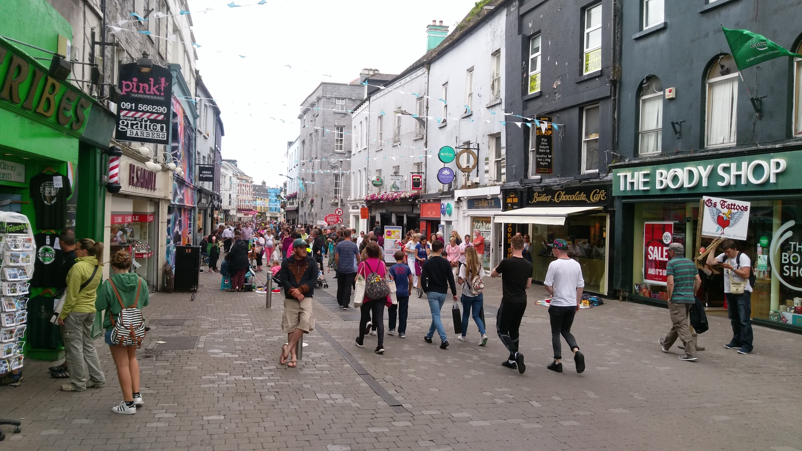
Notes:
Successful cities and towns tend to perform well across multiple sectors (and therefore balance Livelihood and Liveability): Economic; Housing; Environmental; Cultural

Slide 18
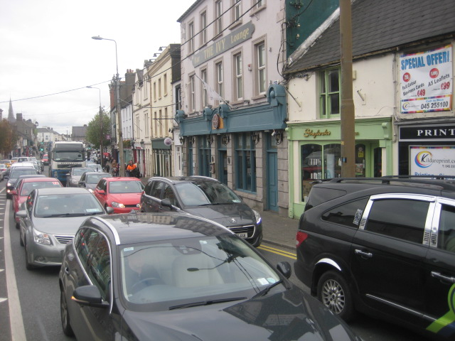
Movement
Commuter split
What is ratio now?
What would it be like in 2040?
Why is Naas so congested?
Environmental / health consequences
Why do we walk / cycle so little
Notes:
Successful cities and towns tend to perform well across multiple sectors (and therefore balance Livelihood and Liveability): Economic; Housing; Environmental; Cultural

Slide 19
Notes:
Successful cities and towns tend to perform well across multiple sectors (and therefore balance Livelihood and Liveability): Economic; Housing; Environmental; Cultural

Slide 20
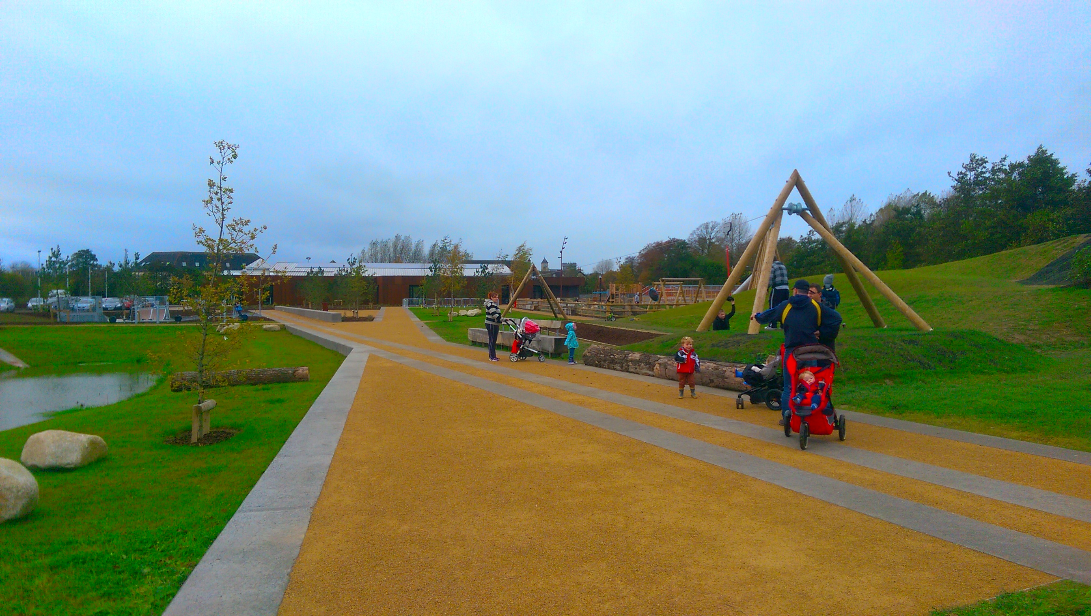
Social & Community
Formal institutional with informal contribution of NGOs / Volunteers
Is Naas a good town for:
Older people?
Children, teenagers, and young adults?
People with disabilities?
People of different cultures?
Notes:
Successful cities and towns tend to perform well across multiple sectors (and therefore balance Livelihood and Liveability): Economic; Housing; Environmental; Cultural

Slide 21
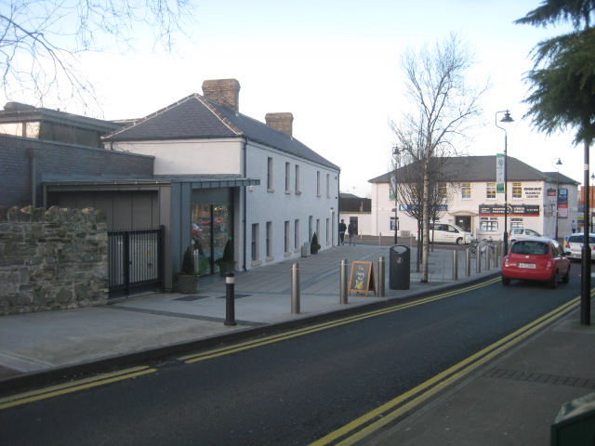
Creative use of older infrastructure
Local authority leadership
Reinventing an urban heart
Notes:
Successful cities and towns tend to perform well across multiple sectors (and therefore balance Livelihood and Liveability): Economic; Housing; Environmental; Cultural

Slide 22
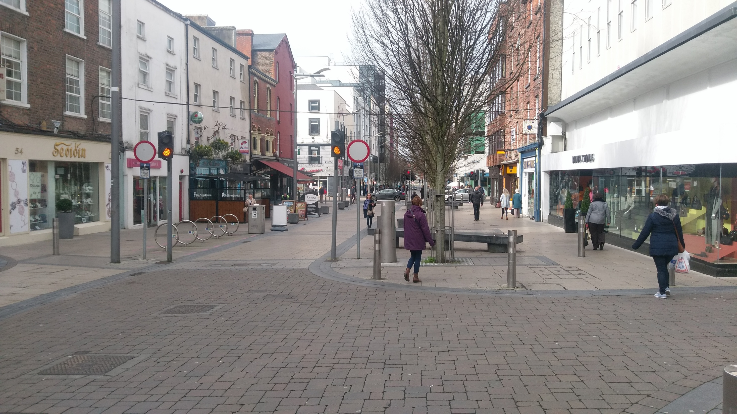
Public Realm & Urban Structure
Streets, squares / open public spaces / Parks / Water
Foster a rich public life
Public realm strategy
unity and connection in the urban structure
Quality of details and finishes
Notes:
Successful cities and towns tend to perform well across multiple sectors (and therefore balance Livelihood and Liveability): Economic; Housing; Environmental; Cultural

Slide 23
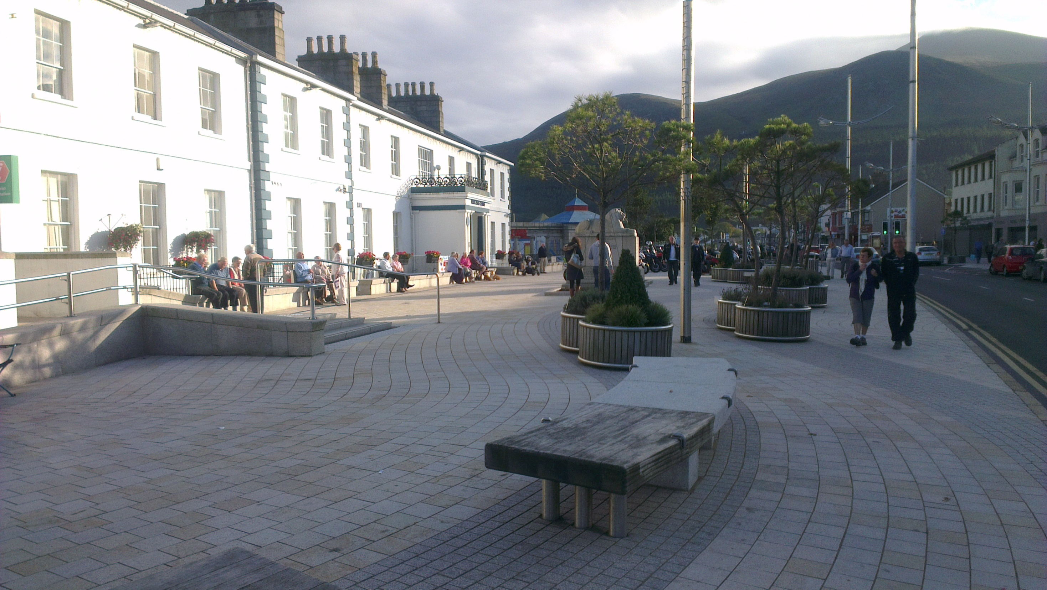
Civic conservation enhanced by public realm
Notes:
Successful cities and towns tend to perform well across multiple sectors (and therefore balance Livelihood and Liveability): Economic; Housing; Environmental; Cultural

Slide 24
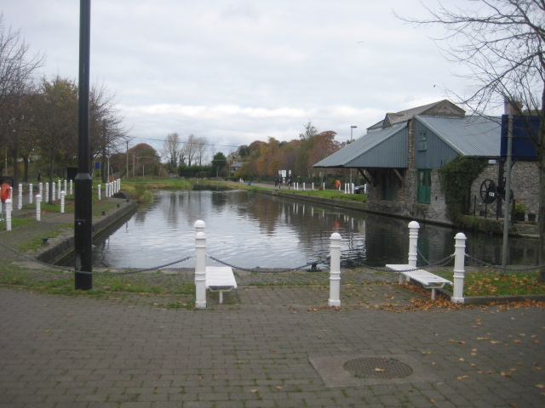
Historic Legacy & Heritage
Small footprint of streets / town centre
Main street: high quality urban space / streetscape
St. David’s Castle
Canal legacy
Jigginstown castle
Notes:
Successful cities and towns tend to perform well across multiple sectors (and therefore balance Livelihood and Liveability): Economic; Housing; Environmental; Cultural

Slide 25
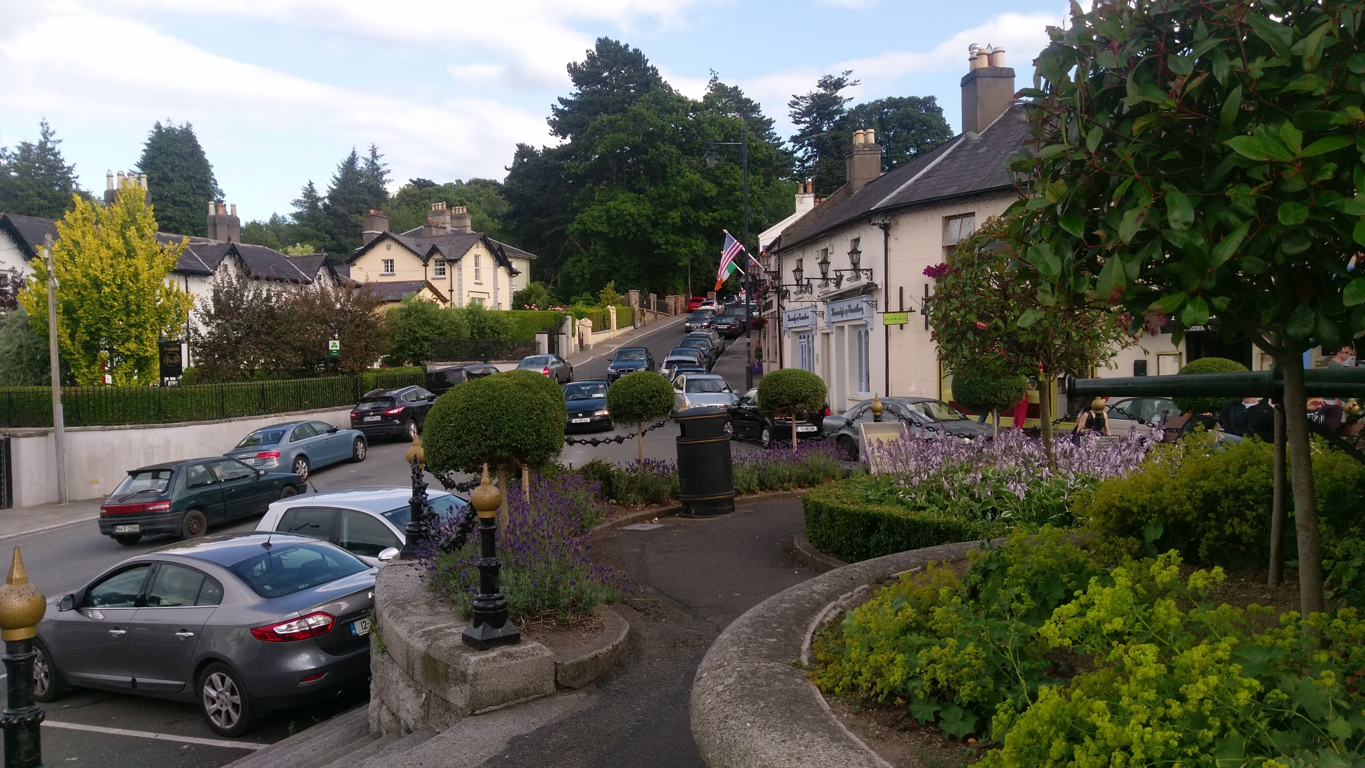
We can still make room for cars
Notes:
Successful cities and towns tend to perform well across multiple sectors (and therefore balance Livelihood and Liveability): Economic; Housing; Environmental; Cultural

Slide 26
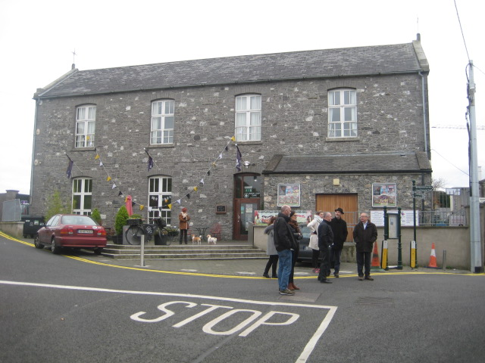
Culture
Often invisible in planning.
Towns project identity through culture
Cultural events lift the population
Anchor a festival / claim a writer or a musician.
Culture needs:
- Infrastructure
- Access / Equity
- Content
Notes:
Successful cities and towns tend to perform well across multiple sectors (and therefore balance Livelihood and Liveability): Economic; Housing; Environmental; Cultural

Slide 27
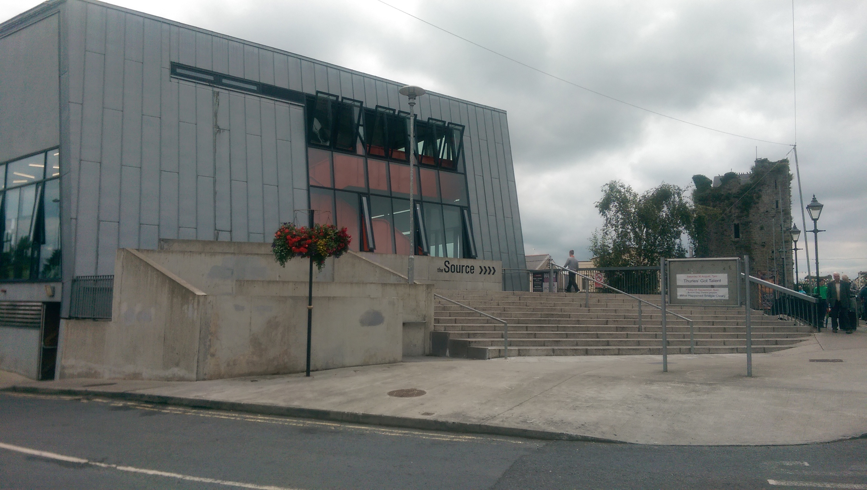
Culture
Profile and ambitious infrastructure
Notes:
Successful cities and towns tend to perform well across multiple sectors (and therefore balance Livelihood and Liveability): Economic; Housing; Environmental; Cultural

Slide 28
Approach
for Naas

Slide 29
Key Sectors
Each sector
must be connected
has trends
makes patterns that impact on place & legacy
influences spatial coherence of Naas

Slide 30
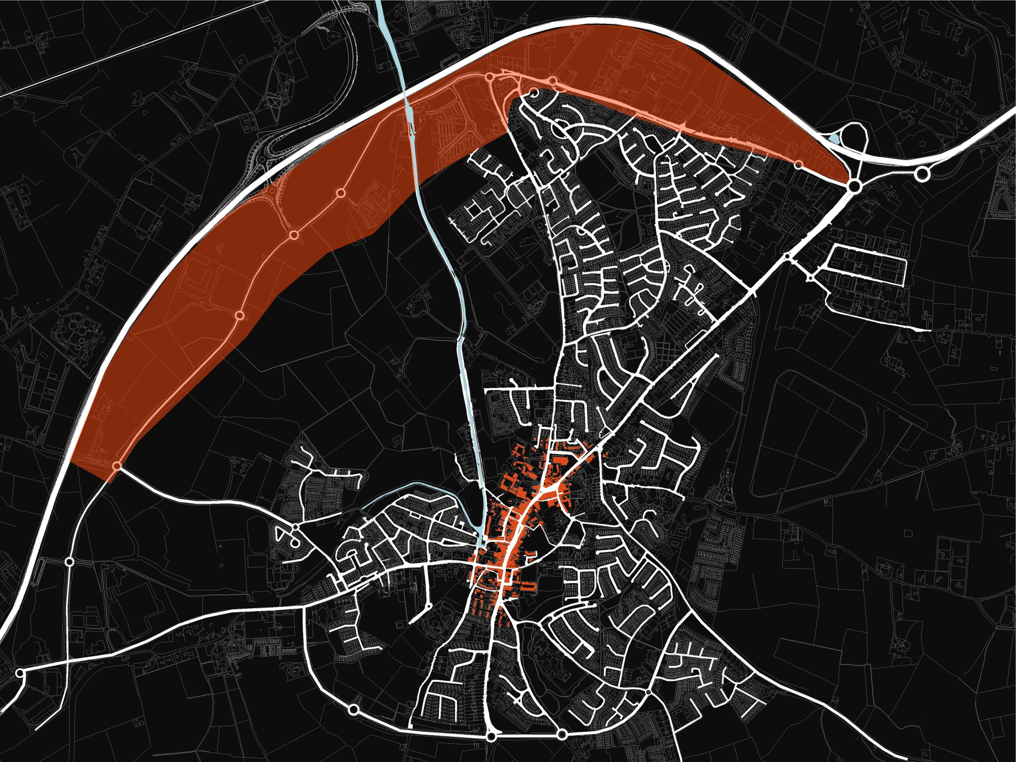
Centre & periphery
separation & disconnect
alignment & powerful two-way relationship
Identify the critical / promising areas
How can Naas be re-aligned to support & connect the town centre & the periphery?

Slide 31
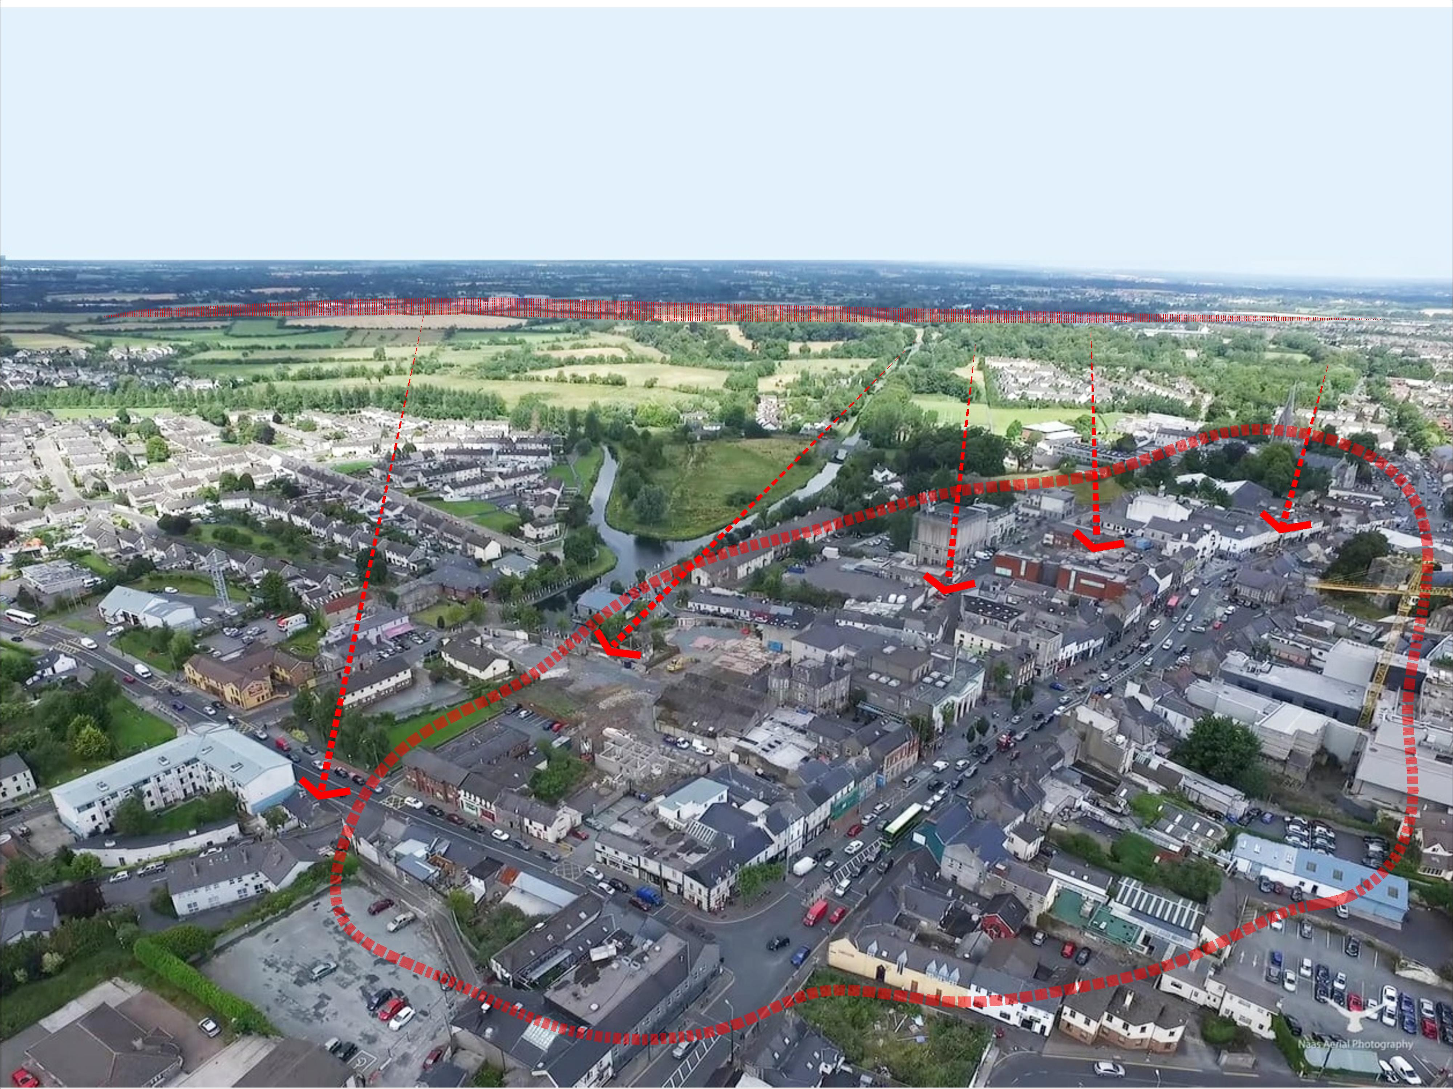
Critical need to generate interconnection between periphery & town centre
Notes:
Successful cities and towns tend to perform well across multiple sectors (and therefore balance Livelihood and Liveability): Economic; Housing; Environmental; Cultural

Slide 32
Town Centre
Housing and residential
Environmental sustainability
Local economy
Movement
Social & Community
Urban Structure & Public Realm
Historic Legacy & Heritage
Culture

Slide 33
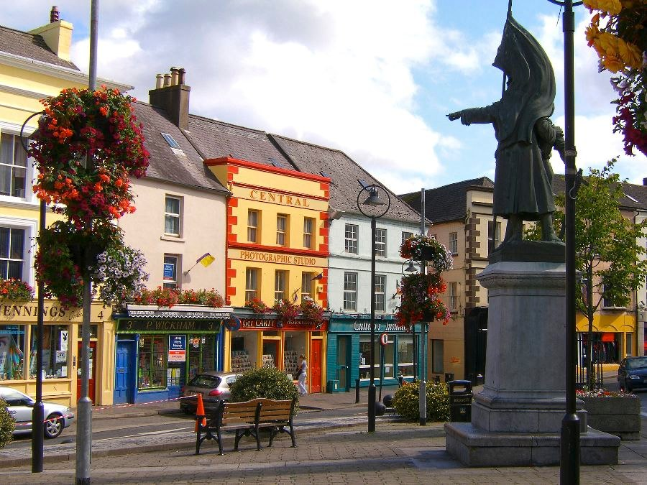
Notes:
Successful cities and towns tend to perform well across multiple sectors (and therefore balance Livelihood and Liveability): Economic; Housing; Environmental; Cultural

Slide 34
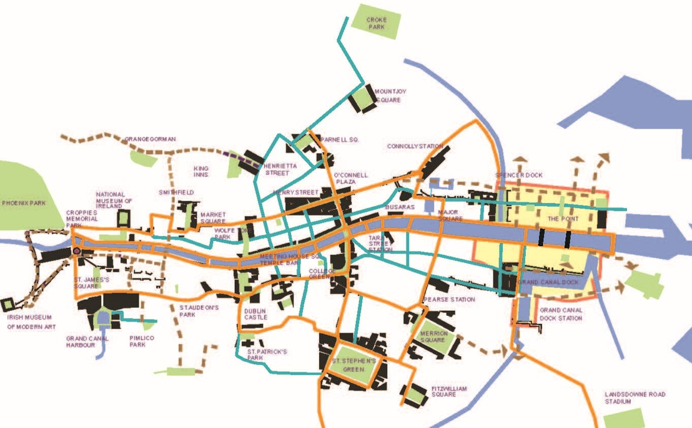
Public Realm
Critical in building unity & inter-connection
Draw in:
-Streets
-squares / designed open public spaces
-Parks
-Water-bodies (lakes & canal
Facilitates / encourages social contact, walking cycling

Slide 35
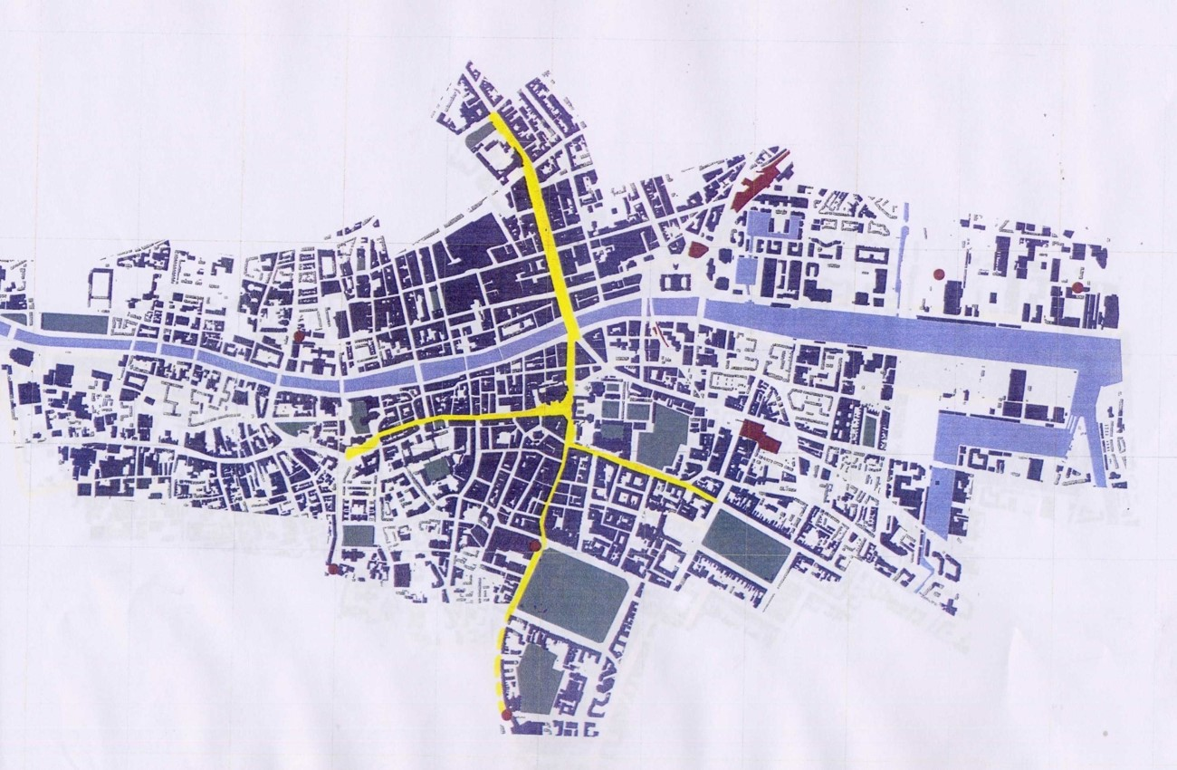

Slide 36
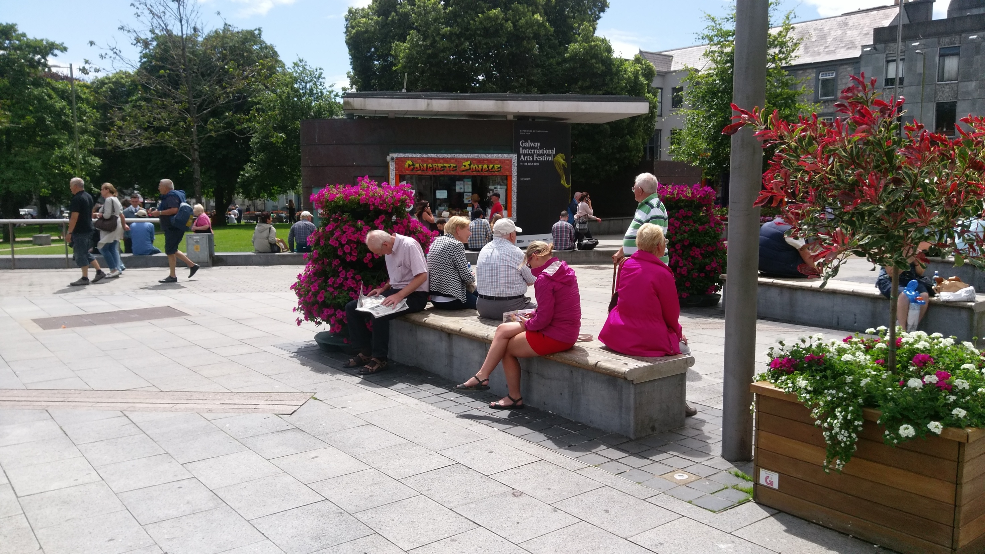
Notes:
Successful cities and towns tend to perform well across multiple sectors (and therefore balance Livelihood and Liveability): Economic; Housing; Environmental; Cultural

Slide 37
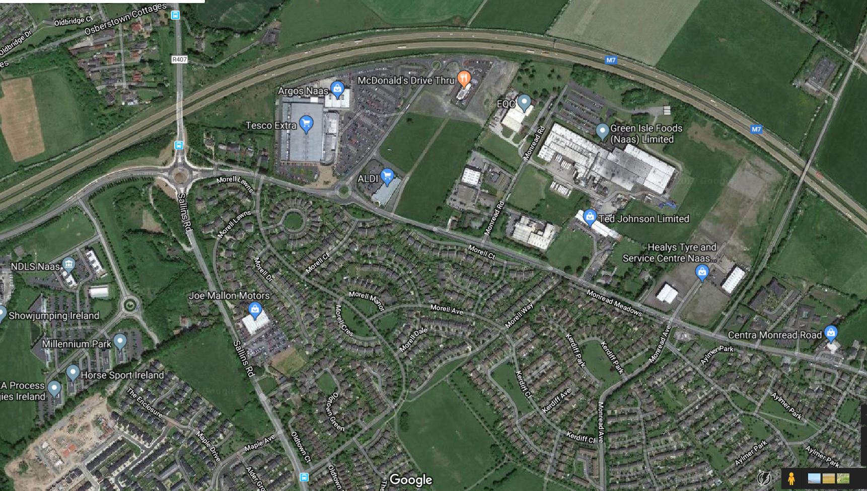
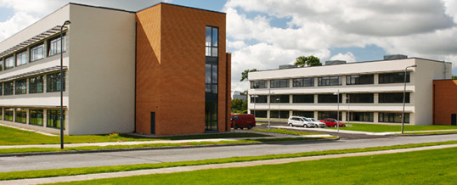
Periphery
Powerful employment platform, is working as well as it could be?
- Urban design
- Architecture
- Zoning / land use
- Behaviour
How do we Connect workers to town centre?

Slide 38
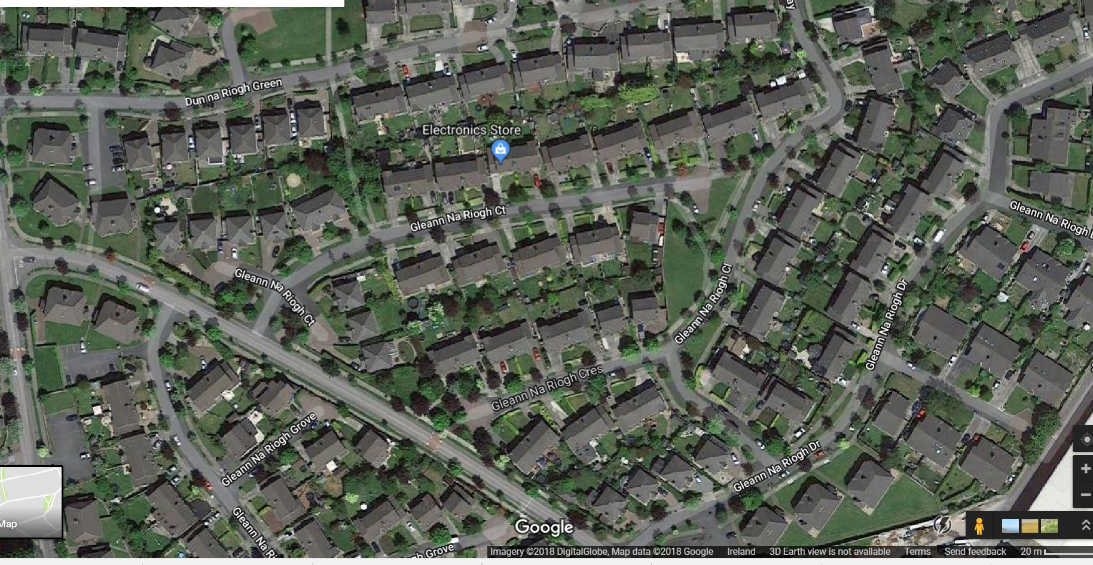
Residential
Need to widen residential offer
Different models need to be explored:
Sustainable densities
Apartments
Mixed-use models
Intergenerational living / housing
Quality & diversity in design & construction

Slide 39
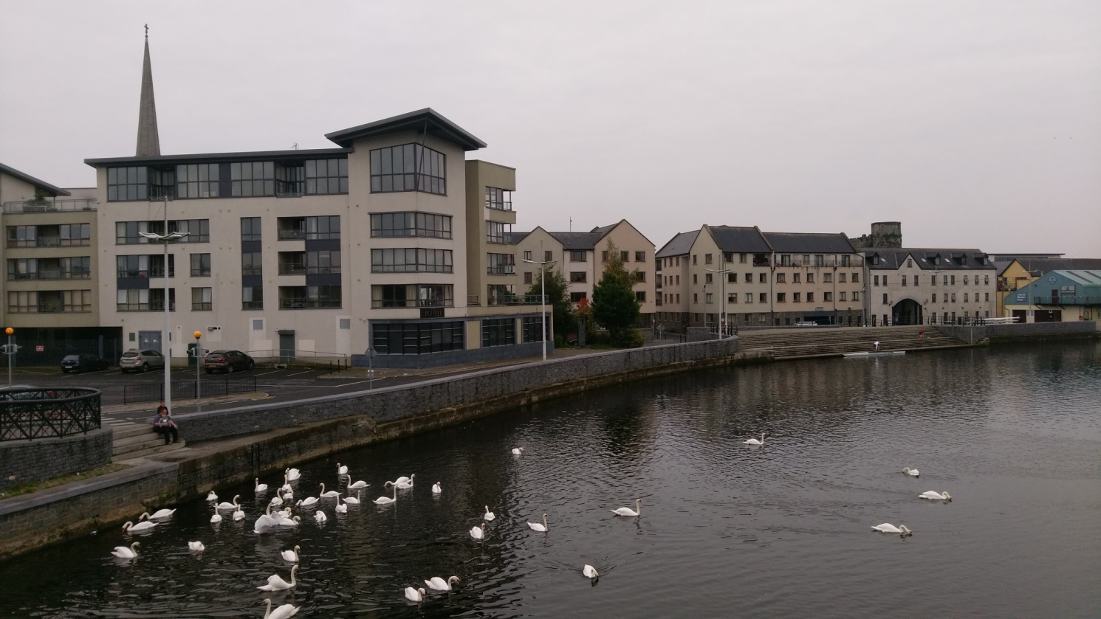
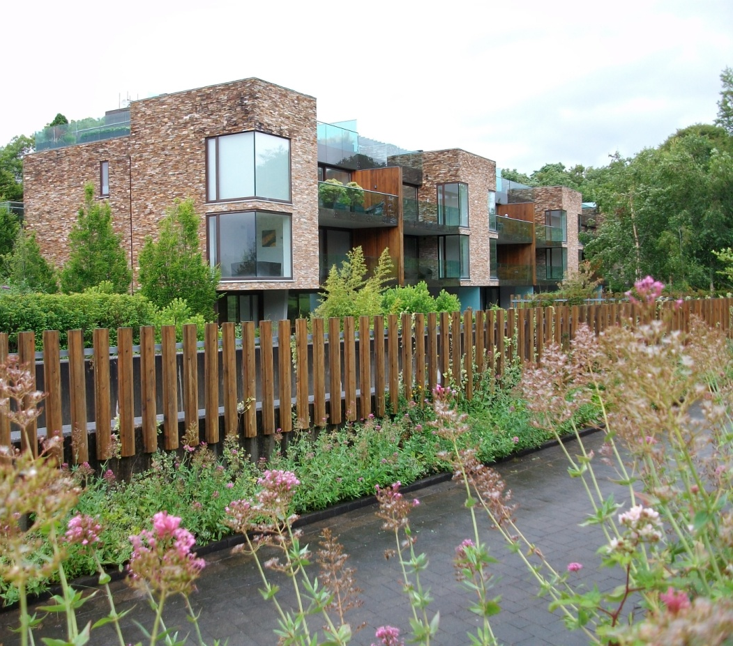
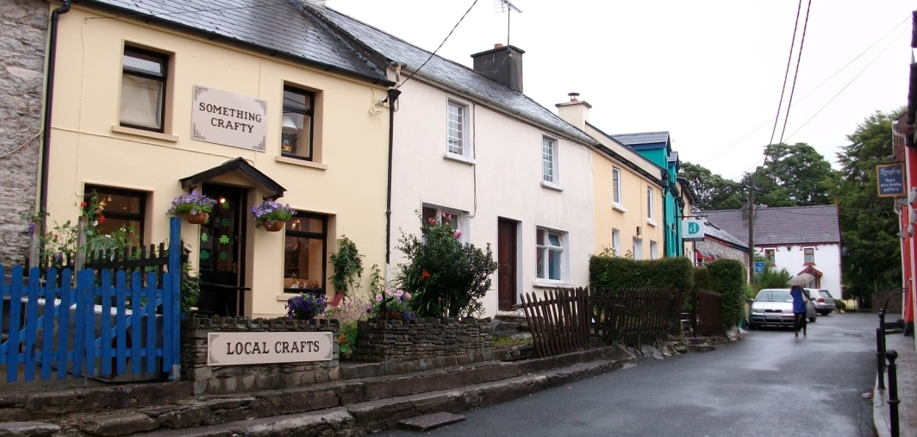
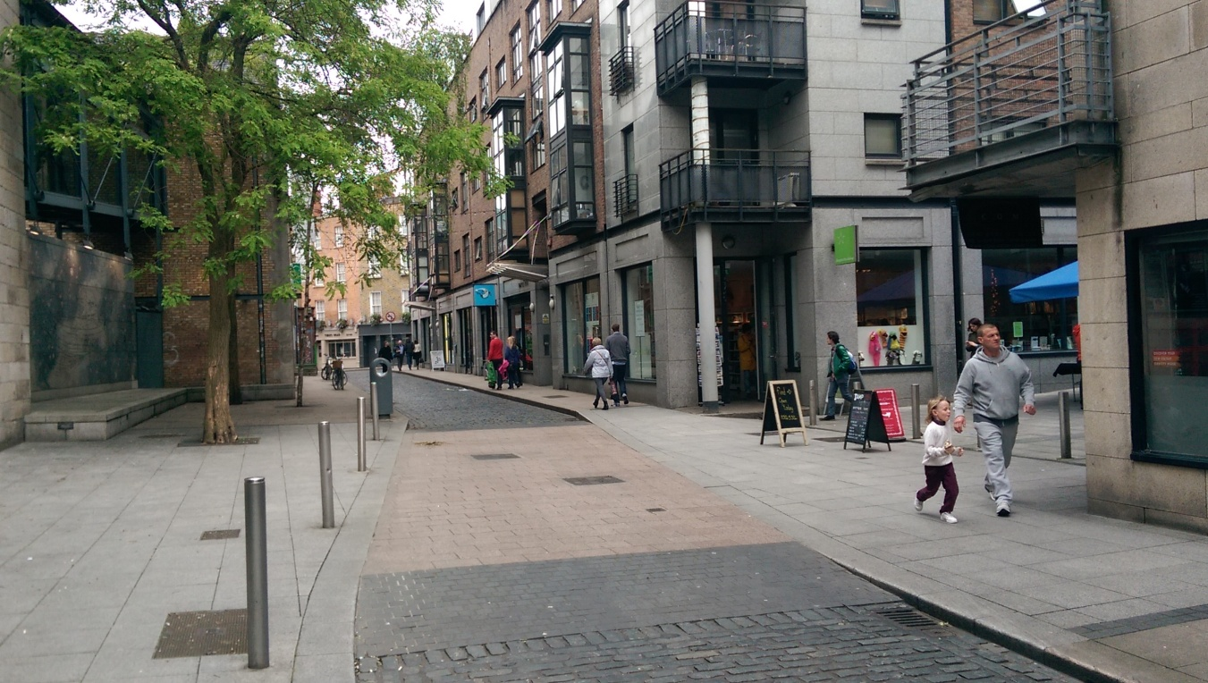
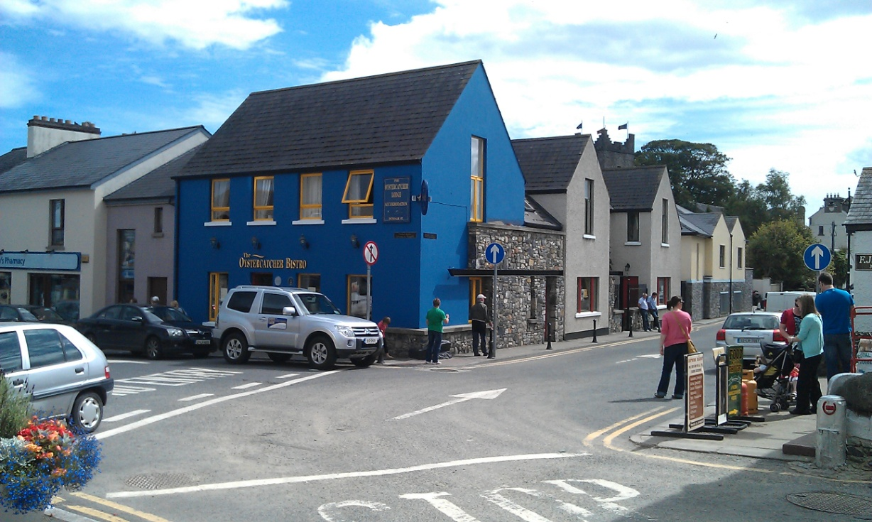
Notes:
Successful cities and towns tend to perform well across multiple sectors (and therefore balance Livelihood and Liveability): Economic; Housing; Environmental; Cultural

Slide 40
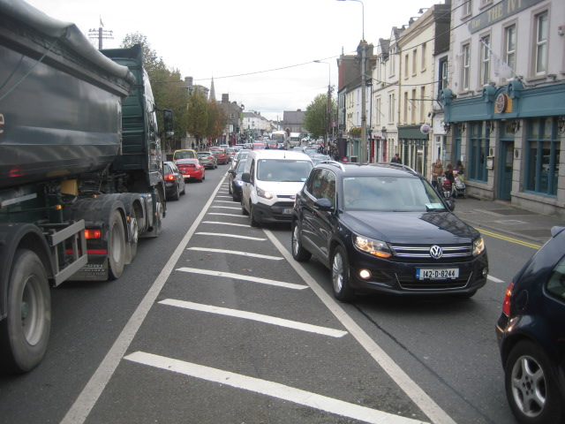
Movement Movement is there to serve Naas, not vice-versa
Re-balance in multiple areas
Anticipate Dublin-Naas Greenway
Connect Naas to its hinterland
Create a diverse movement network that supports cycling and walking, connects and exploits key places within Naas
Movement

Slide 41
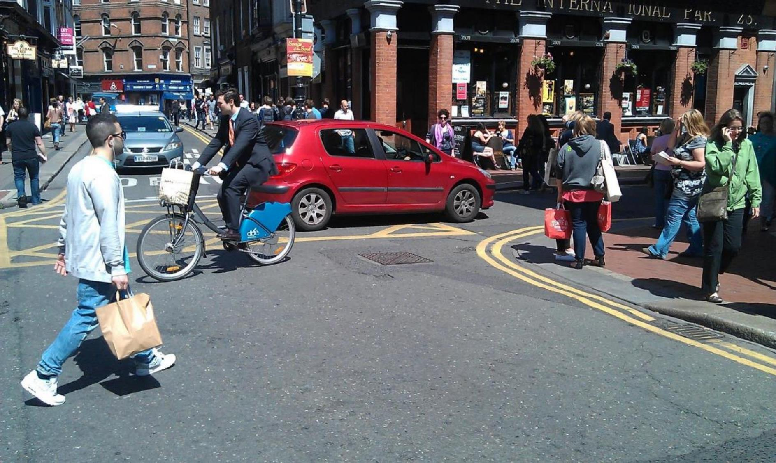
Pedestrian priority, mixed modes of travel, good public realm
TrinityHaus
www.trinityhaus.tcd.ie

Slide 42
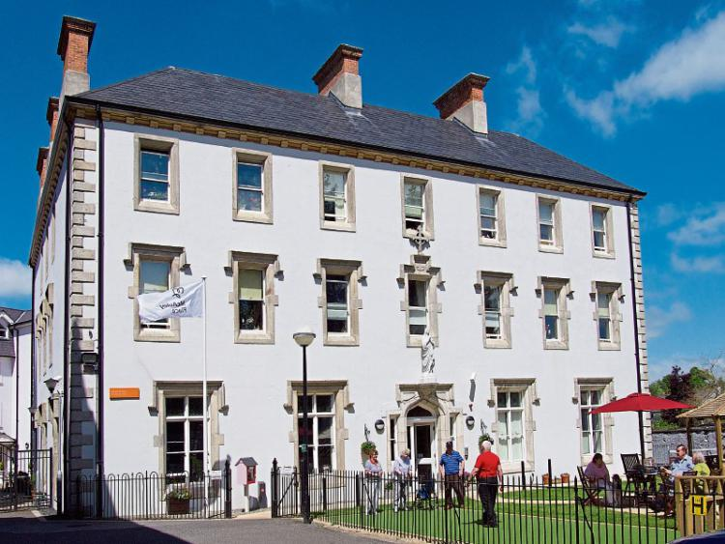
Public realm in Copenhagen
Art in Carlow
Literature in Listowel
Traditional Music in Ennis
Contemporary music in Dingle
McAuley Place
Can Naas build a food ecology based on restaurants, markets, festivals, Kerry Foods Group?
Positively subversive topics

Slide 43
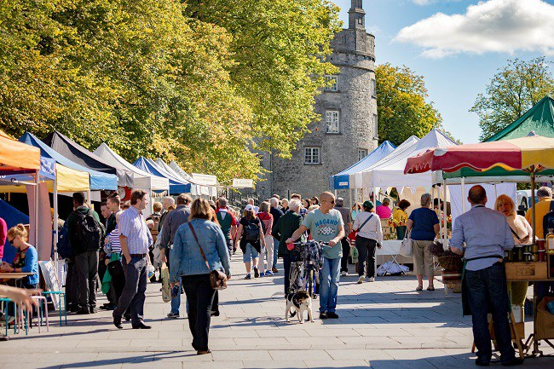
Market Place Kilkenny
Notes:
Successful cities and towns tend to perform well across multiple sectors (and therefore balance Livelihood and Liveability): Economic; Housing; Environmental; Cultural

Slide 44
LAP implementation
Collaborative stakeholder capacity
Naas Urban Observatory?

Slide 45
Movement

Slide 46
2018 - 2024 - 2040

Slide 47
M7 3-lane upgrade life span.
Iarnrod Eireann 4-track to Kildare
Naas Main St at capacity
Junction 9 at capacity
Town of 50,000?? needs internal public transport, cycle links, reduced car dependency

Slide 48
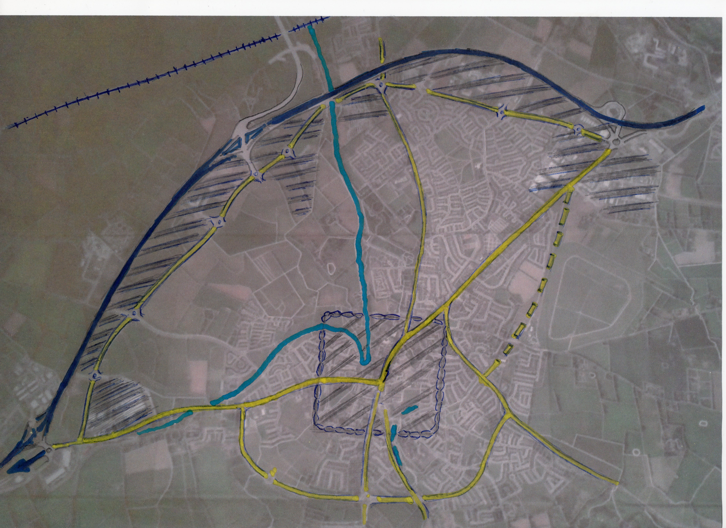

Slide 49
Kildare Archaeological Society: Vol XVI, No4, 1983/84 Castles of Naas, Ben Murtagh
A St David’s Castle
B Eustace Castle
C Watergate Castle
D mentioned in 1782
E Black Castle
F Lyard’s or Motley
G White Castle
H Wheatley’s Castle

Slide 50
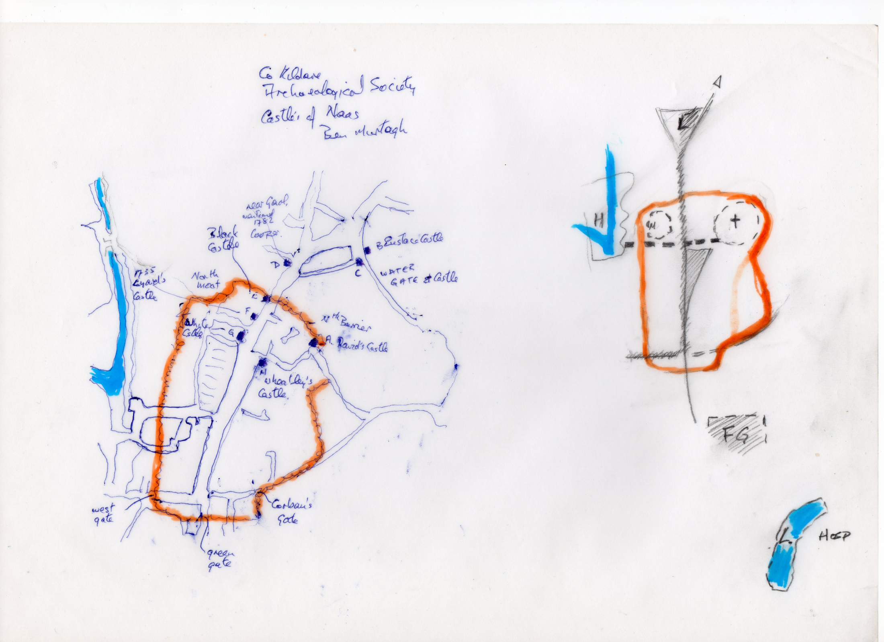

Slide 51
Backcasting from 2040
Population 50,000?? people.
LAP 2024 should provide for 2024 increase and begin skeleton of 2040.
Access to the town centre (schools, retail, etc.) from Naas residential and employment made possible by walking cycling or public transport.
Main street to be gradually reduced in the traffic network. Car parking/ servicing at rear
High density opportunities in centre.
Notes:
250% increase
30% in 6 years

Slide 52
LAP should have Objective for completion of Multi-modal Transport Study for next LAP.
Focus in LAP should be on north-west quadrant and west of Naas.
Potential for car park close to, and, bus and cycle links to Rail Station.
Naas bus terminus in N/W also multi-storey P
Harbour Development with only pedestrian/ cycle bridges to town, car access from west.

Slide 53
Urban Design
Key Issues for Naas

Slide 54
Key Urbanism Values & Design Qualities

Slide 55
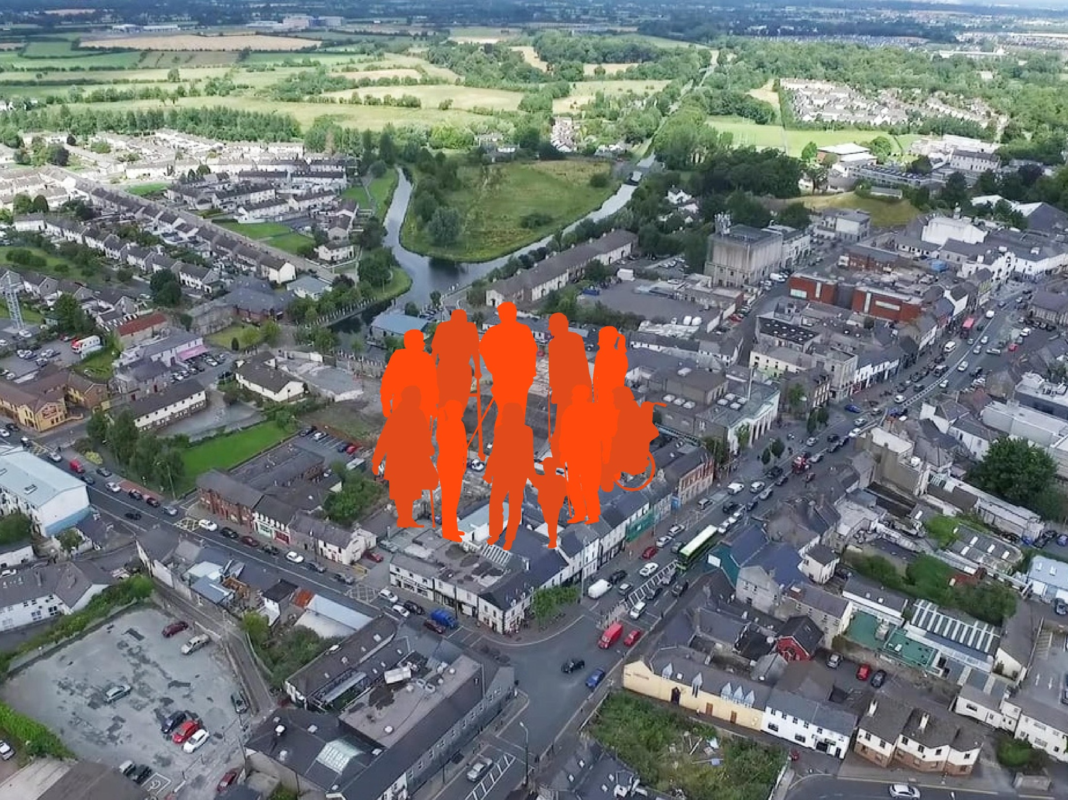
Inclusion & participation
Diversity & liveliness
biodiversity & connection to nature
connectivity, & choice of movement
Environmental sustainability
safe & comfortable pubic realm
Urbanism Values
economic opportunities
quality, affordable, diverse housing
innovation, creativity, education
Sense of place & identity
coherence & good legibility

Slide 56
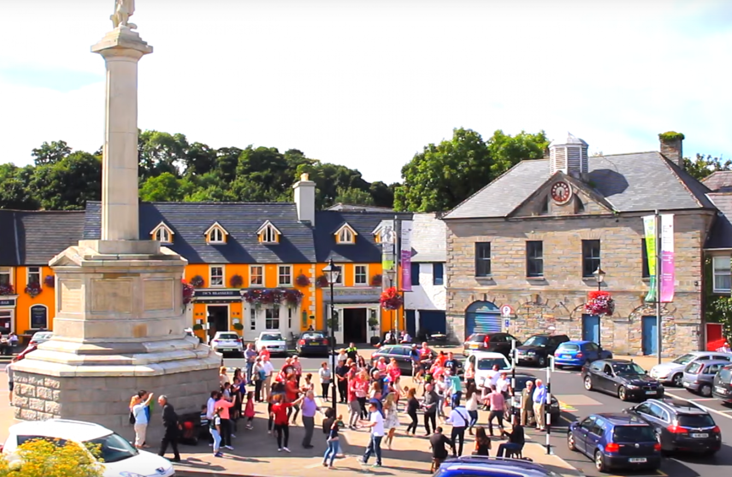
Urban Design Qualities
Density of use
Diversity of building use (mixed-use residential, healthcare, education, local services, amenity spaces, playgrounds etc.)
Range of open space use
Active street frontage

Slide 57
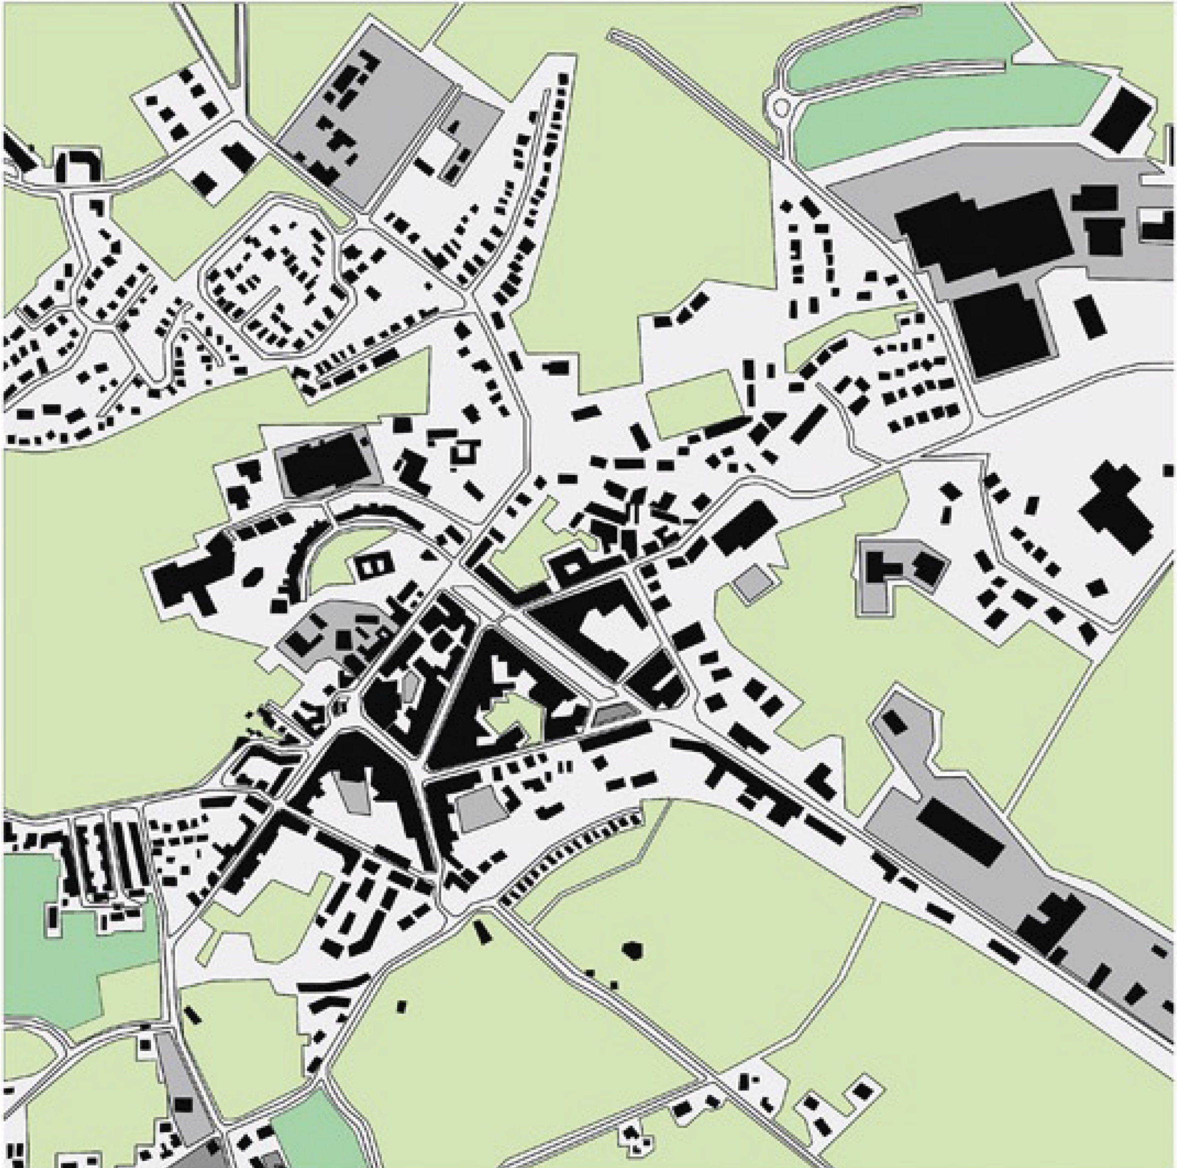
Urban Design Qualities Qualities
Compact
Imageability (distinct, recognisable)
Legibility & wayfinding
Enclosure
Human-scale
Linkage
Coherence
Accessibility & usability
Safety & security
Comfort & Enjoyment

Slide 58
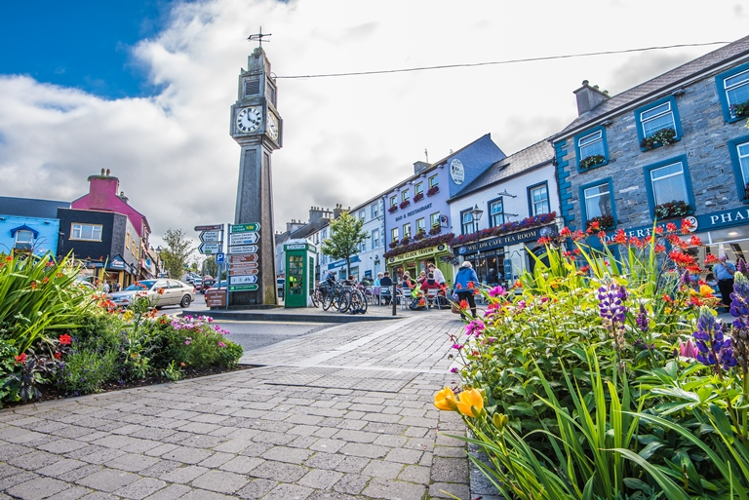
Urban Design Qualities
Quality & durable local materials
Local & vernacular detailing
Provision of diverse seating & shelter options
Integrated green & blue spaces
Adaptability & flexibility
Resilience
Conservation & protected structures

Slide 59
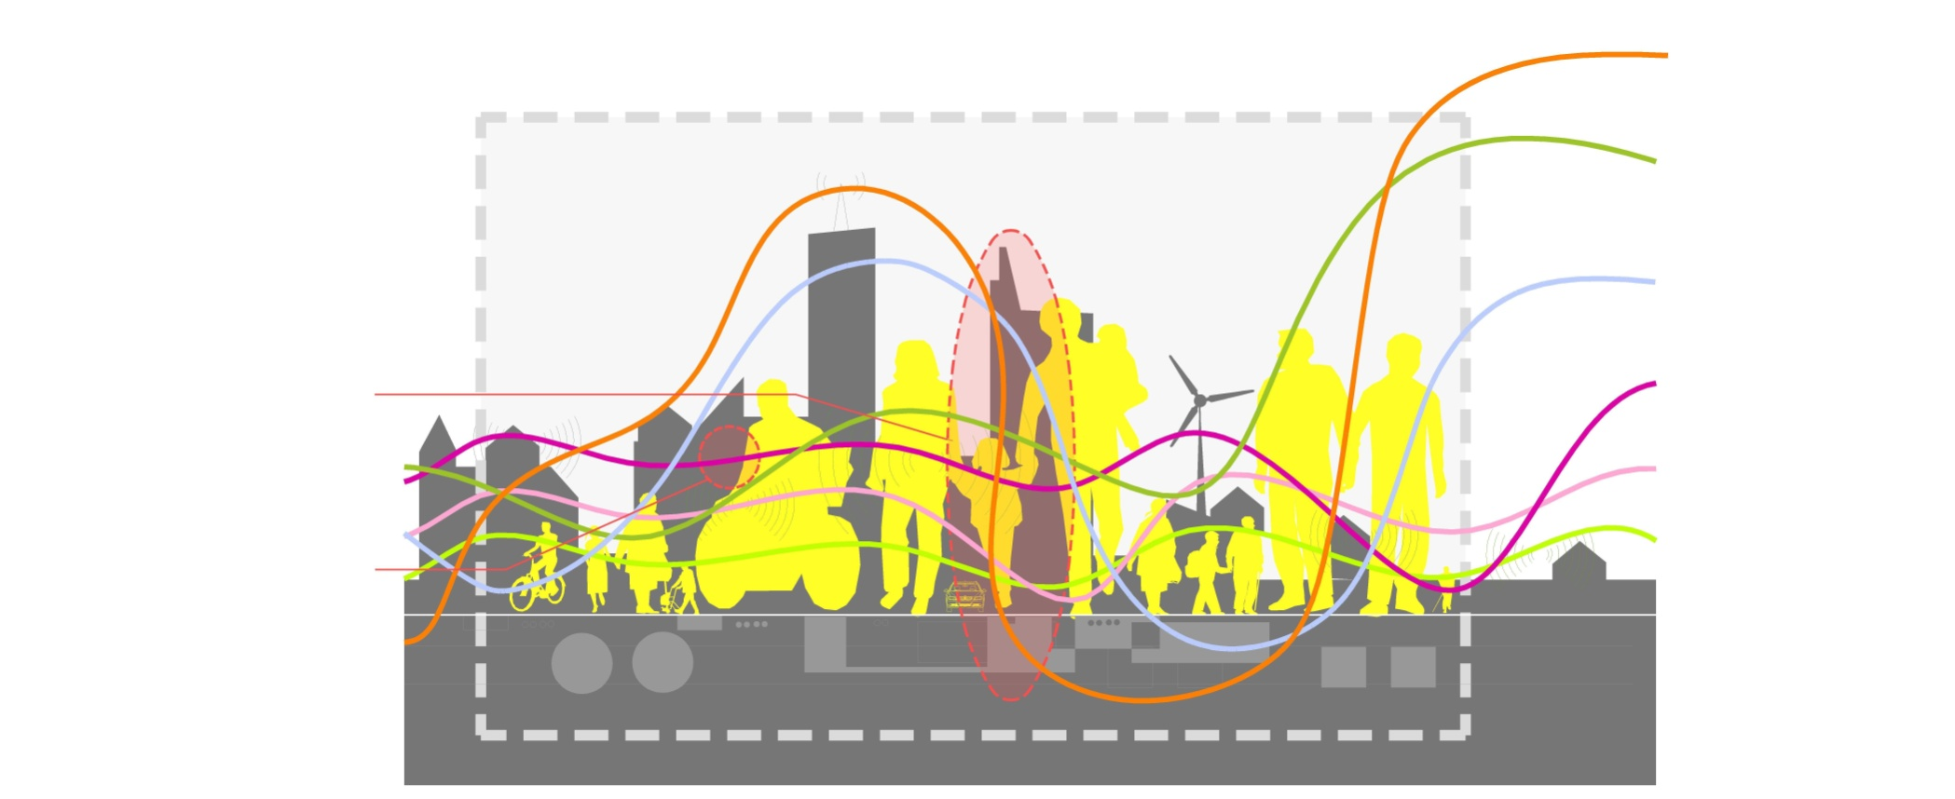
Hard & Soft Infrastructures
Top-down
Utilities
Urban
Space
Buildings
Institutions
Community
Personal
Bottom-up

Slide 60
Key Urban Design challenges for Naas

Slide 61
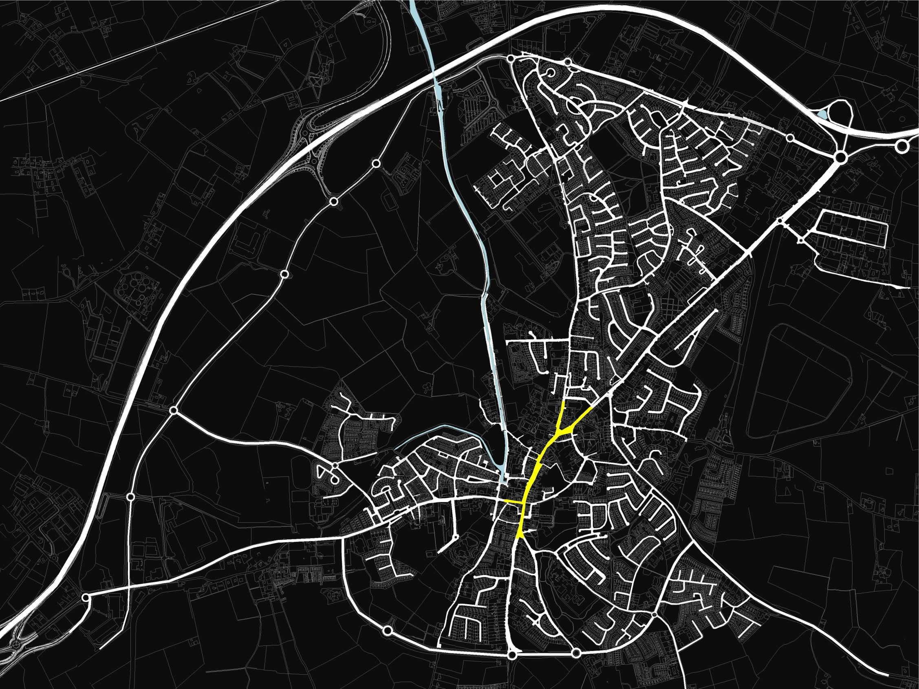
Overall Urban Structure
Small town centre
Low density cul-de-sac residential development
Peripheral development
Strong reliance on a small number of radial routes

Slide 62
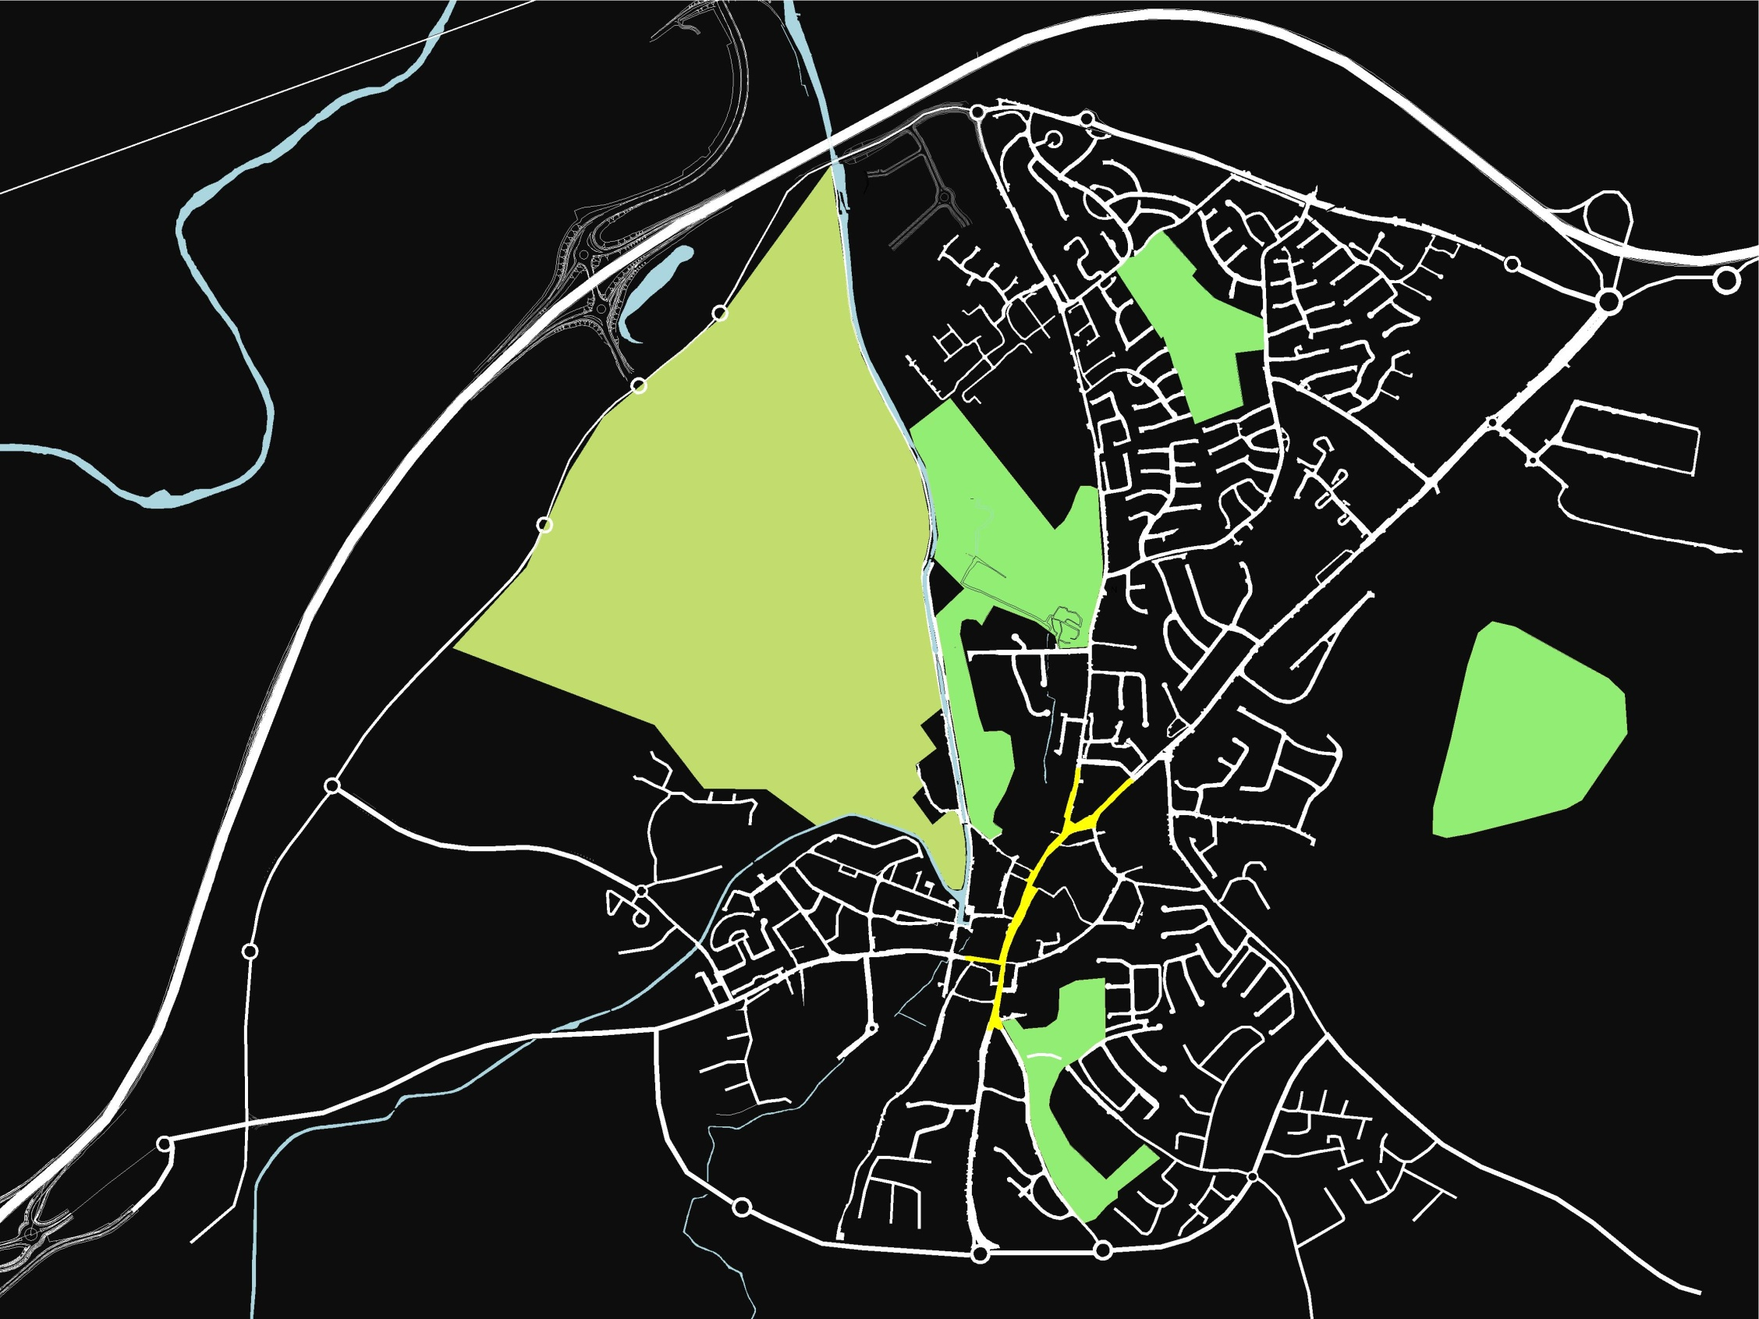
Green & Blue Areas
Under-utilised & disconnected green spaces
Neglected canal & harbour

Slide 63
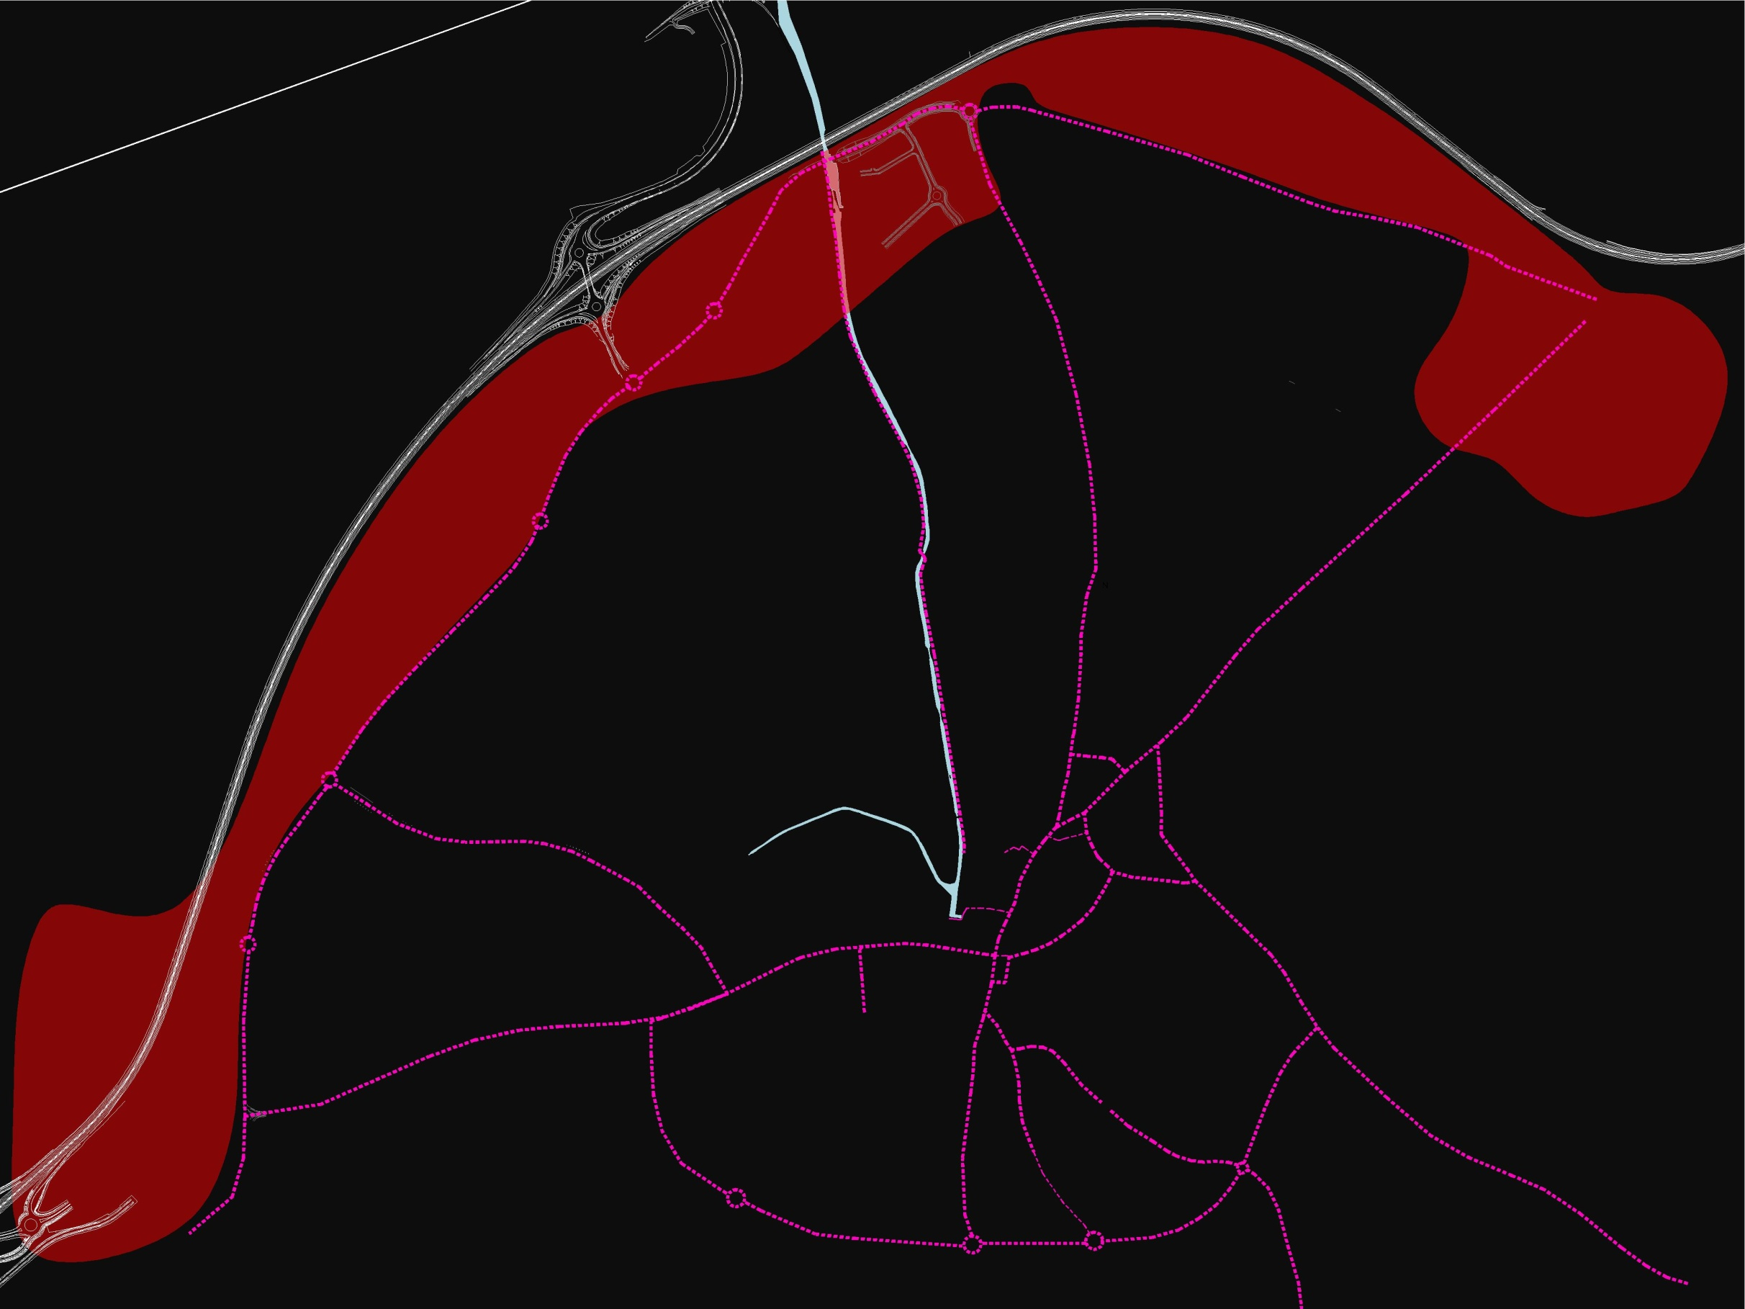
Lack of good connecting routes & key public spaces
Large impermeable blocks of land
Over-used main routes that are undermined by traffic
Lack of easily accessed high quality public space

Slide 64
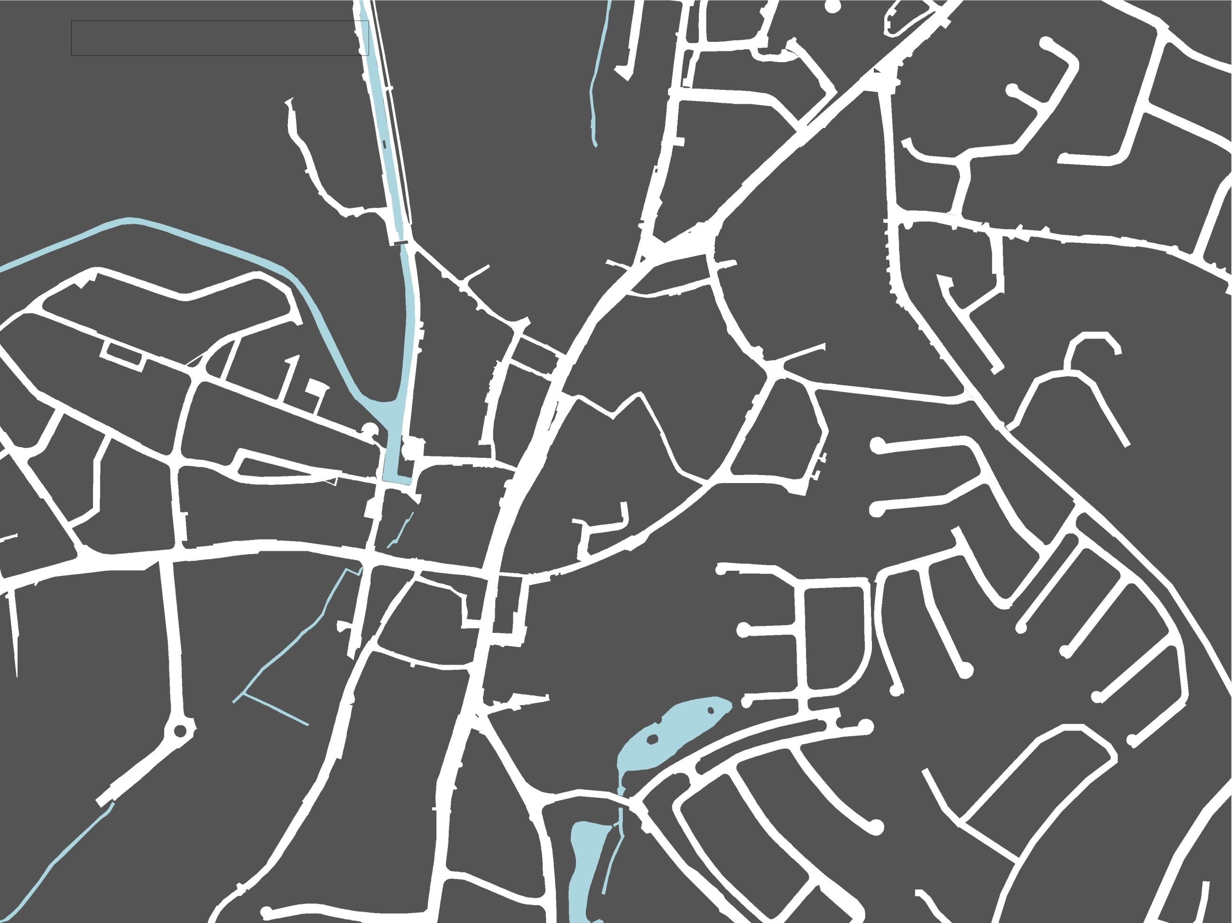
Town centre lacking in a fine urban grain
Impenetrable urban blocks
Few town centre connecting routes
Lack of main public square or similar usable central space

Slide 65
Fragmented town core and lack of strong centres

Slide 66
Poor connection between centre & periphery

Slide 67
Strengthening and renewing the urban structure in Naas

Slide 68
Thinking about Character Areas
Primary uses
Route structure
Natural & landscape character
Historic elements
Local perception

Slide 69
Possible Character Areas

Slide 70
Primary uses
Route structure
Natural & landscape character
Historic elements
Local perception

Slide 71
Centres & key locations/
destinations

Slide 72
Key development locations & creation of centres

Slide 73
Connect them…

Slide 74
Connect them…

Slide 75
Connect them…

Slide 76
Create strong centres & Neighbourhood
Big enough to support a range of services...
Small enough to foster a sense of belonging & community…
Sufﬁciently dense to enable essential facilities within easy walking distance…

Slide 77
Good Neighbourhood Design
Create strong centres & Neighbourhood
Responding to a range of age groups
Robust & adaptable
served by public transport
Provide a range of open spaces
Reflects local character
Nurtures local community groups
Sensitive to hard & soft infrastructure
Apply Urban Design Qualities

Slide 78
Hard & Soft Infrastructures
Top-down
Utilities
Urban
Space
Buildings
Institutions
Community
Personal
Bottom-up

Slide 79
Thank you
Naas Planning Advisory Group
NAs

