Slide 1
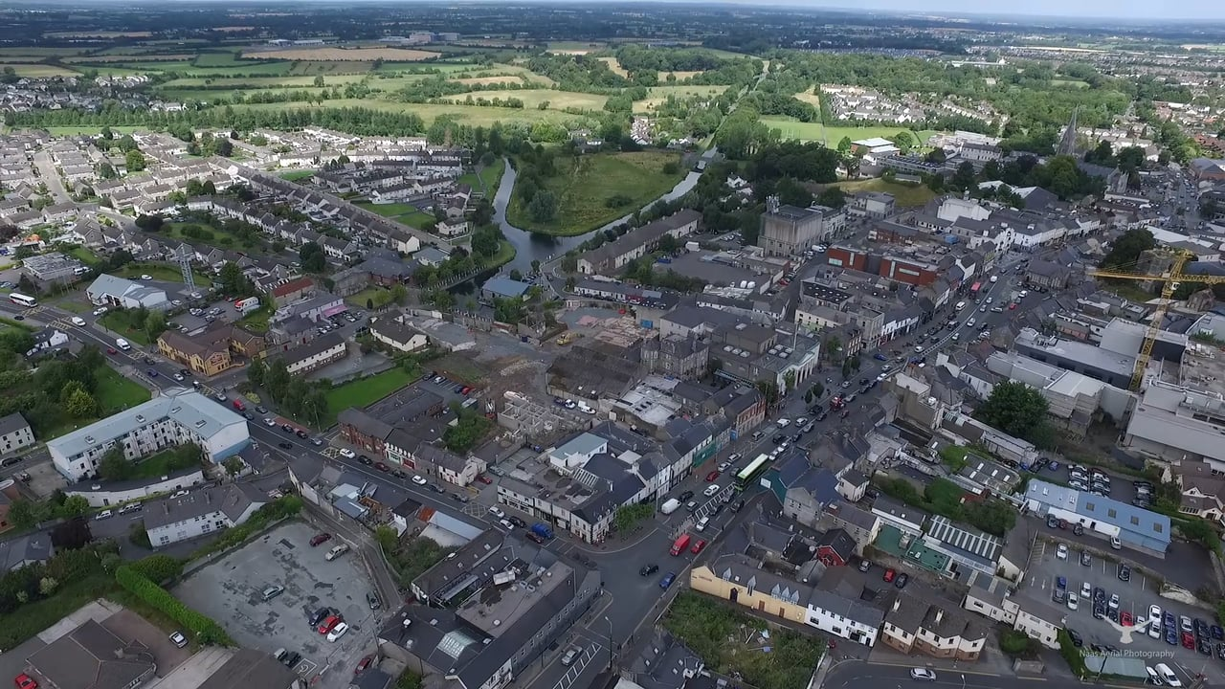
Naas Local Area Plan 2018-2024
Plenary 2
14/03/2018

Slide 2
Naas Planning Advisory Group
To advise Kildare County Council in relation to the preparation of the Naas Local Area Plan 2018-2040 with a focus on:
Identifying Key Sectors and Themes
Analysis and Strategy for Urban Structure and Urban Design
Overall Movement Strategy
Stakeholder Engagement

Slide 3
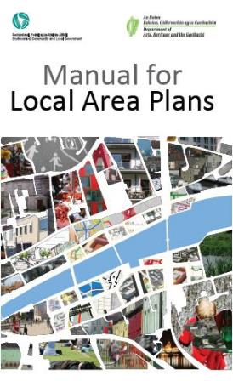
Local Area Plans: Key aims
..setting out a balanced understanding, vision & spatial strategies at the local level
..frameworks to secure sustainable development that balances social, economic & environmental considerations at the local level while minimising the potential adverse effects of development on the environment.
Fit within the existing planning and policy hierarchy
Are founded on a thorough understanding of the place
Strive towards an agreed vision, elaborated by a set of robust principles
Set out place-specific strategies for heritage, land use, urban and landscape structure and movement
Provide appropriate guidelines for realising the vision
Set out realistic and feasible means of delivery
Provide a framework for monitoring progress

Slide 4
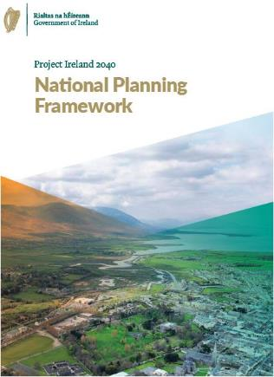
National Planning Framework - Ireland 2040
…process of run-down of city & town centre and established suburban areas as jobs, retail and housing move out, leaving behind declining school enrolments, empty buildings and a lack of sufficient people to create strong and vibrant places, both day and night (p28)
…most development takes the form of greenfield sprawl that extends the physical footprint of our urban areas, & when it is the principal form of development, works against the creation of attractive, liveable, high quality urban places in which people are increasingly wishing to live, work and invest, and A significantly higher carbon footprint than the EU average.
…compact development that focuses on reusing previously developed, ‘brownfield’ land, building up infill sites, which may not have been built on before & either reusing or redeveloping existing sites & buildings
An increase in the proportion of more compact forms of growth in the development of settlements of all sizes, from the largest city to the smallest village, has the potential to make a transformational difference.

Slide 5
Overall context

Slide 6
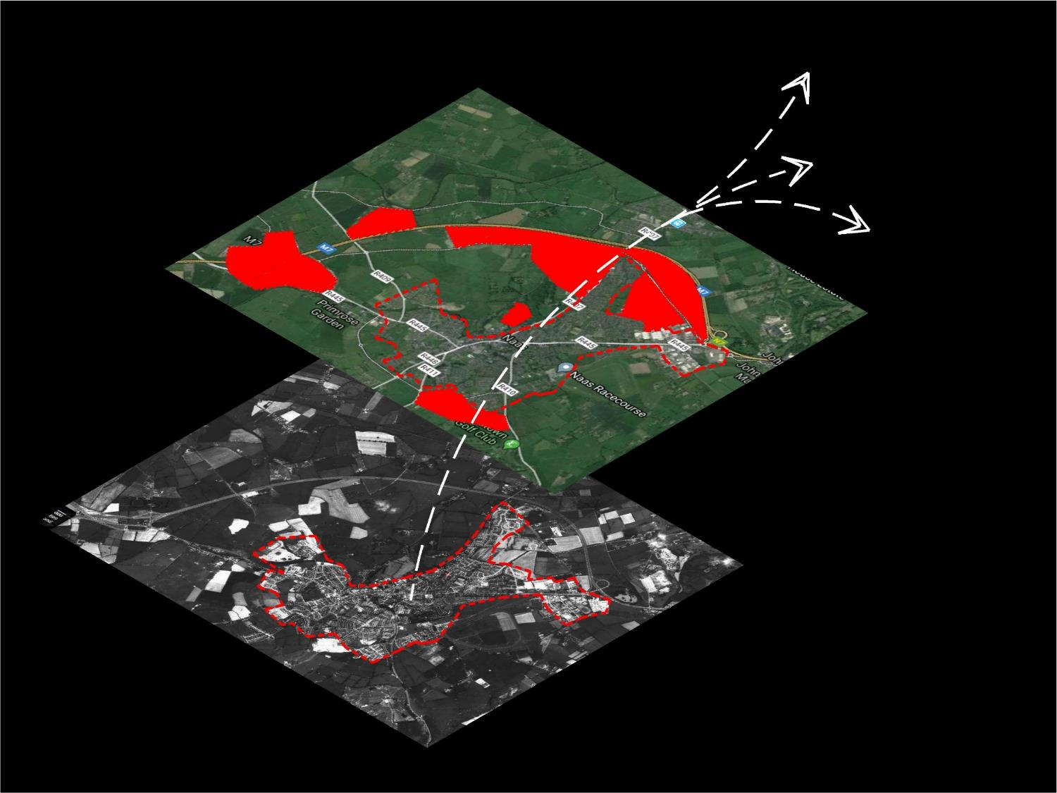
2040
population
?????
2018 pop.
approx. 21493
1990 pop.
approx. 10,000

Slide 7
Navan
Dundalk
Drogheda
Mullingar
Tullamore
Portlaoise
Kilkenny
Westport
Wexford
Naas 2040
What kind of town?
economically
socially
environmentally
physically
Notes:
Vision for Naas -What is our value system as a county town? / Most cities trying to balance Liveability and Livelihood / What is our identity and how can we develop?/ What might the shape of success look like if its driven by values (vision)

Slide 8
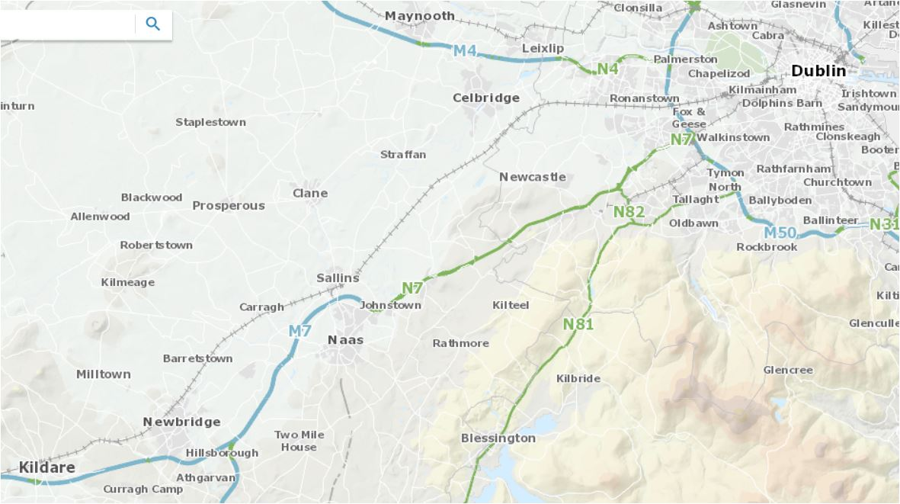
Strategic location
Exciting Hinterland
Motorway & rail
Canal
Spine of main street

Slide 9
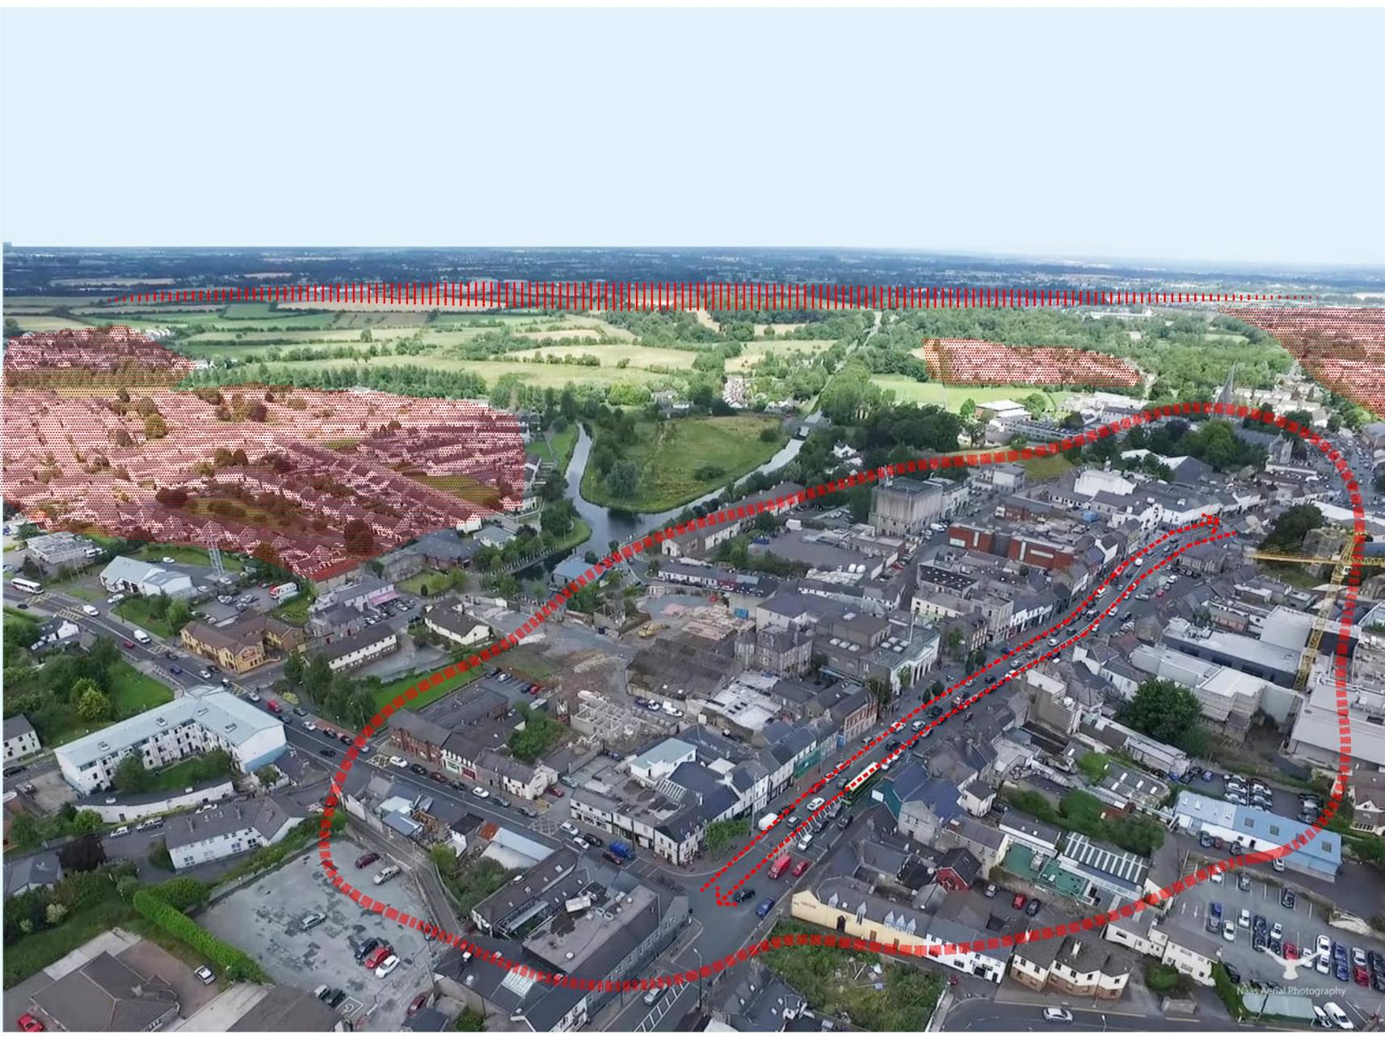
Role as county town?
Leadership
Assets/Platforms
Infrastructure
Projects
Attitude
Strong economic periphery
Housing estate town
Underperforming town centre
Fragmented urban structure
Vehicle dominated Movement

Slide 10
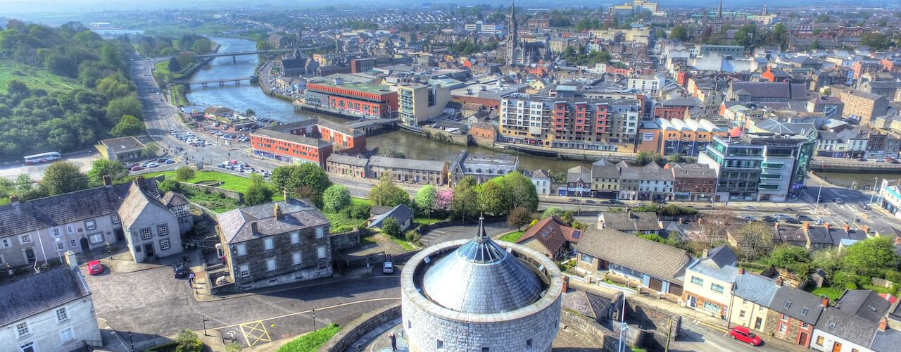
Successful Places
Identity / Role & Value System
Integrated Themes
Long term thinking
Legible town jigsaw
Good governance
Infrastructure
Notes:
Successful cities and towns tend to perform well across multiple sectors (and therefore balance Livelihood and Liveability): Economic; Housing; Environmental; Cultural

Slide 11
Climate change
Technology/data
Automation
Ageing population
Citizen capacity

Slide 12
Key Sectors (High level themes)

Slide 13
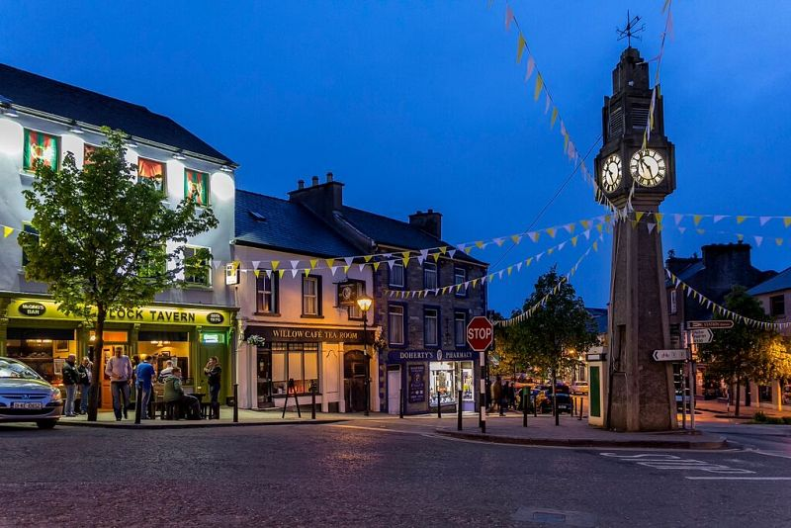
Balance Livelihood & Liveability

Slide 14
Understand Place
Establish Vision & Principles
Generate Strategies
Provide Guidelines

Slide 15
1
8
AchievementsIssues & challenges;
& the way forward
7
2
3
6
value system;
the shape
of success; blockages / disconnects
4
5

Slide 16
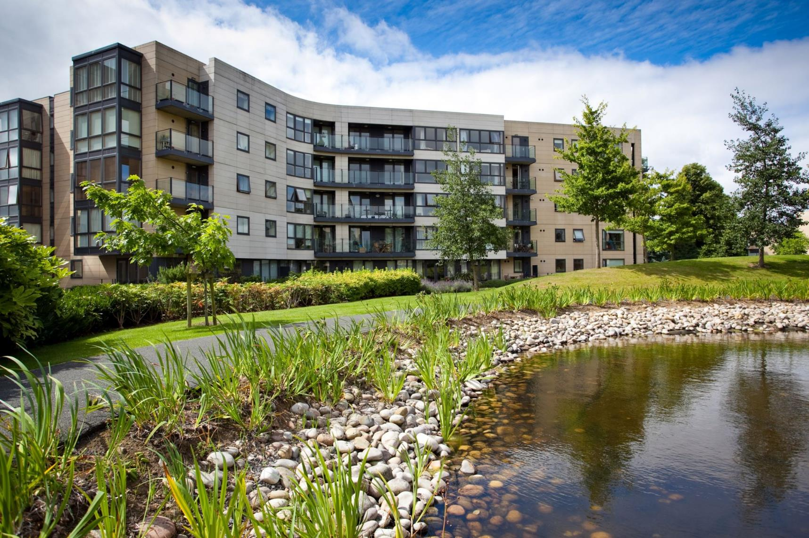
1. Housing /
residential
Sustainable density
Mixed-tenure
Diversity of typologies (incl. apartments)
Liveable neighbourhoods
Supported by social infrastructure
Notes:
Successful cities and towns tend to perform well across multiple sectors (and therefore balance Livelihood and Liveability): Economic; Housing; Environmental; Cultural

Slide 17
2. Environmental sustainability
Climate Change
Realignment in Naas:
Green infrastructure
Low carbon society &economy
Density & sustainable construction
Behaviour change
Notes:
Successful cities and towns tend to perform well across multiple sectors (and therefore balance Livelihood and Liveability): Economic; Housing; Environmental; Cultural

Slide 18
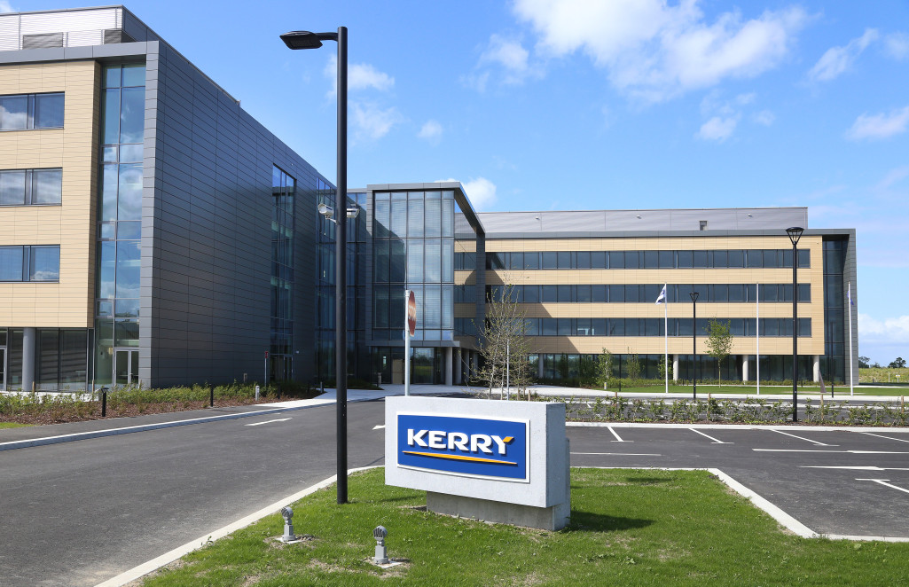
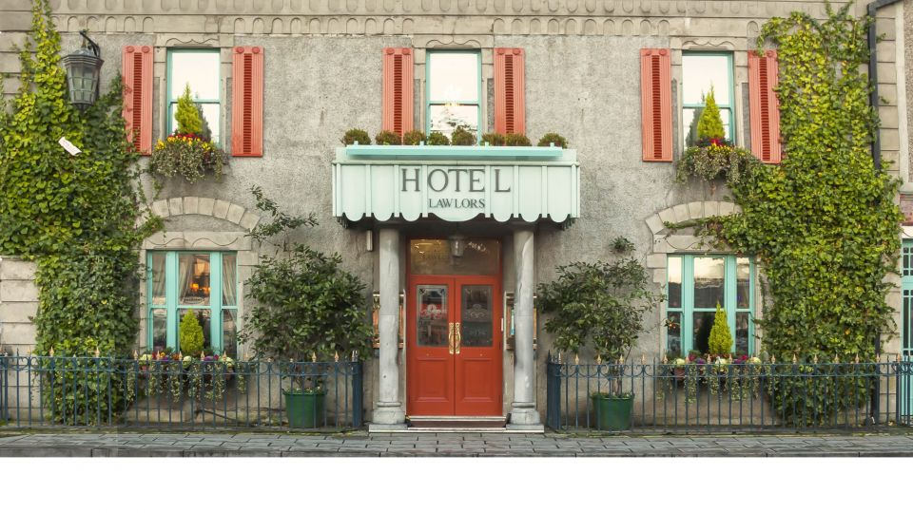
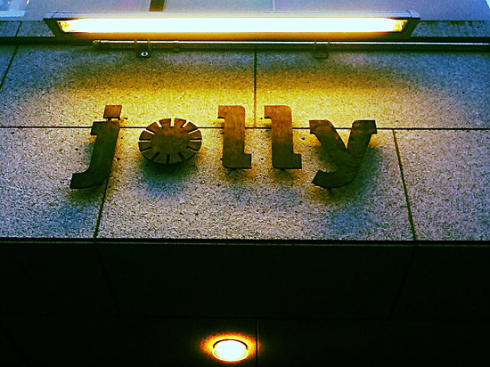
3. Naas economy
12,000 jobs
Spatial character: periphery and bleaching of town centre economically
Character of peripheral model
Notes:
Successful cities and towns tend to perform well across multiple sectors (and therefore balance Livelihood and Liveability): Economic; Housing; Environmental; Cultural

Slide 19
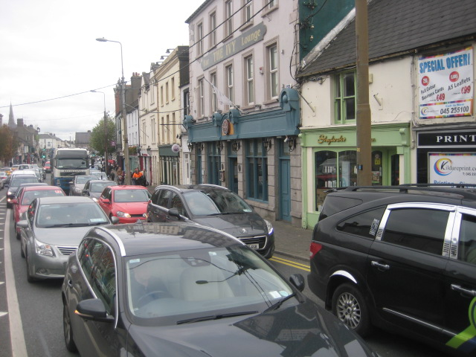
4. Movement
Commuter split
What is ratio now?
What would it be like in 2040?
Why is Naas so congested?
Environmental / health consequences
Why do we walk / cycle so little
Notes:
Successful cities and towns tend to perform well across multiple sectors (and therefore balance Livelihood and Liveability): Economic; Housing; Environmental; Cultural

Slide 20
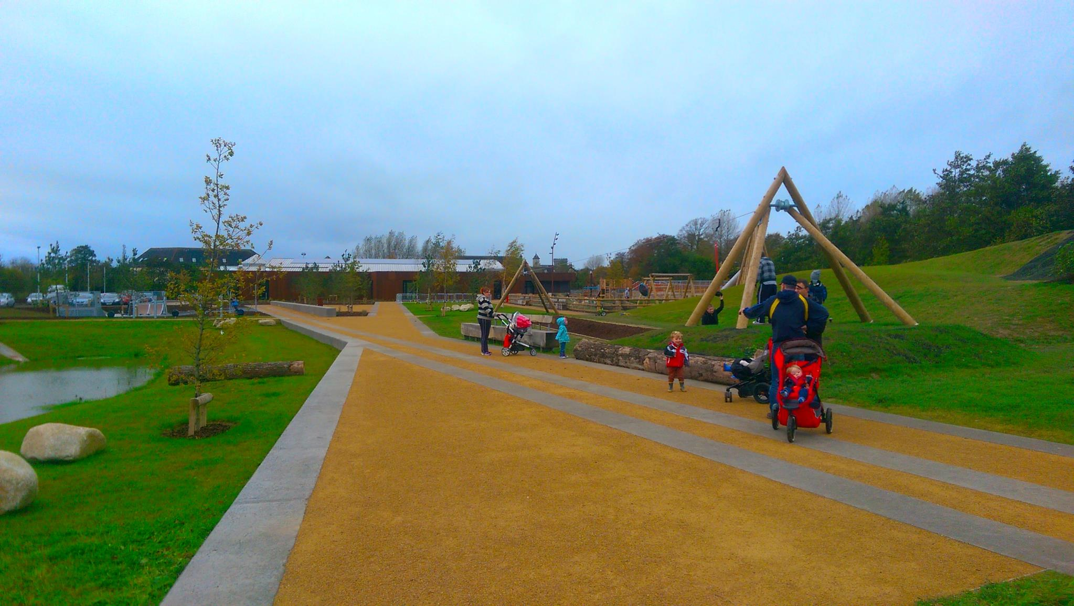
5. Social & Community
Formal institutional with informal contribution of NGOs / Volunteers
Is Naas a good town for:
Older people?
Children, teenagers, and young adults?
People with disabilities?
People of different cultures?
Notes:
Successful cities and towns tend to perform well across multiple sectors (and therefore balance Livelihood and Liveability): Economic; Housing; Environmental; Cultural

Slide 21
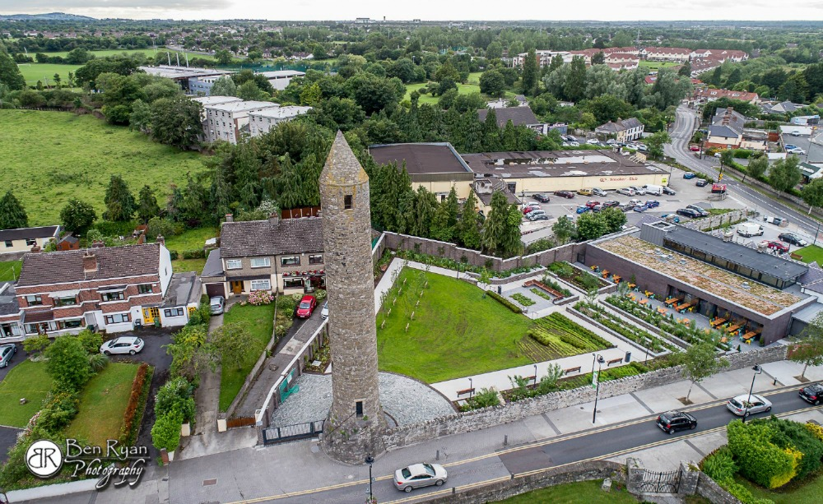
Creative use of older infrastructure
Local authority leadership
Reinventing an urban heart
Notes:
Successful cities and towns tend to perform well across multiple sectors (and therefore balance Livelihood and Liveability): Economic; Housing; Environmental; Cultural

Slide 22
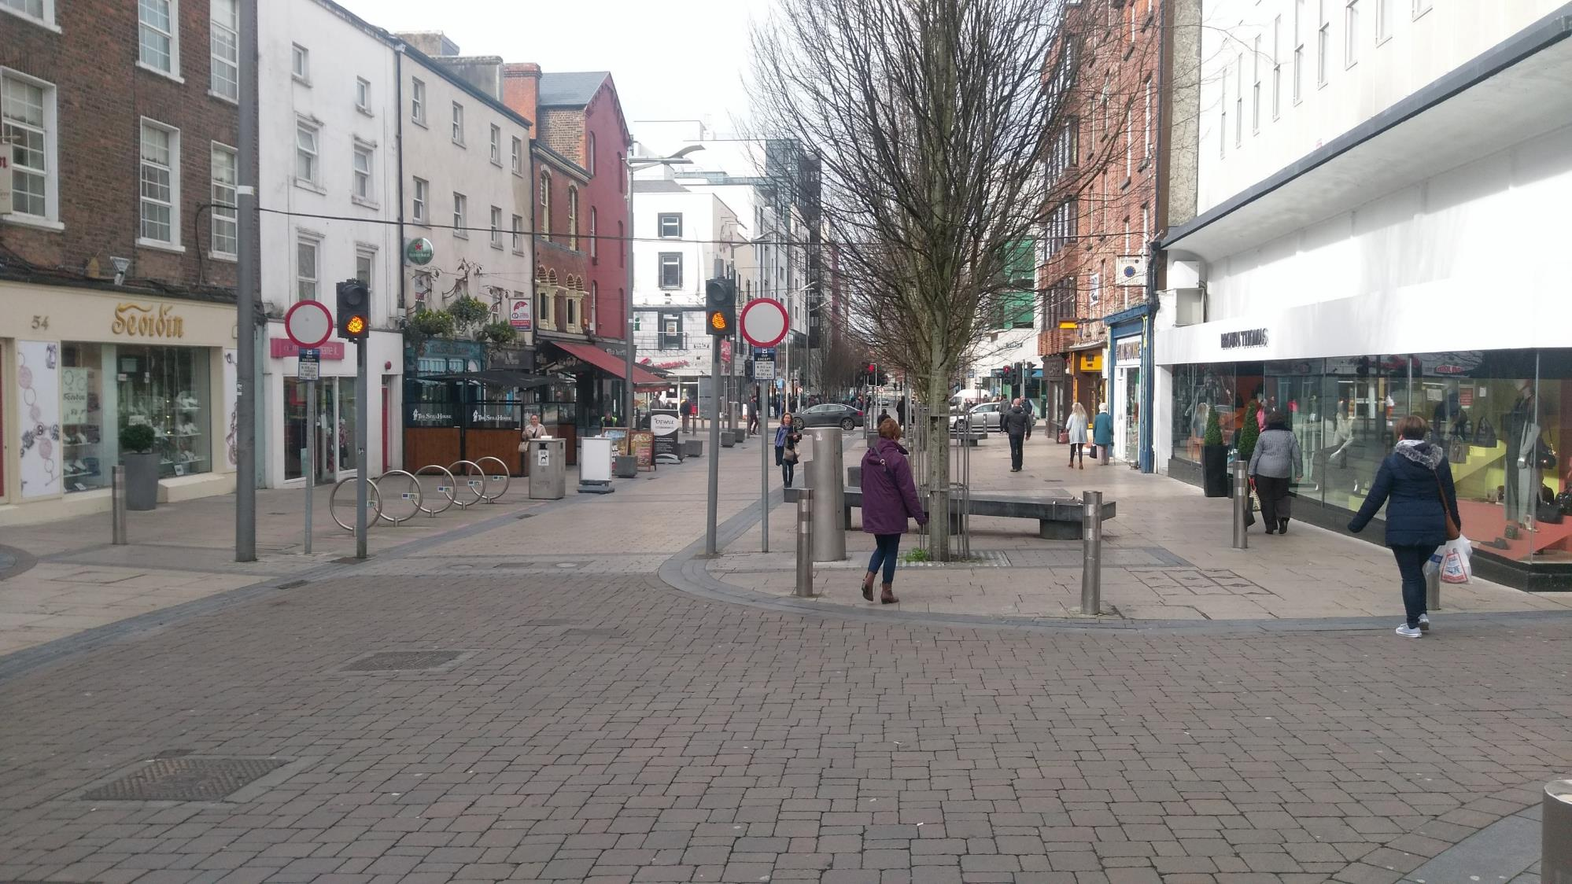
6. Public Realm & Urban Structure
Streets, squares / open public spaces / Parks / Water
Foster a rich public life
Public realm strategy
unity and connection in the urban structure
Quality of details and finishes
Notes:
Successful cities and towns tend to perform well across multiple sectors (and therefore balance Livelihood and Liveability): Economic; Housing; Environmental; Cultural

Slide 23
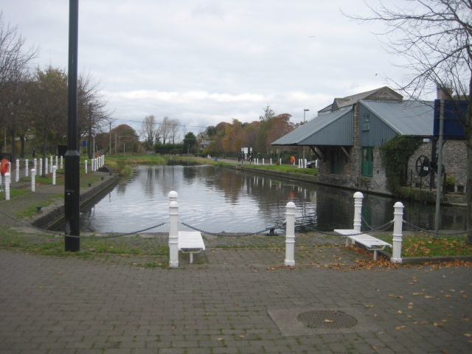
7. Historic Legacy & Heritage
Small footprint of streets / town centre
Main street: high quality urban space / streetscape
St. David’s Castle
Canal legacy
Jigginstown castle
Notes:
Successful cities and towns tend to perform well across multiple sectors (and therefore balance Livelihood and Liveability): Economic; Housing; Environmental; Cultural

Slide 24
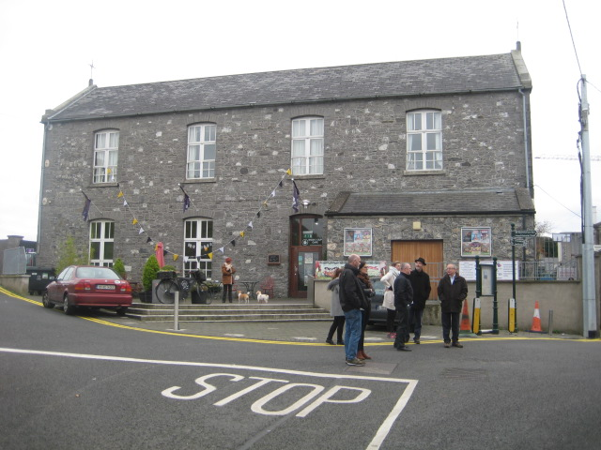
8. Culture
Often invisible in planning.
Towns project identity through culture
Cultural events lift the population
Anchor a festival / claim a writer or a musician.
Culture needs:
- Infrastructure
- Access / Equity
- Content
Notes:
Successful cities and towns tend to perform well across multiple sectors (and therefore balance Livelihood and Liveability): Economic; Housing; Environmental; Cultural

Slide 25
Urbanism
for Naas

Slide 26
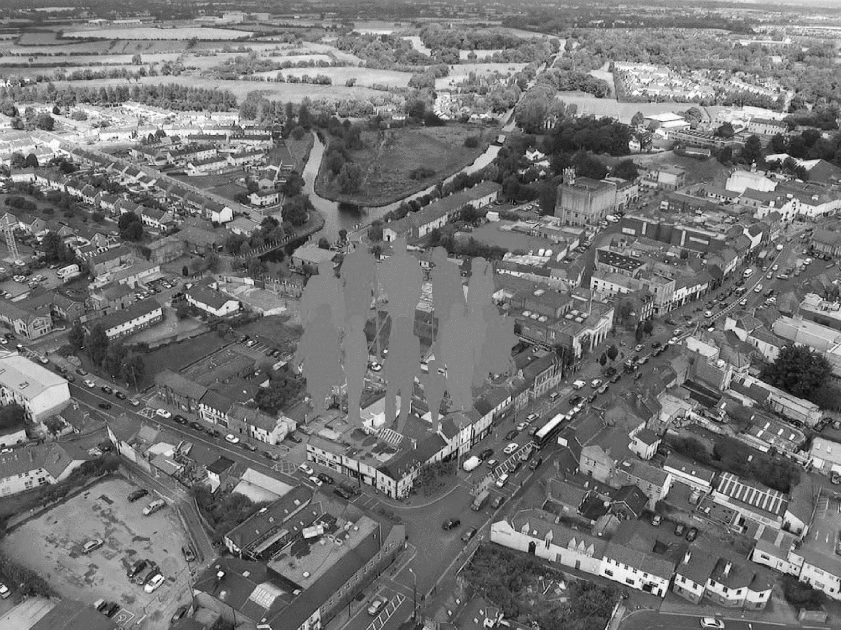
Inclusion & participation
Diversity & liveliness
biodiversity & connection to nature
connectivity, & choice of movement
Environmental sustainability
Urbanism Values
safe & comfortable pubic realm
economic opportunities
quality, affordable, diverse housing
innovation, creativity, education
Sense of place & identity
coherence & good legibility

Slide 27
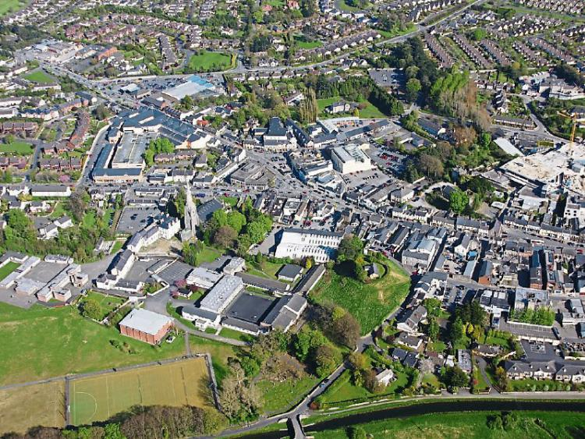
The combination of philosophy [urbanism values] and methodology [urban design] to prompt a compelling Urban Narrative based on:
[a] layered understanding of the current context of Naas
[b] sympathetic understanding of the urban legacy of Naas from the past
[c] consensus on the shape of success for the Naas of the future.

Slide 28
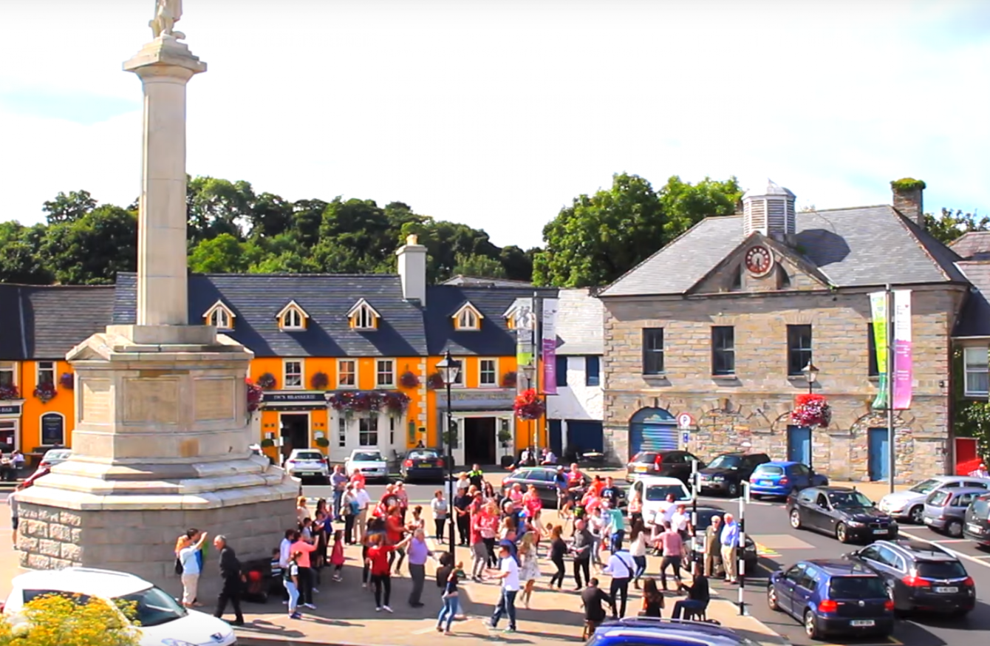
Urban Design Qualities
Density of use
Diversity of building use (mixed-use residential, healthcare, education, local services, amenity spaces, playgrounds etc.)
Range of open space use
Active street frontage

Slide 29
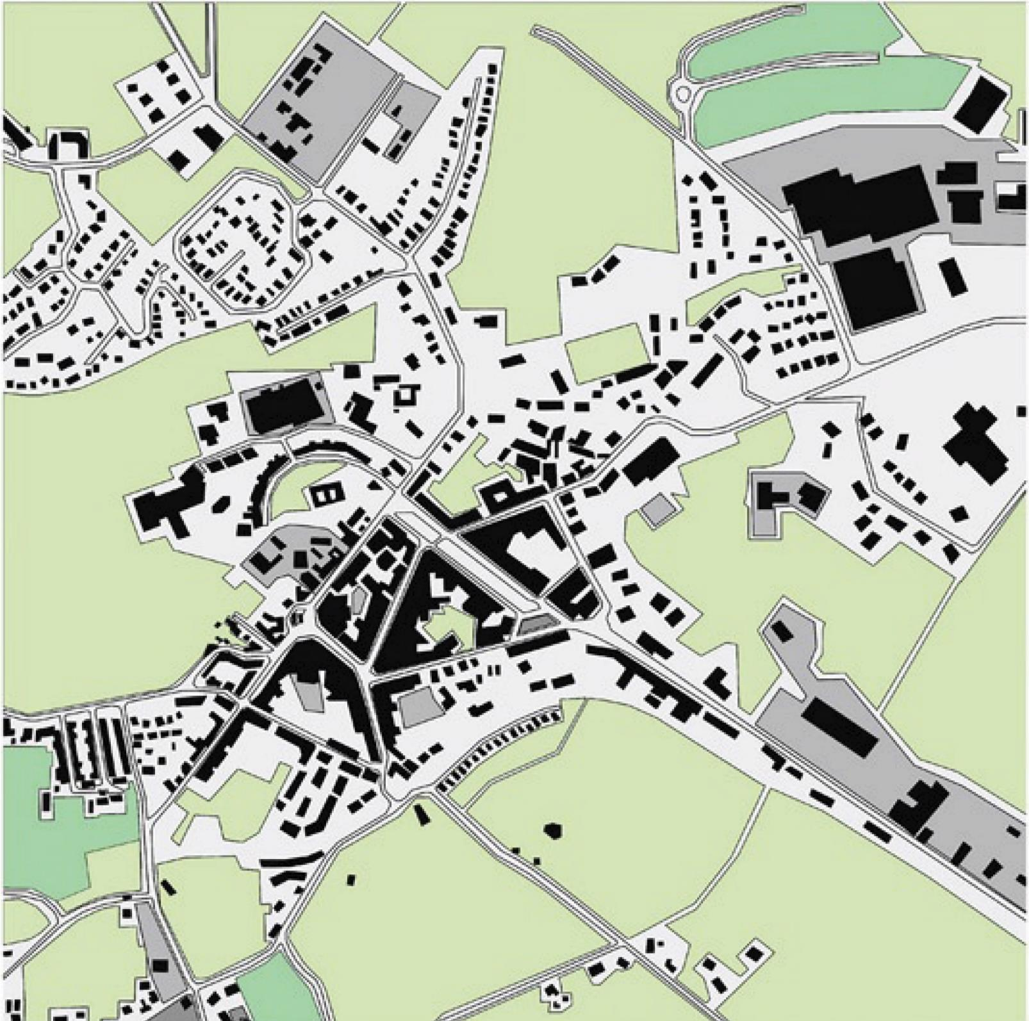
Urban Design Qualities Qualities
Compact
Imageability (distinct, recognisable)
Legibility & wayfinding
Enclosure
Human-scale
Linkage
Coherence
Accessibility & usability
Safety & security
Comfort & Enjoyment

Slide 30
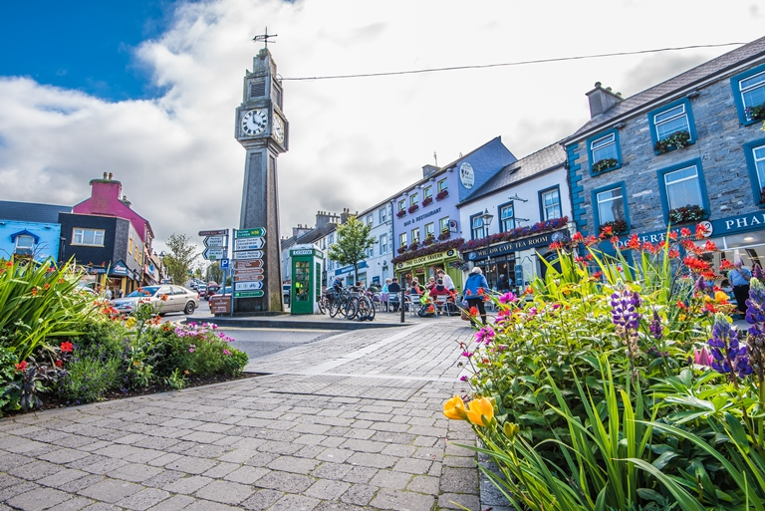
Urban Design Qualities
Quality & durable local materials
Local & vernacular detailing
Provision of diverse seating & shelter options
Integrated green & blue spaces
Adaptability & flexibility
Resilience
Conservation & protected structures

Slide 31
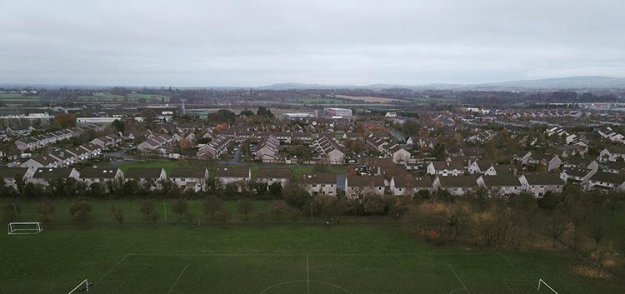
Retrofitting existing Neighbourhoods
Creating permeability & linkages through walking and cycling routes
Upgrading public realm & creating a sense of place
Inserting much needed social & community infrastructure (community centres, child-care, health or education)
Age-attuned housing for local downsizers
Strategic insertions to meet local needs, improve urban environment, & create a sense of place

Slide 32
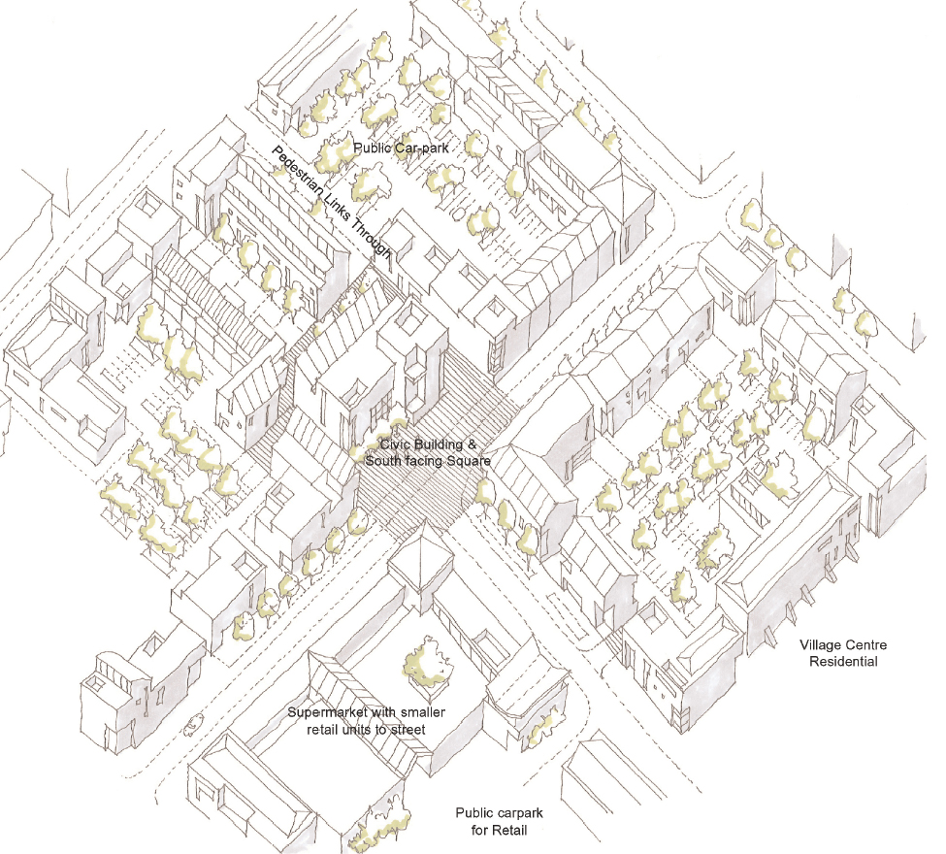
Into the future create strong Centres & Neighbourhood
Big enough to support a range of services...
Small enough to foster a sense of belonging & community…
Sufﬁciently dense to enable essential facilities within easy walking distance…

Slide 33
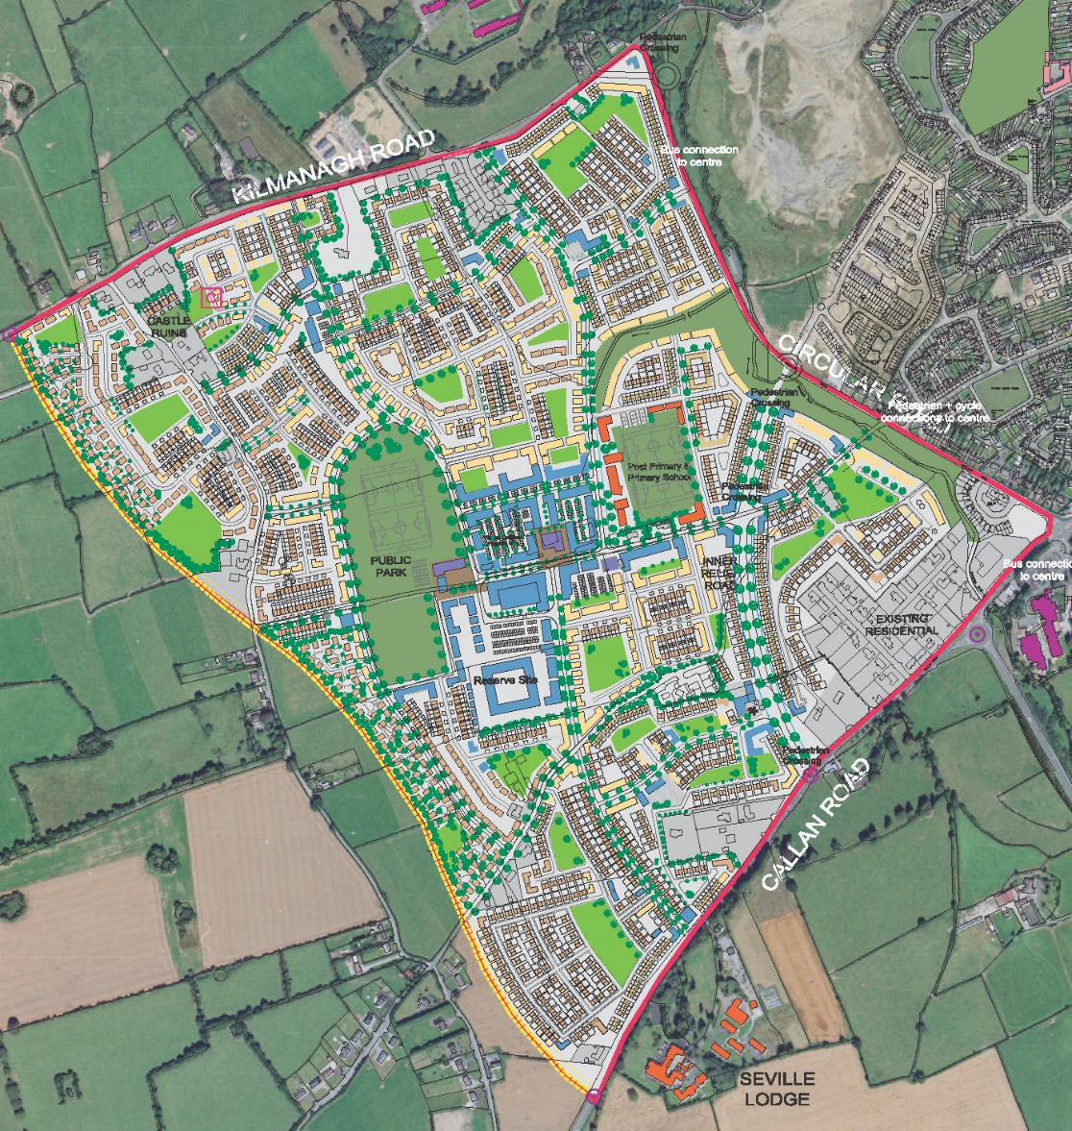
Responding to a range of age groups
Robust & adaptable
served by public transport
Provide a range of open spaces
Reflects local character
Nurtures local community groups
Sensitive to hard & soft infrastructure
Apply Urban Design Qualities

Slide 34
Key Issues for
for Naas

Slide 35
Key Sectors
Each sector
must be connected
has trends
makes patterns that impact on place & legacy
influences spatial coherence of Naas

Slide 36
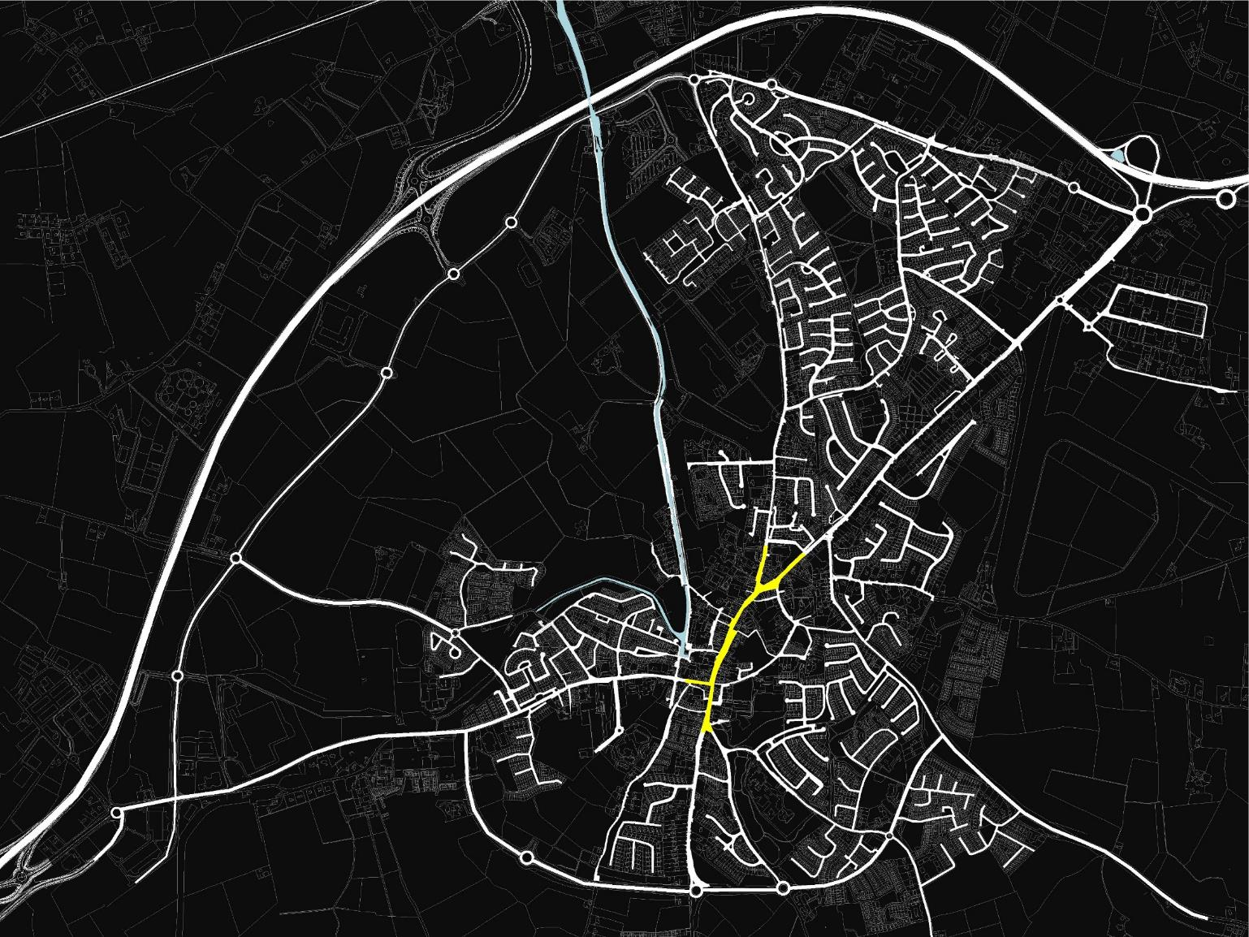
Overall Urban Structure
Small town centre
Low density cul-de-sac residential development
Peripheral development
Strong reliance on a small number of radial routes

Slide 37
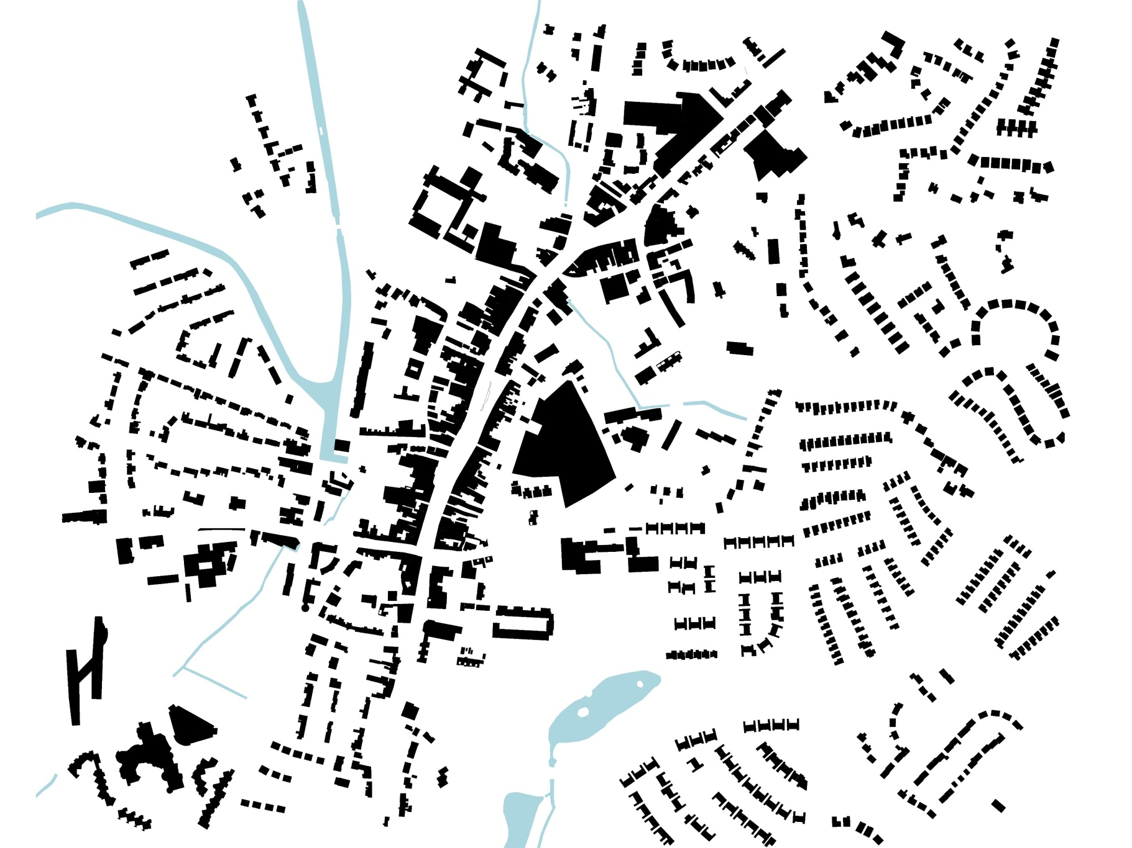
The existing pattern of development is worrying…fragmentation, dispersal, low-density, mono-cultural housing estates
Poor urban structure legibility.
Large residential applications introverted in character, self-referential, dis-connected from the bigger spatial picture.
Layered urban design analysis missing
Planners are in a weak position to negotiate and challenge commercially driven and weak development proposals

Slide 38
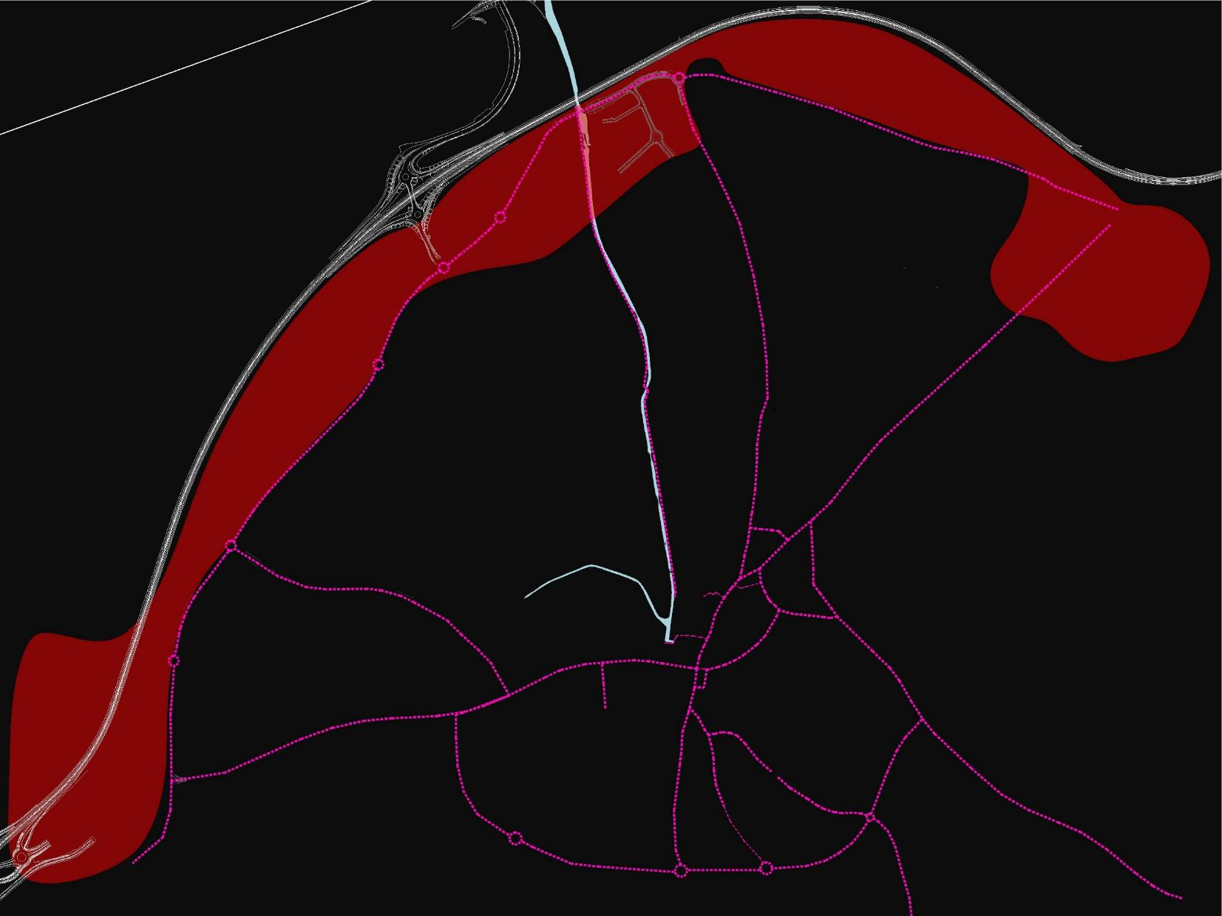
Lack of connecting routes & key public spaces
Large impermeable blocks of land
Over-used main routes that are undermined by traffic
Lack of easily accessed high quality public space

Slide 39
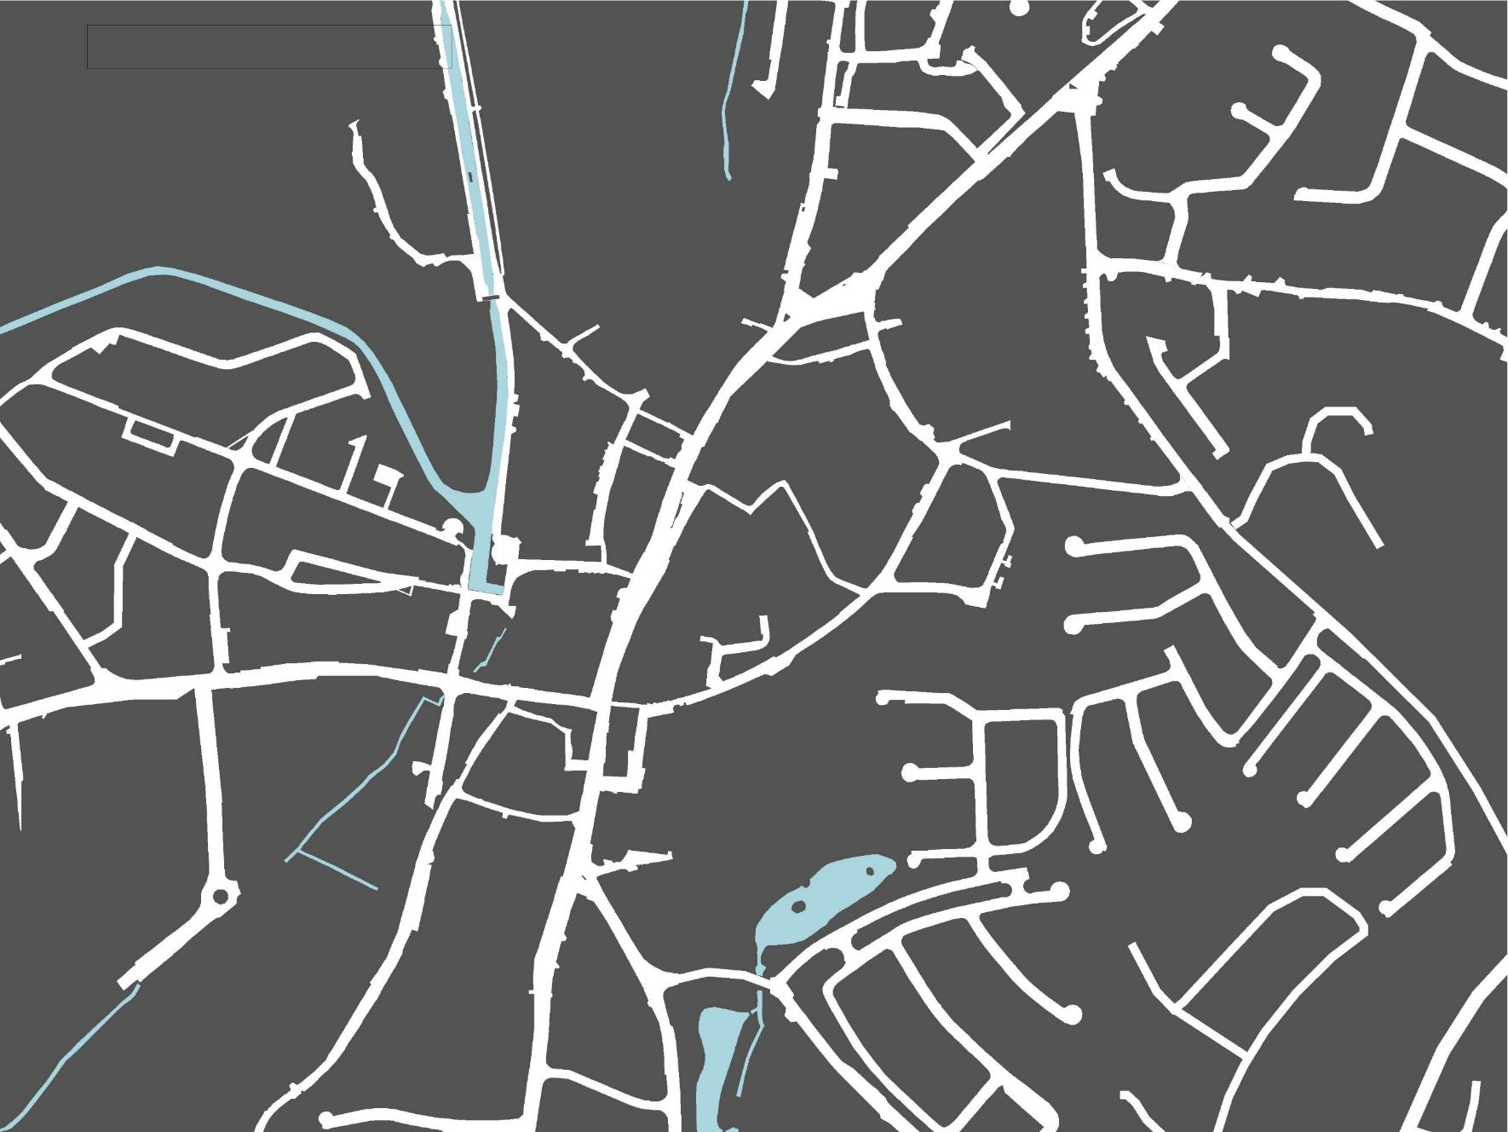
Town Centre
Town centre lacking in a fine urban grain
Impenetrable urban blocks
Few town centre connecting routes
Lack of main public square / similar usable central space

Slide 40
Fragmented town core and lack of strong centres

Slide 41
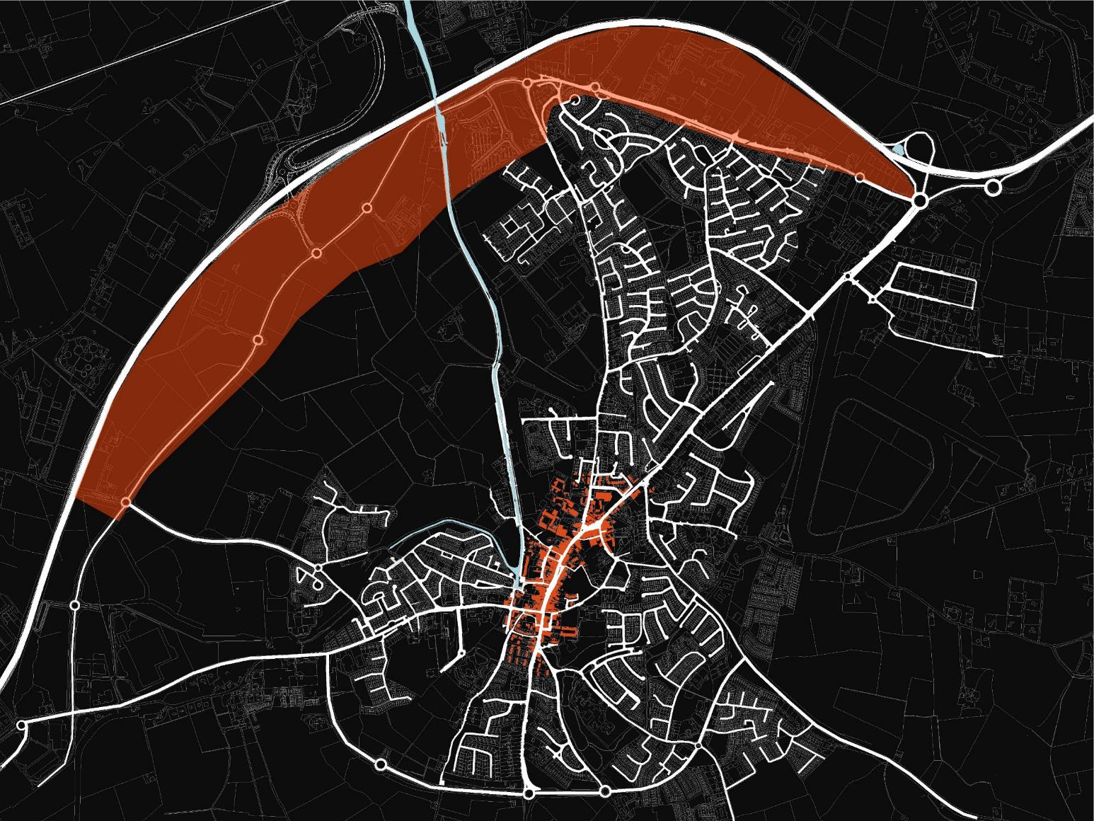
Centre & periphery
separation & disconnect
alignment & powerful two-way relationship
Identify the critical / promising areas
How can Naas be re-aligned to support & connect the town centre & the periphery?

Slide 42
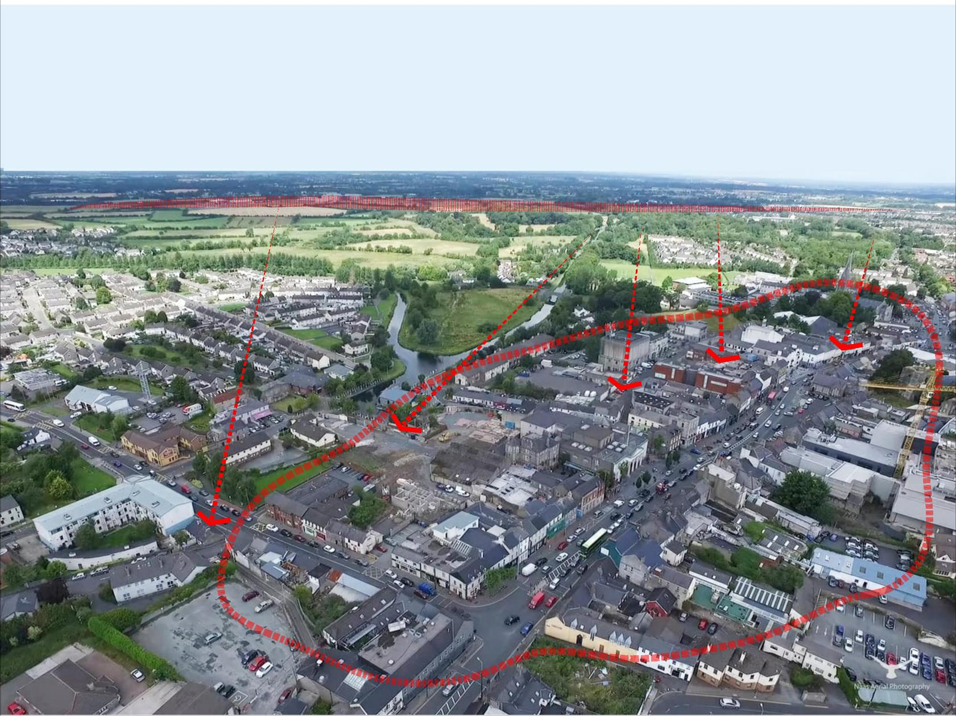
Critical need to generate interconnection between periphery & town centre
Notes:
Successful cities and towns tend to perform well across multiple sectors (and therefore balance Livelihood and Liveability): Economic; Housing; Environmental; Cultural

Slide 43
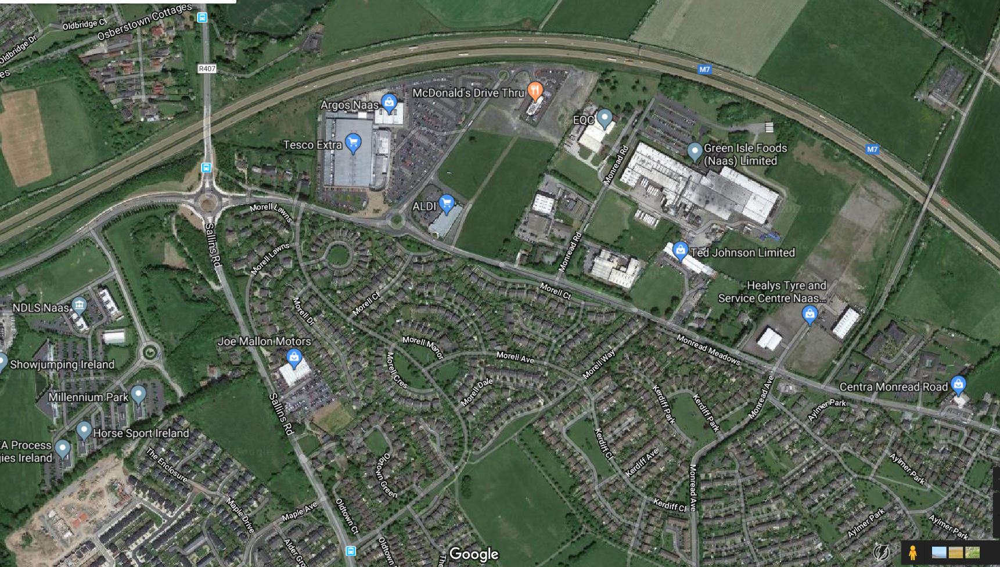
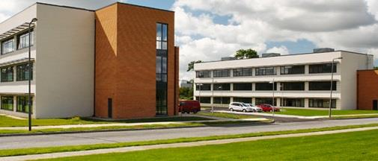
Periphery
Powerful employment platform, is working as well as it could be?
- Urban design
- Architecture
- Zoning / land use
- Behaviour
How do we Connect workers to town centre?

Slide 44
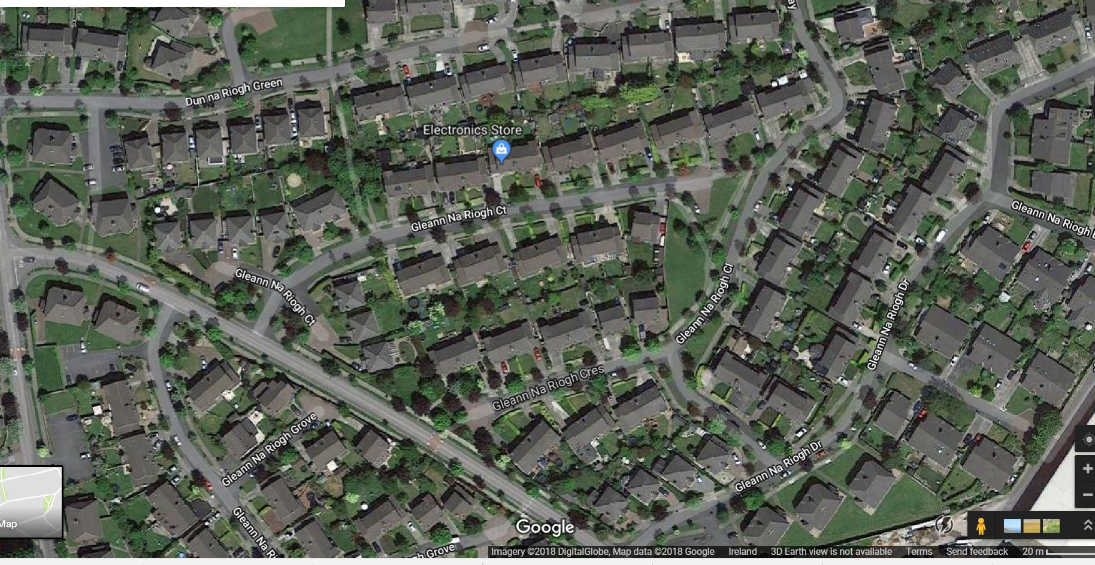
Residential
Residential
Need to widen residential offer
Different models need to be explored:
Sustainable densities
Apartments
Mixed-use models
Intergenerational living / housing
Quality & diversity in design & construction

Slide 45
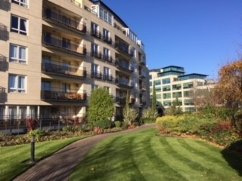
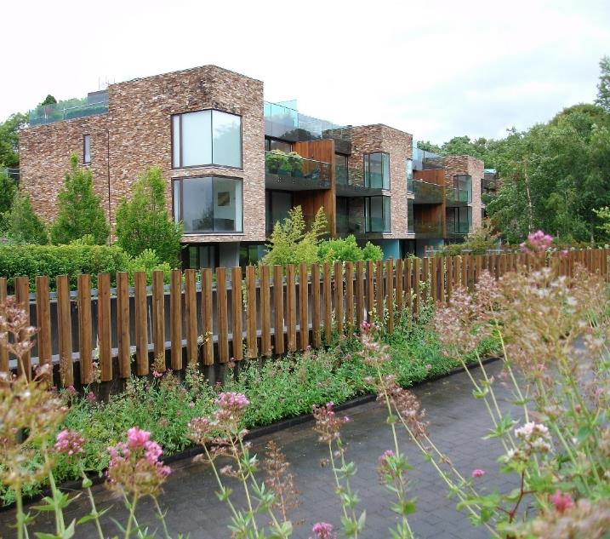
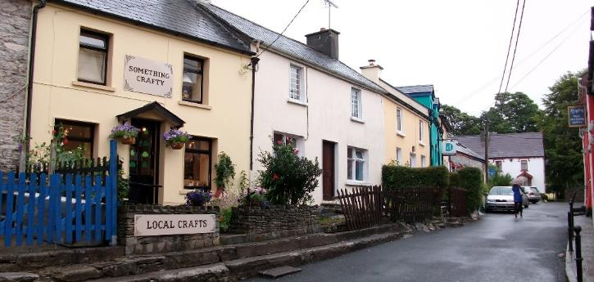
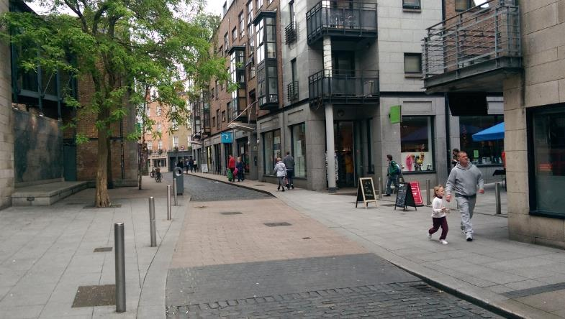
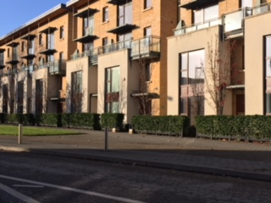
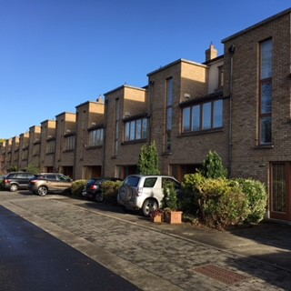
Notes:
Successful cities and towns tend to perform well across multiple sectors (and therefore balance Livelihood and Liveability): Economic; Housing; Environmental; Cultural

Slide 46
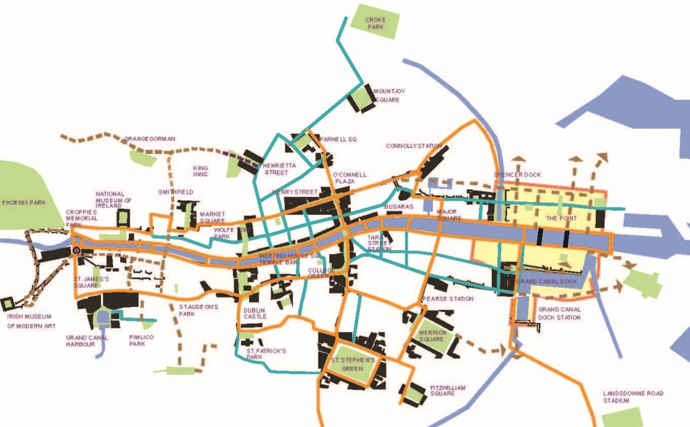
Public Realm
Critical in building unity & inter-connection
Draw in:
-Streets
-squares / designed open public spaces
-Parks
-Water-bodies (lakes & canal
Facilitates / encourages social contact, walking cycling

Slide 47
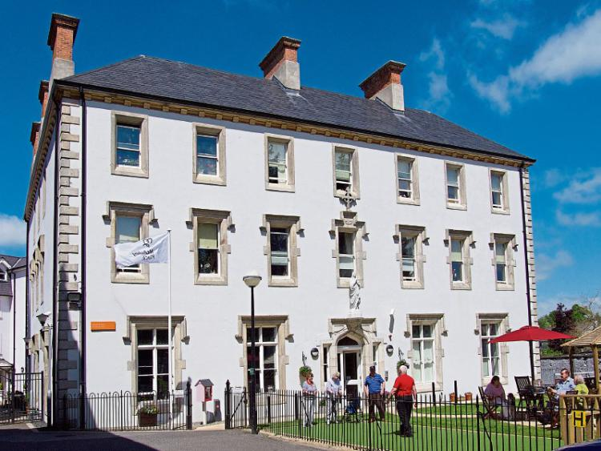
Positively subversive topics
Public realm in Copenhagen
Art in Carlow
Literature in Listowel
Traditional Music in Ennis
Contemporary music in Dingle
McAuley Place
Can Naas build a food ecology based on restaurants, markets, festivals, Kerry Foods Group?

Slide 48
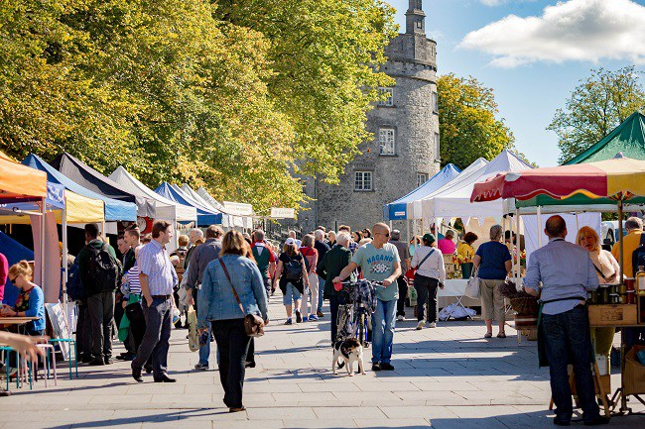
Market Place Kilkenny
Notes:
Successful cities and towns tend to perform well across multiple sectors (and therefore balance Livelihood and Liveability): Economic; Housing; Environmental; Cultural

Slide 49
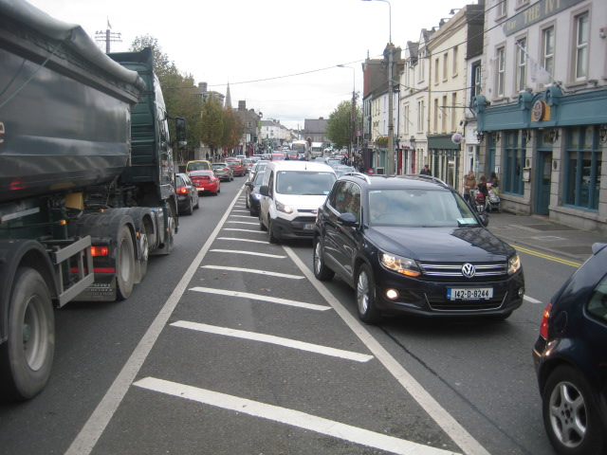
Movement
Movement
Movement is there to serve Naas, not vice-versa
Re-balance in multiple areas
Anticipate Dublin-Naas Greenway
Connect Naas to its hinterland
Create a diverse movement network that supports cycling and walking, connects and exploits key places within Naas

Slide 50
Naas Consultation

Slide 51
Red-Threads from first Plenary
Great Heritage assets lying un-used and vacant…David’s Castle, Canals, Jigginstown, Leinster Mills
Movement/Traffic a huge issue, even without further development
Positive economic platform, Kerry a big fish to land, but must build on this
Town-centre in trouble on many fronts, needs multiple strategies
Good sports clubs but big shortage of playing fields
New neighbourhoods must have local facilities/social infrastructure
Mc Auley Place a great exemplar. Apply the thinking to other areas.
Action needed now - We are tired of Plans going nowhere

Slide 52
Role of Naas as County Town
Create a position of Naas Town Centre Project Manager
Naas-town of the 3 Harbours
Economic theme
Kerry a huge success, but it must be leveraged
IDA and Enterprise Ireland have recognized Naas for innovation
Social and Community
Existing Family-friendly environment
Developer’s need to consider wider requirements within town
Community infrastructure lacking in local areas
Living in Naas
Residential must have social and community facilities
Naas needs heritage/Tourism centre
Integrate social housing better

Slide 53
Shaping a successful Town-centre
Town has a great ‘village feel’, vibrant socially in the evening
Many historic assets…just sitting there, need to exploit them
Too few people living in the town centre
Public Space Urban Structure
Oldtown Demesne must be opened up/Linked to canal potential
Critical to link Poplar, Market Sq, Abbey St and Harbour
Build Green-way and Blue-way network
Movement and Infrastructure
Naas completely dominated by car-based traffic
Need to improve train service/complete the ring road
Residents often fail to see the bigger picture

Slide 54
Consultations between the Plenaries
1. Elders group- cross section of community
Naas does not know what kind of town it wants to be
In Kilkenny, the County Manager knocked heads together…leadership
You cannot plan Naas without planning Sallins, Johnstown, and Kill…walkways, cycling, schools, recreation and culture must be viewed under an overall umbrella
2. Social and Community
Naas is a good enough place to live, but ‘My God What it could be’
Naas has always had it easy….exploited it’s relationship to the Curragh and Dublin…Drive not in the DNA ?
3. Town-centre retail group
McAuley Place and the Purple Flag initiative have clear vision but Naas lacks this
Thirty somethings with children in Naas are choosing to go elsewhere

Slide 55
4. Arts and Culture group
There are so many vacant buildings in Naas which could house art initiatives. Eircom in Abbey could be a Naas Tate
Under Culture in the LAP. Could the concept of ‘Curating Naas’ be developed
5. Urbact Group
Has developed an app ‘Naas Engagers’ to help stakeholders carry out research and present it digitally
While the focus is Naas Town-centre, the group have put forward 35 actions/projects for consideration in the LAP
6. Environmental Group
Abbey St has amazing potential…sorting office, Eircom site
Arriving into Naas, a very bad start…abandoned sites, use CPOs
Lakes at hospital great, could we consider lakes in NW Quadrant, resonating with De Burgh

Slide 56
7. Developer’s Group
Consider a section 48/49 Contributions scheme for LAP
Provide clarity on fixed and flexible elements and clear responsibility for the developer and the Local Authority
Developers not against exploring new housing typologies
When you see the ambition of projects like Marley Park, The pharma campus at Grange, and Adamstown realized, you know courage was an ingredient
Relax car parking standards in key locations to allow sustainable and economically viable development

Slide 57
A vision for Naas as a whole

Slide 58
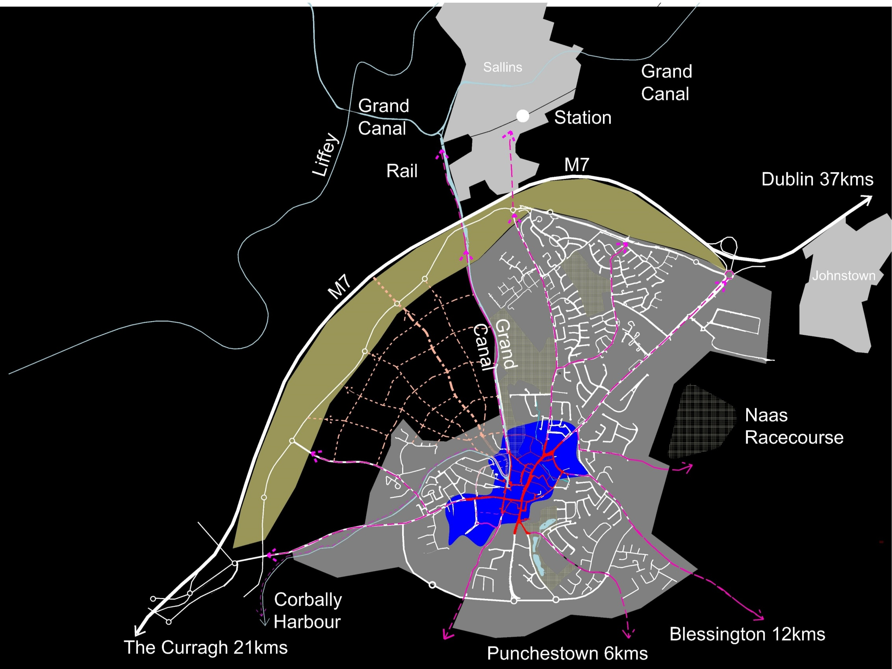
Town Centre
Urban Structure & Public Realm
Connecting Peripheral Economic Arc
Movement
Connecting to Hinterland
Collaboration
Implementation

Slide 59
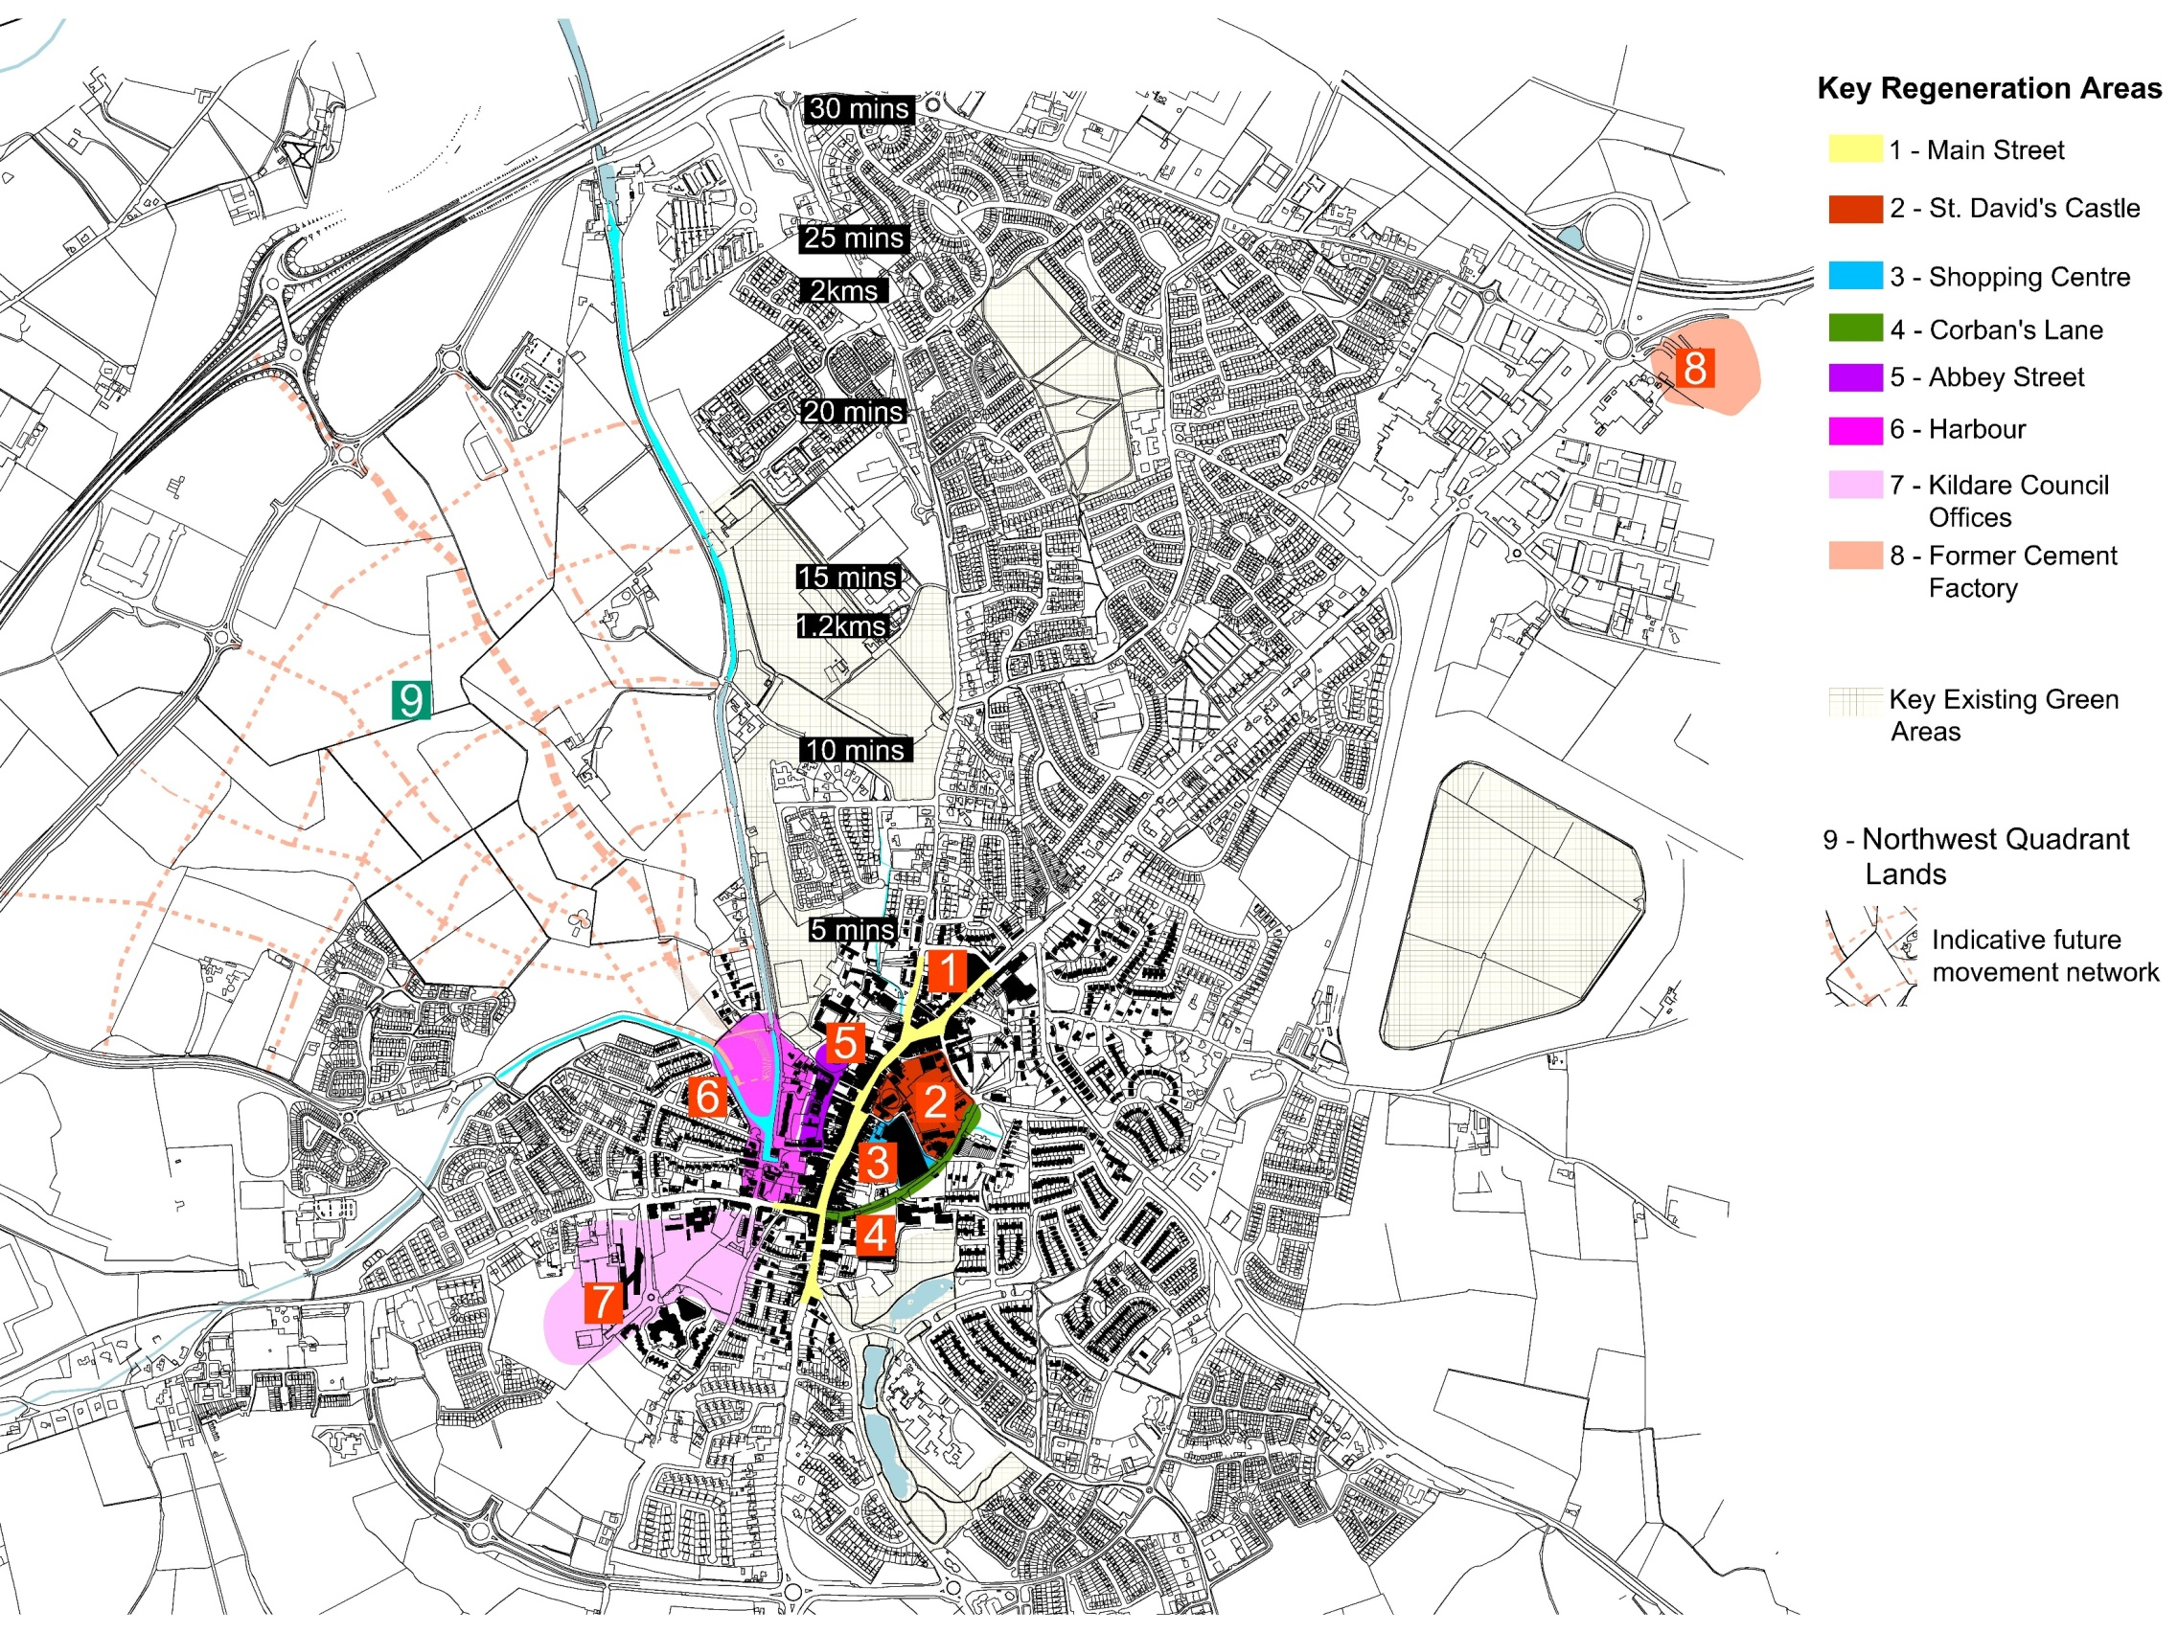
Centres & key locations/
destinations
Strategic Regeneration Sites

Slide 60
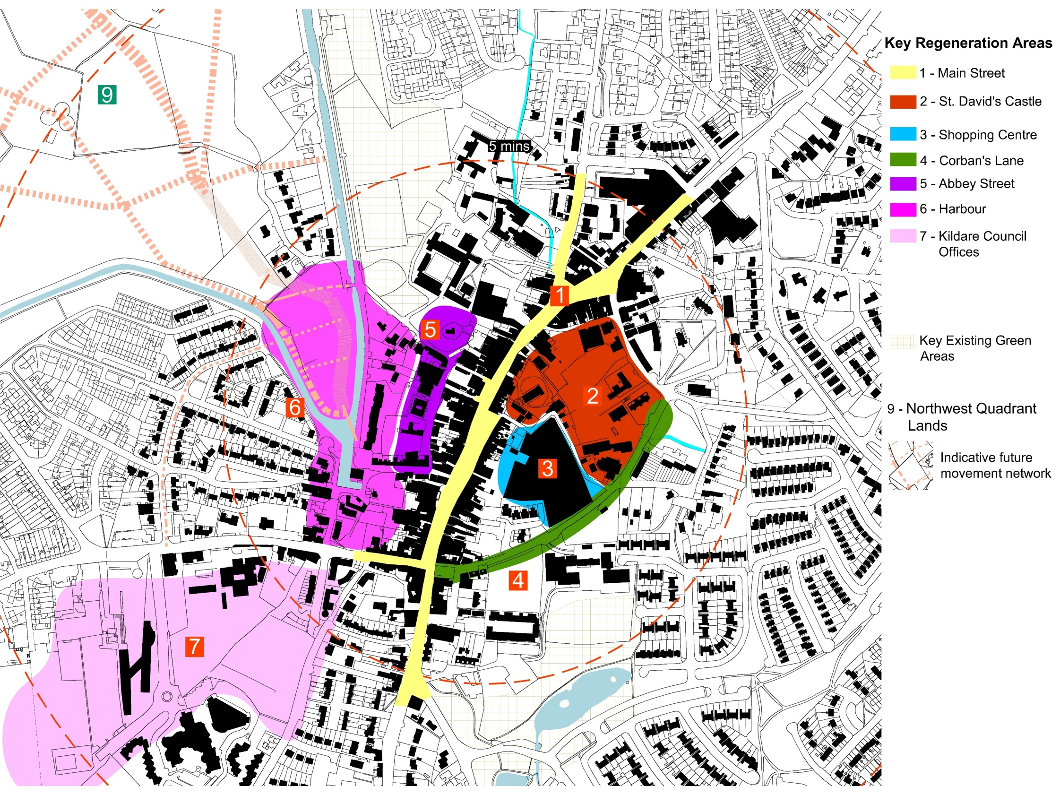
Centres & key locations/
destinations
Town Centre

Slide 61
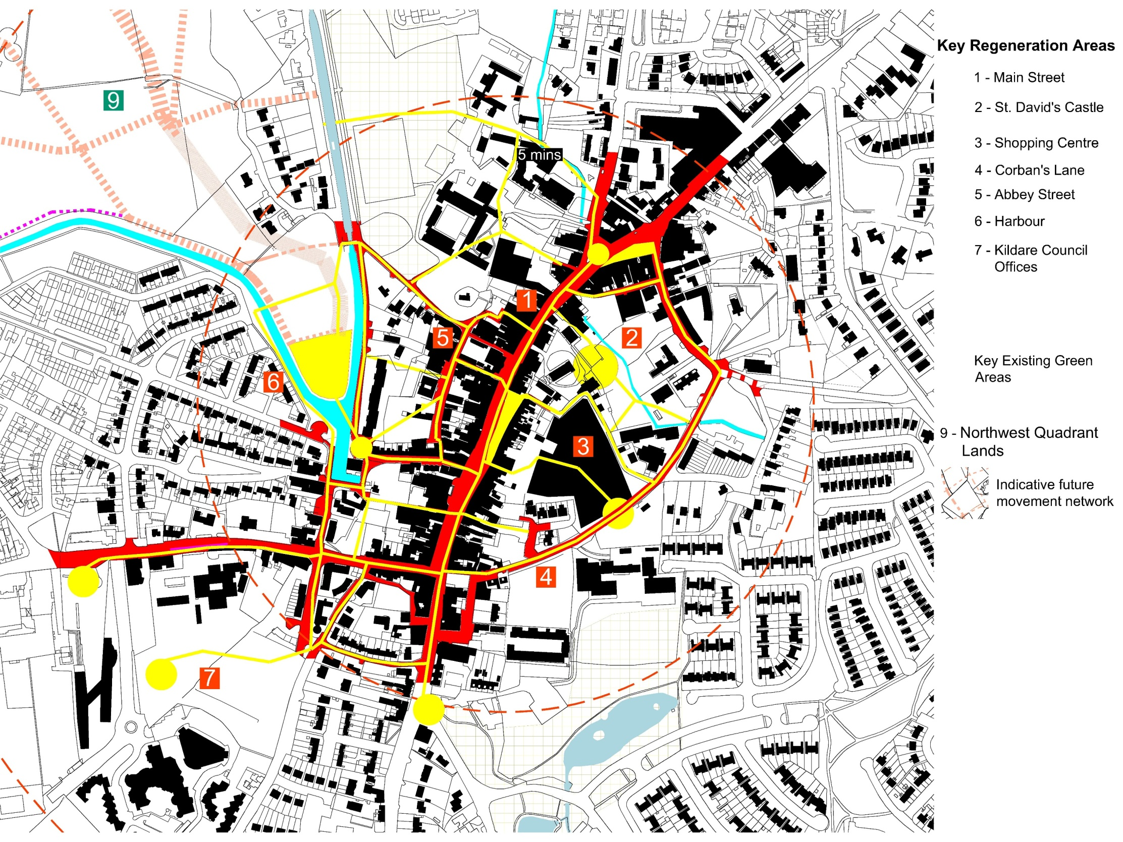
Centres & key locations/
destinations
Urban Structure and Public Realm

Slide 62
Connecting Periphery
Use Urban Structure & Public Realm
Strengthen existing links
Use future development to tie periphery and town together

Slide 63
Naas 2018-2024 → 2040
Movement

Slide 65
2040 Vision
Sustainable town - Internal movement through soft modes in a permeable, safe public realm.
Higher densities, mixed use, lower parking standards, pedestrian dominated Centre.
Internal public transport linking new 4-track Sallins rail station, employment, residents, shops, schools etc.
Revitalised Main St supported by secondary street network from Harbour to St David’s Castle with new public spaces reflecting heritage.

Slide 66
2040 Continued
Naas linked to hinterland via public transport, private car and national cycle network. Car parks close to but not dependant on Main St.
Parks, water bodies, sports and playgrounds linked by green routes.
Eastern and southern by-pass complete forming an orbital around Naas City Centre.

Slide 67
To be put in place
Multi-Modal Transportation Study to address internal movement, hinterland, regional and international linkage, cycling and walking, car parking, freight and servicing, public transport,.
Transport projects are subject to separate planning processes, finance, TII and NTA protocols. Process will take time.
Utilities expansion to cater for growth.

Slide 68
LAP 2018-2024
Reduce vehicle dependence on Main St. for car parking while introducing high density residential development in the centre.
Link edge M7 with Centre via green routes.
Park and ride, plus public transport priority links from Sallins to employment, schools, residences and Centre.
Reduce car parking requirements where sustainable alternatives exist, or where street capacity or density requirements demand it.
Implement outstanding 2011-2017 LAP Objectives.
Introduce freight management and delivery scheme, car park strategy and VMS signage.
Complete Multi-Modal Transportation Study.

Slide 69
Hinterland
Use strategic cycle network, walking routes, canal, & equestrian trails to connect Naas to its rich hinterland

Slide 70
Collaboration
Involve stakeholders from all key sectors
Collaboration to co-produce the Naas of the future

Slide 71
Implementation
Set out place-specific strategies supported by inter-agency cooperation and institutional collaboration
Appropriate guidelines to ensure quality
Realistic and feasible means of delivery
Framework for monitoring progress

Slide 72
Town Centre
Urban Structure & Public Realm
Connecting Peripheral Economic Arc
Movement
Connecting to Hinterland
Collaboration
Implementation

Slide 73
Thank you
Naas Planning Advisory Group
NAs

